Slide 1
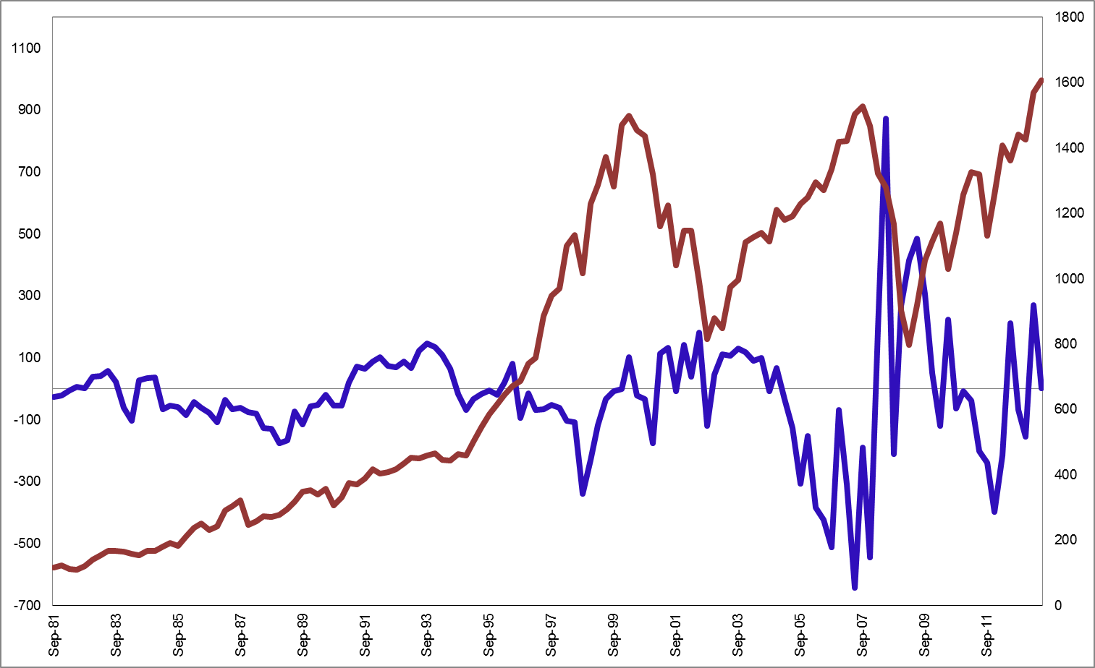
Flow of Funds: Net Change in Supply of Stock
S&P 500
$Billions
Quarterly, SAAR
Index
MTA Educational Foundation University Course – Technical Analysis of the Financial Markets © 2014

Slide 2
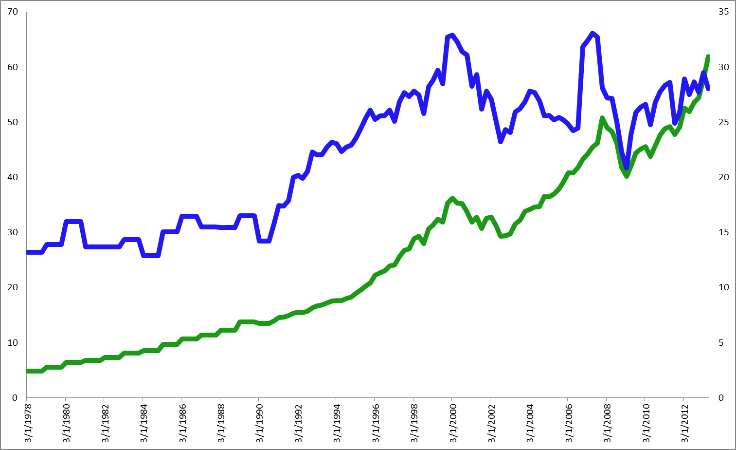
Flow of Funds: Households
Equity Percent
$Billions
Percent
S&P 500
Total Financial Assets
MTA Educational Foundation University Course – Technical Analysis of the Financial Markets © 2014

Slide 3
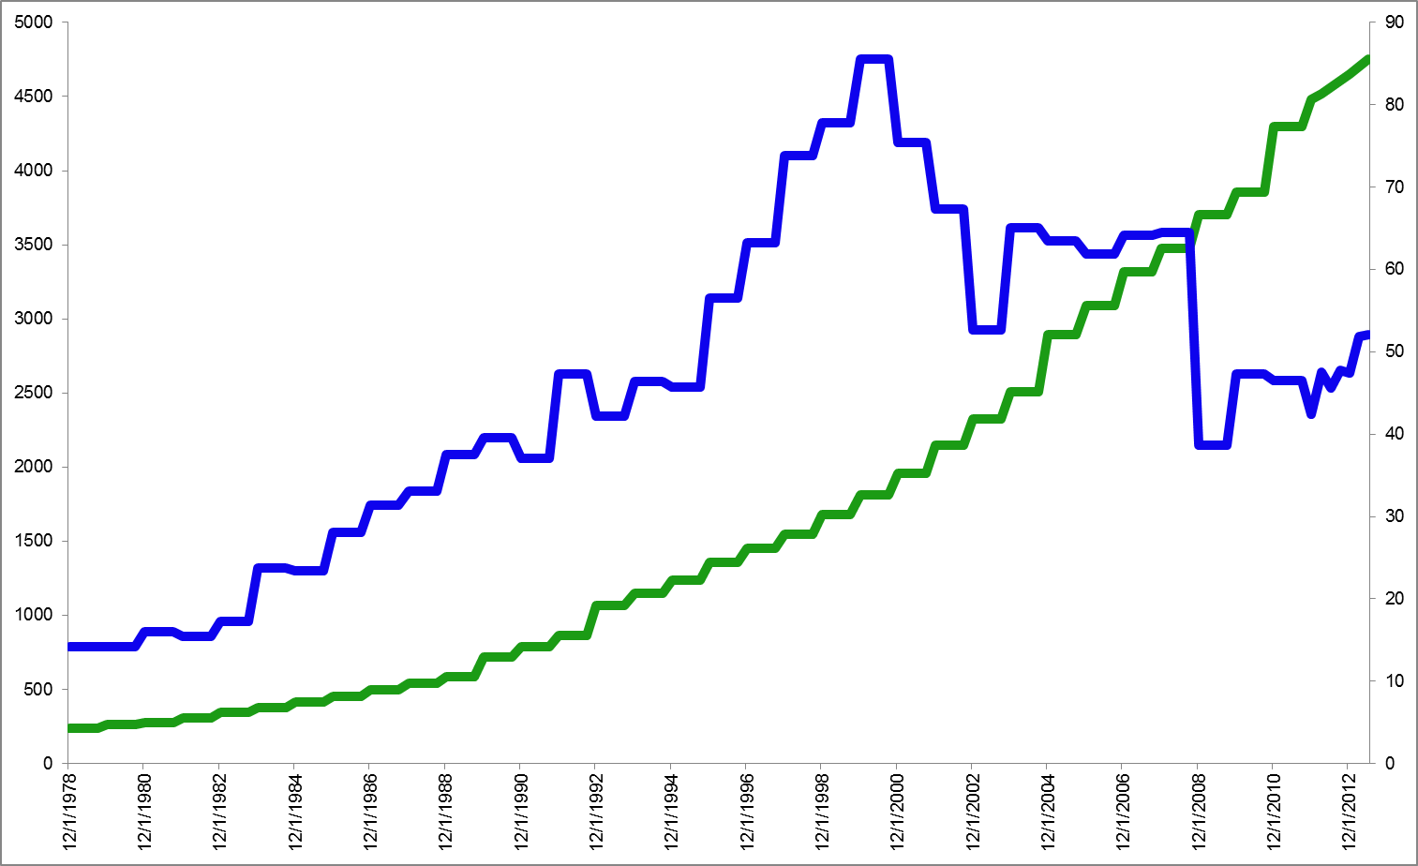
Flow of Funds: State & Local Government Employee Retirement Funds
Equity Percent
$Billions
Percent
S&P 500
Total Financial Assets
MTA Educational Foundation University Course – Technical Analysis of the Financial Markets © 2014

Slide 4
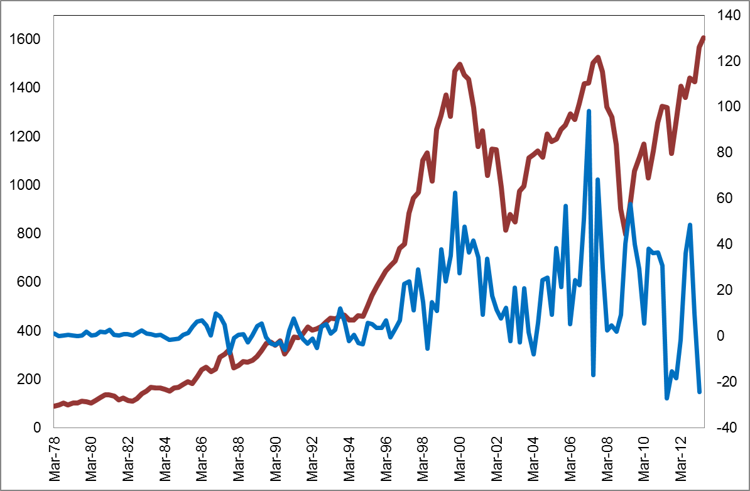
Net Purchases of U.S. Equities by Foreign Investors
S&P 500
Index
$Billions
Quarterly net purchases
MTA Educational Foundation University Course – Technical Analysis of the Financial Markets © 2014

Slide 5
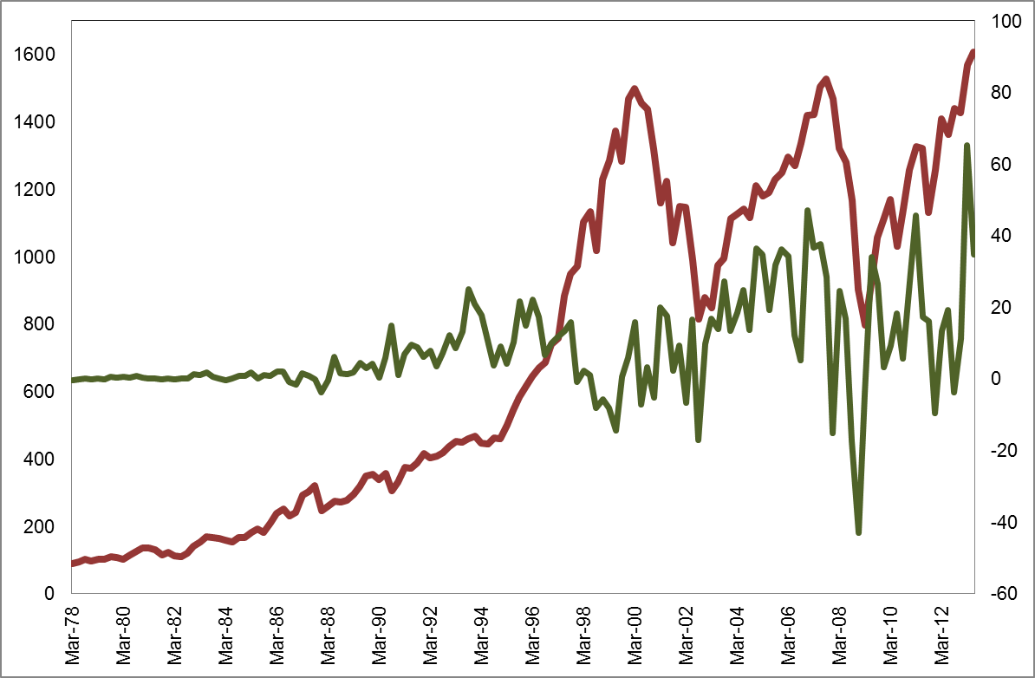
Net Purchases of Foreign Equities by U.S. Investors
S&P 500
Index
$Billions
Quarterly net purchases
MTA Educational Foundation University Course – Technical Analysis of the Financial Markets © 2014

Slide 6
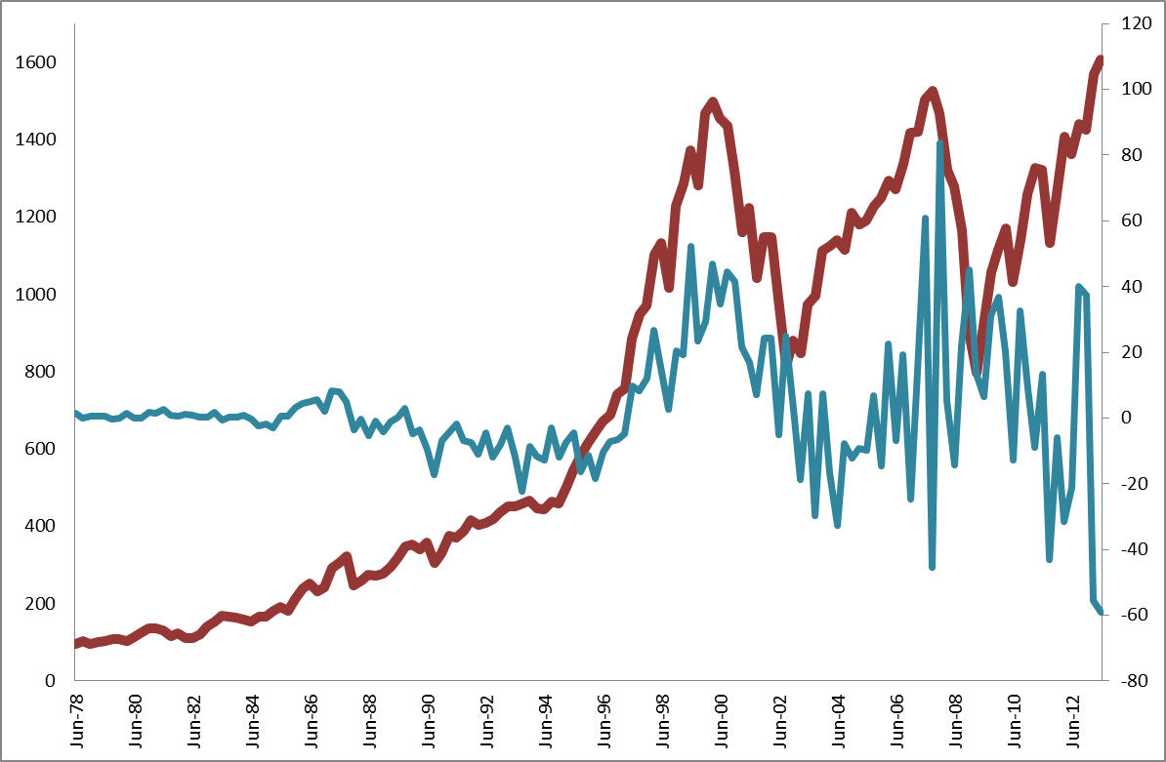
Net Purchases of U.S. Equities by Foreign Investors minus Net Purchases of Foreign Equities by U.S. Investors
S&P 500
Index
$Billions
Quarterly net flows
MTA Educational Foundation University Course – Technical Analysis of the Financial Markets © 2014

Slide 7
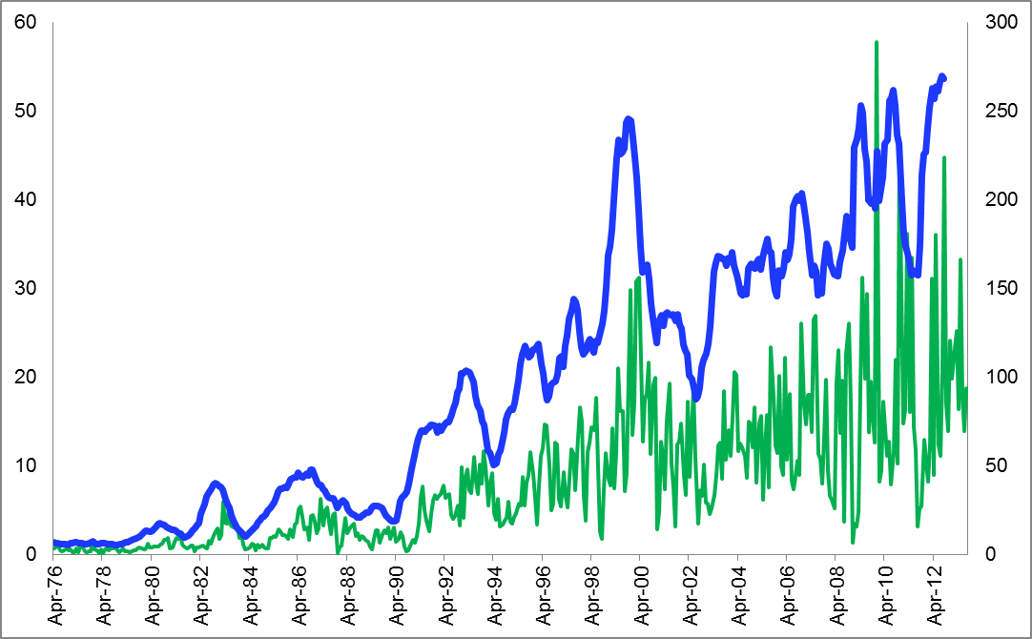
New Equity Financing
Monthly
S&P 500 Index
$Billions
$Billions
12-Month Total
MTA Educational Foundation University Course – Technical Analysis of the Financial Markets © 2014

Slide 8
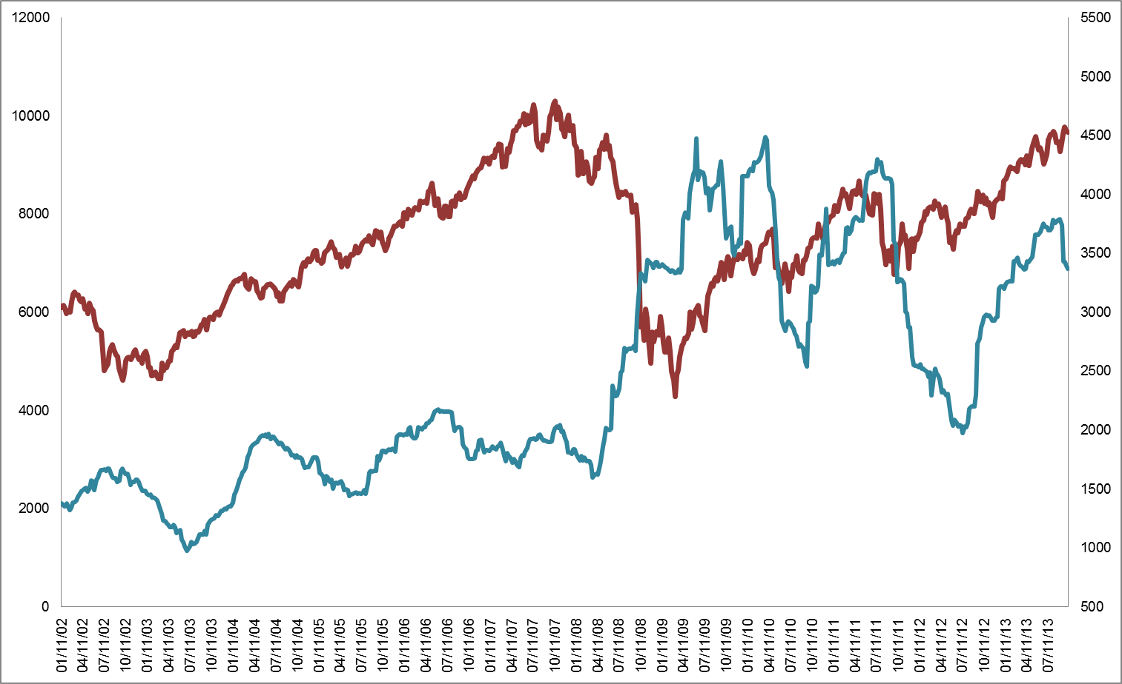
Secondary Distributions: Value
NYSE Composite
$Millions
52-Week Moving Average
Index
MTA Educational Foundation University Course – Technical Analysis of the Financial Markets © 2014

Slide 9
Margin Debt versus % of Market Value
Prior to January 1997,
NYSE figures only
Margin Debt
$Billions
% of Market Value
Market Value
MTA Educational Foundation University Course – Technical Analysis of the Financial Markets © 2014

Slide 10
Insider Activity
S&P 500
Index
8-Week Moving Average
Bearish
Bullish
MTA Educational Foundation University Course – Technical Analysis of the Financial Markets © 2014

Slide 11
Individual Buying Power Index
S&P 500
Buying Power Index
Individual Buying Power Index
Index
MTA Educational Foundation University Course – Technical Analysis of the Financial Markets © 2014

Slide 12
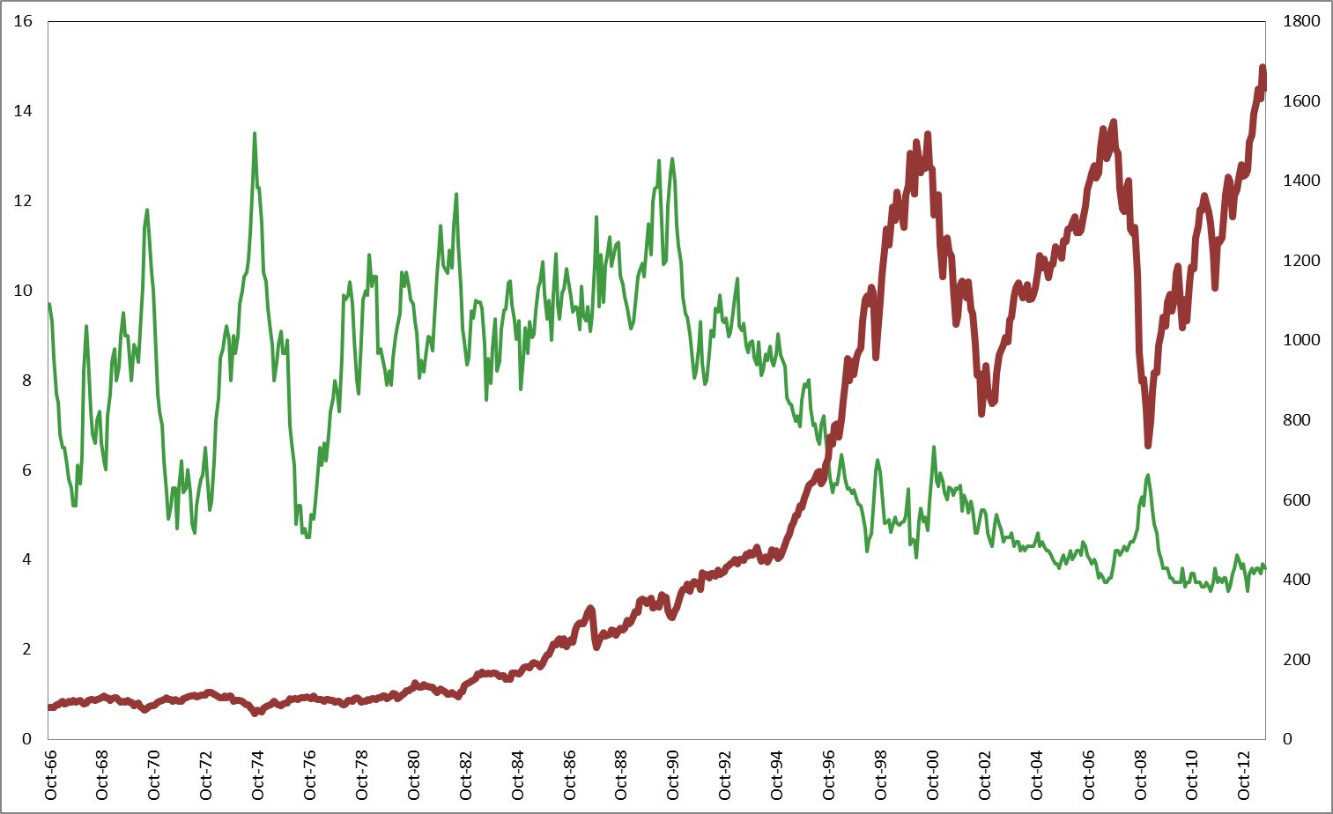
Equity Mutual Funds: Cash Percentage of Net Assets
Cash Percentage (Monthly)
S&P 500
Index
Percent
MTA Educational Foundation University Course – Technical Analysis of the Financial Markets © 2014

Slide 13
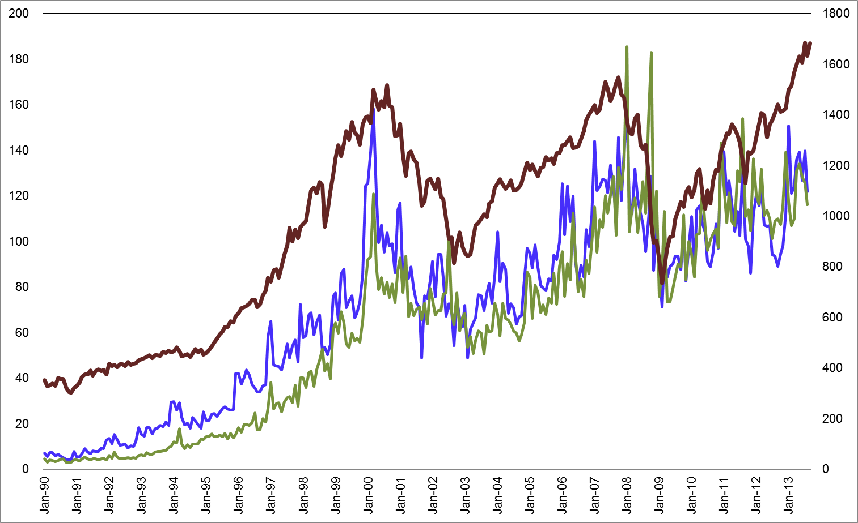
Sales (Including Reinvested Dividends) and Redemptions of Equity Mutual Funds
S&P 500
Sales
$Billions
Index
Redemptions
MTA Educational Foundation University Course – Technical Analysis of the Financial Markets © 2014

Slide 14
Net Sales of Equity Mutual Funds (Including Reinvested Dividends)
Including Net Issuance of ETFs after December 2007
S&P 500
$Billions
Index
Net Sales (Monthly) Including ETFs
Net Sales (Monthly)
MTA Educational Foundation University Course – Technical Analysis of the Financial Markets © 2014

Slide 15
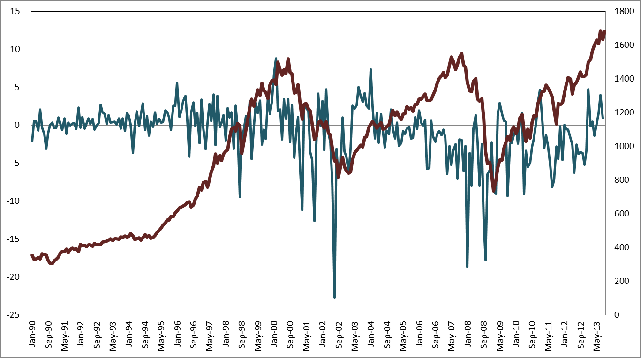
Net Exchanges into Equity Mutual Funds
S&P 500
$Billions
Index
Net Exchanges (monthly)
MTA Educational Foundation University Course – Technical Analysis of the Financial Markets © 2014

Slide 16
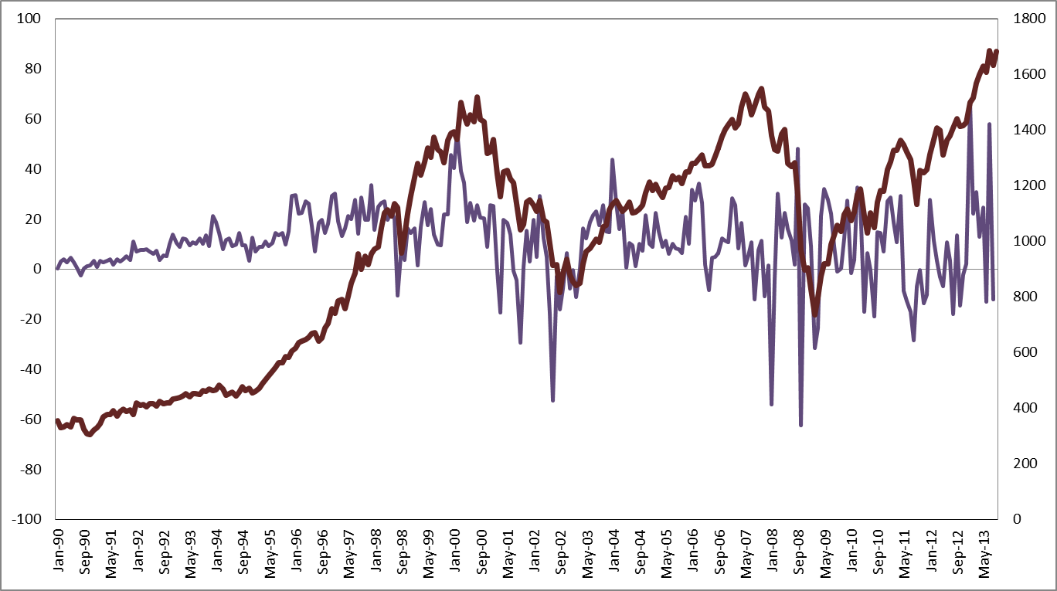
Equity Mutual Funds: Total Flows (including ETFs as of Jan. 2008)
S&P 500
Total Flows (Monthly)
$Billions
Index
Data change as
of January 2008
MTA Educational Foundation University Course – Technical Analysis of the Financial Markets © 2014

Slide 17
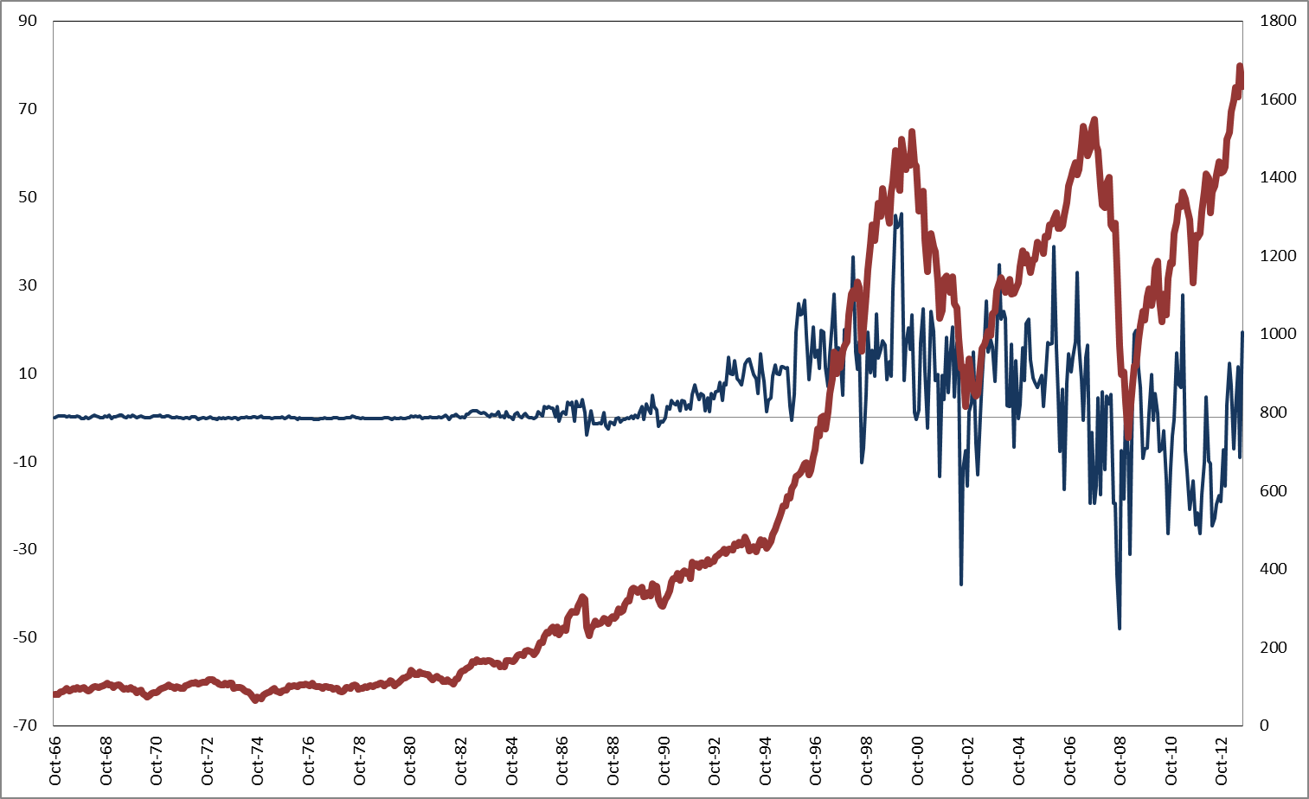
Equity Mutual Funds: Net Purchases of Common Stock
S&P 500
Net Purchases (Monthly)
$Billions
Index
MTA Educational Foundation University Course – Technical Analysis of the Financial Markets © 2014

Slide 18
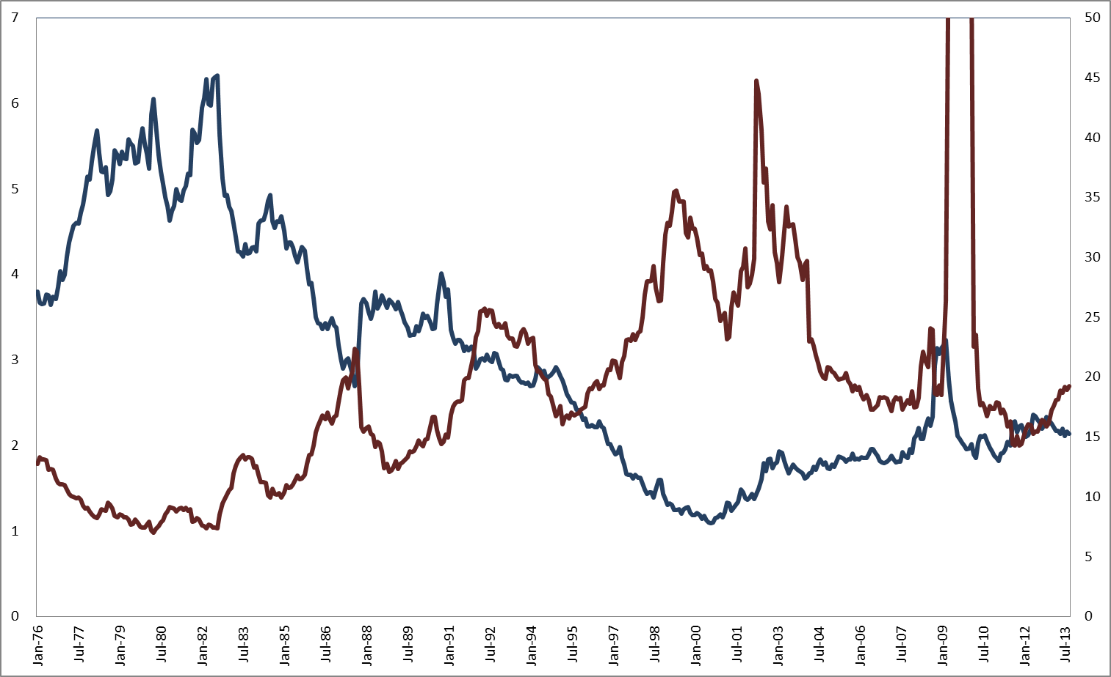
S&P 500 Dividend Yield vs. Price / Earnings Ratio
P/E Ratio 142.30 - October 2009
Dividend Yield
Percent
Ratio
P/E Ratio
SPX Index
MTA Educational Foundation University Course – Technical Analysis of the Financial Markets © 2014

Slide 19
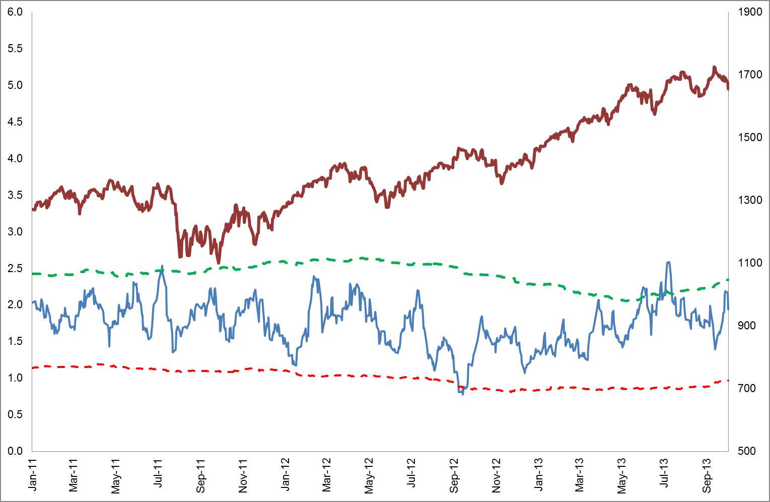
ISE 10-Day Index Put/Call Ratio
S&P 500
Ratio
Bullish
10-Day Ratio
Index
Bearish
MTA Educational Foundation University Course – Technical Analysis of the Financial Markets © 2014

Slide 20
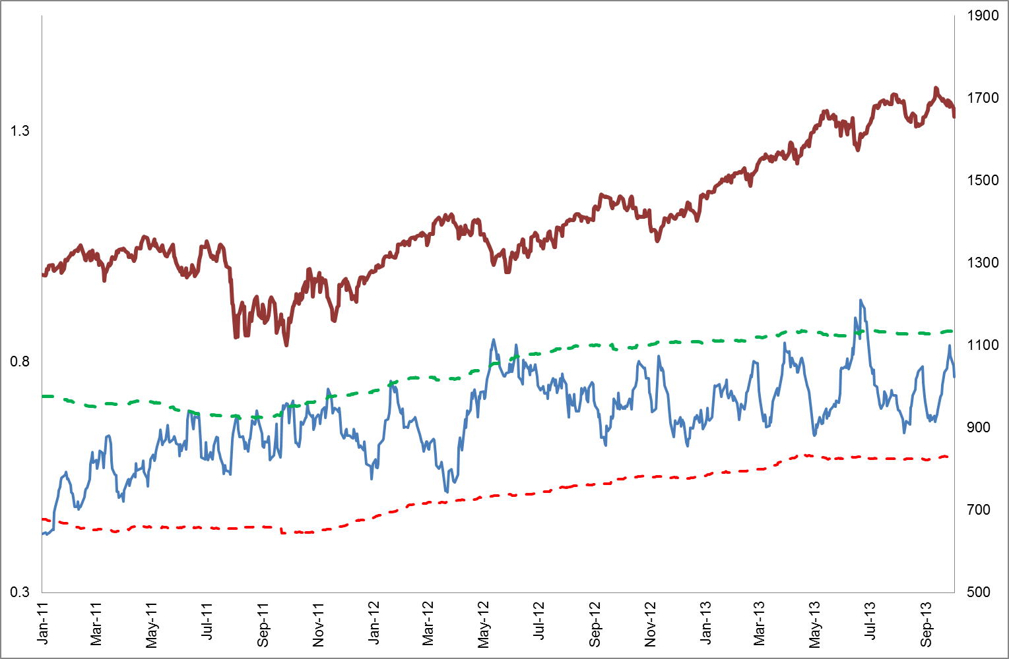
ISE 10-Day Equity Put/Call Ratio
S&P 500
10-Day Ratio
Ratio
Index
Bullish
Bearish
MTA Educational Foundation University Course – Technical Analysis of the Financial Markets © 2014

Slide 21
CBOE 10-Day Index Put/Call Ratio
S&P 500
Ratio
10-Day Ratio
Index
Bullish
Bearish
MTA Educational Foundation University Course – Technical Analysis of the Financial Markets © 2014

Slide 22
CBOE 10-Day Equity Put/Call Ratio
S&P 500
Ratio
Index
10-Day Ratio
Bullish
Bearish
MTA Educational Foundation University Course – Technical Analysis of the Financial Markets © 2014

Slide 23
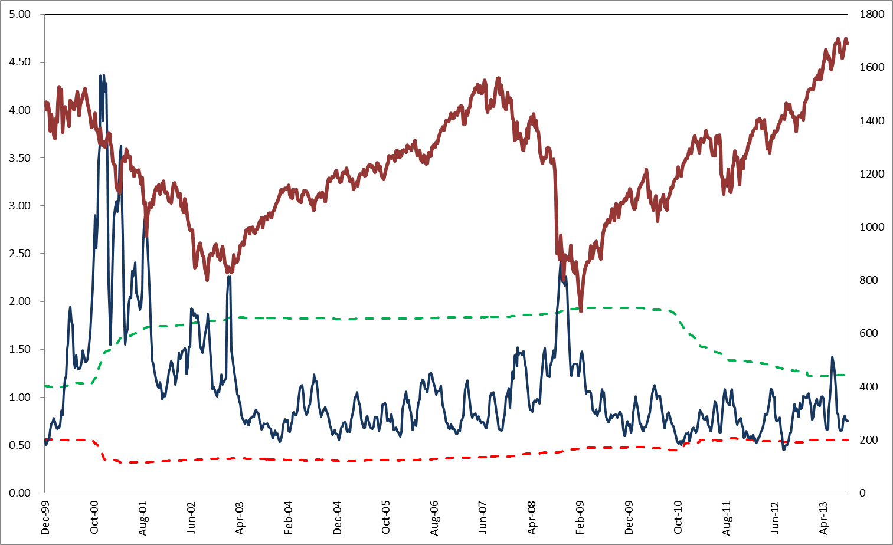
Options Clearing Corp. (OCC) Equity Options Premium Put/Call Ratio (with Bull/Bear Line)
S&P 500
Ratio
Index
4-Week
Moving Average
Bullish
Bearish
MTA Educational Foundation University Course – Technical Analysis of the Financial Markets © 2014

Slide 24
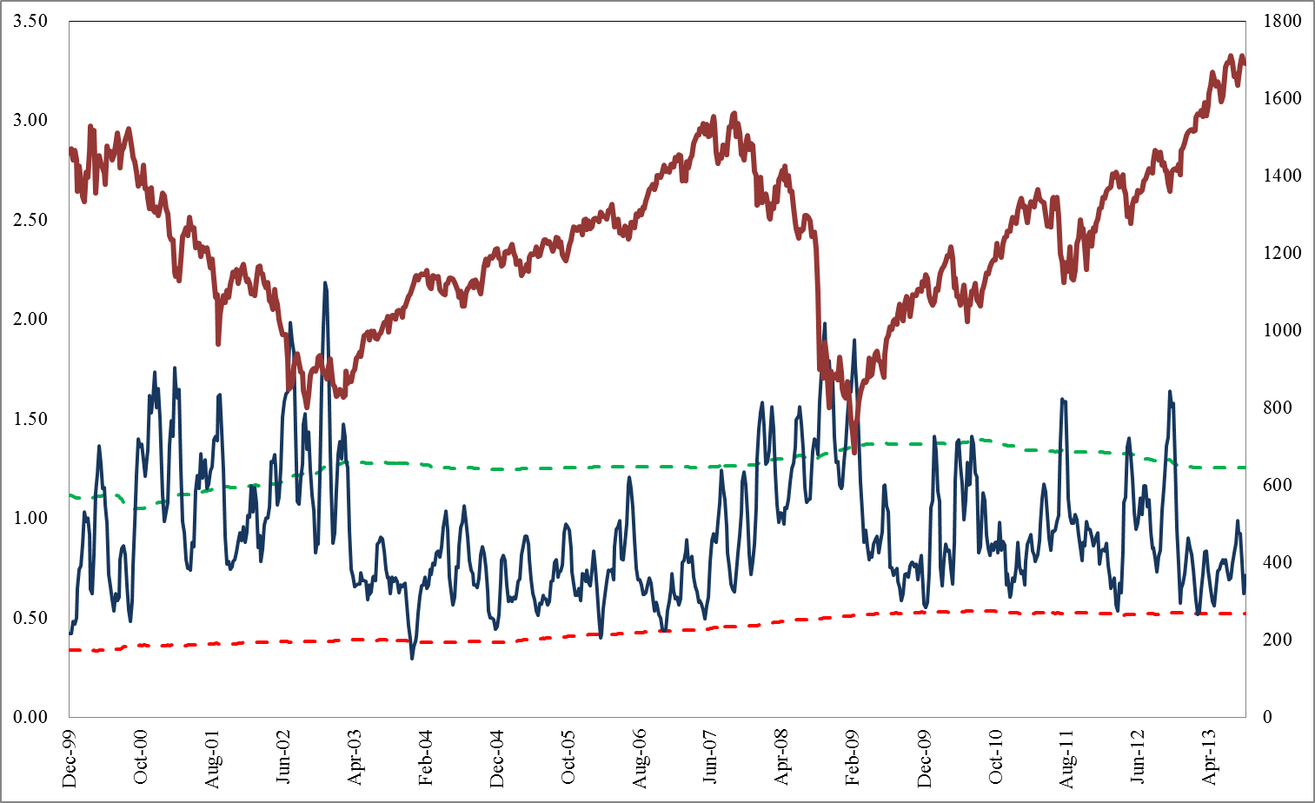
Options Clearing Corp. (OCC) Index Options Premium Put/Call Ratio (with Bull/Bear lines)
S&P 500
4-Wk. Moving Average
Ratio
Index
Bullish
Bearish
MTA Educational Foundation University Course – Technical Analysis of the Financial Markets © 2014

Slide 25
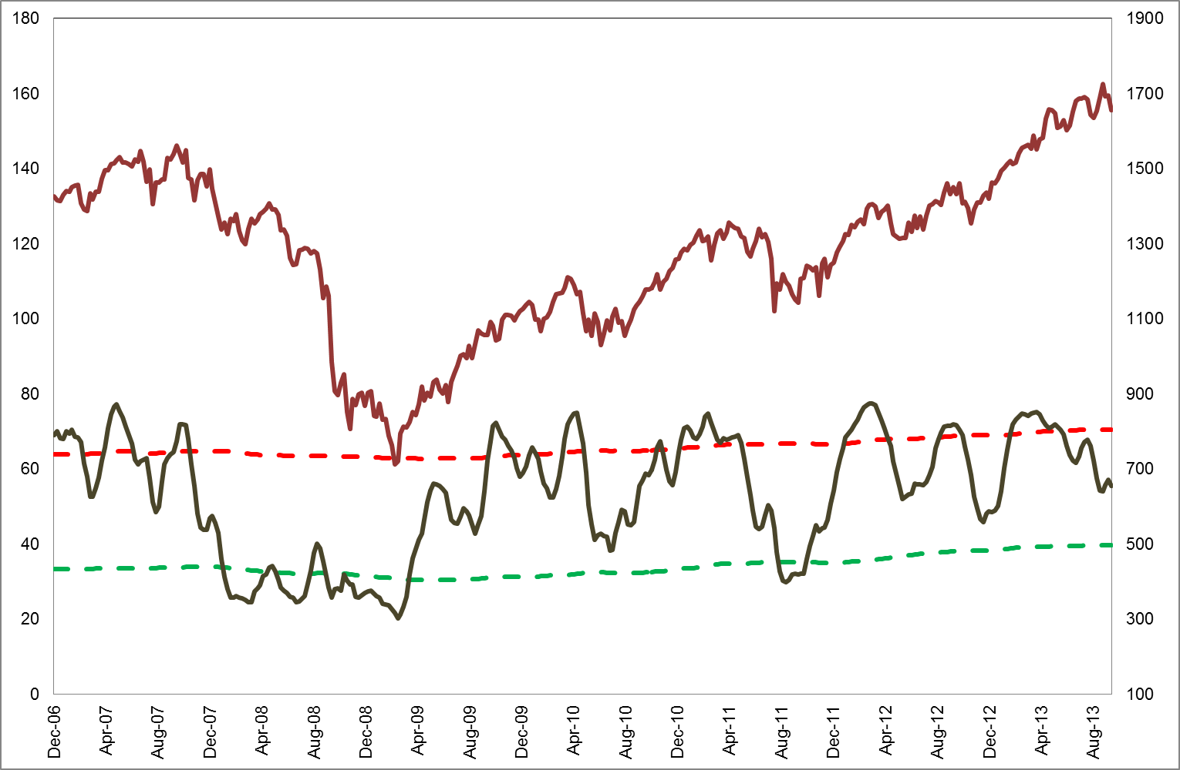
Consensus Inc. Bullish Percentage: Equities
S&P 500
Percent
4-Week Moving Average
Index
Bearish
Bullish
MTA Educational Foundation University Course – Technical Analysis of the Financial Markets © 2014

Slide 26
Market Vane Bullish Percentage: Equities
S&P 500
Percent
4-Week Moving Average
Index
Bearish
Bullish
MTA Educational Foundation University Course – Technical Analysis of the Financial Markets © 2014

Slide 27
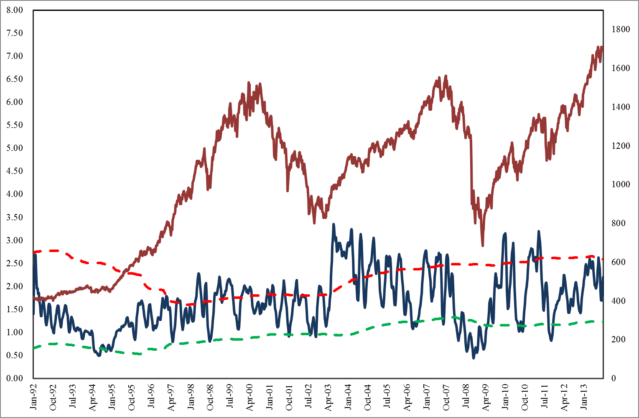
Bull/Bear Ratio from Investor’s Intelligence
S&P 500
Index
4-Week Moving Average
Percent
Bearish
Bullish
MTA Educational Foundation University Course – Technical Analysis of the Financial Markets © 2014

Slide 28
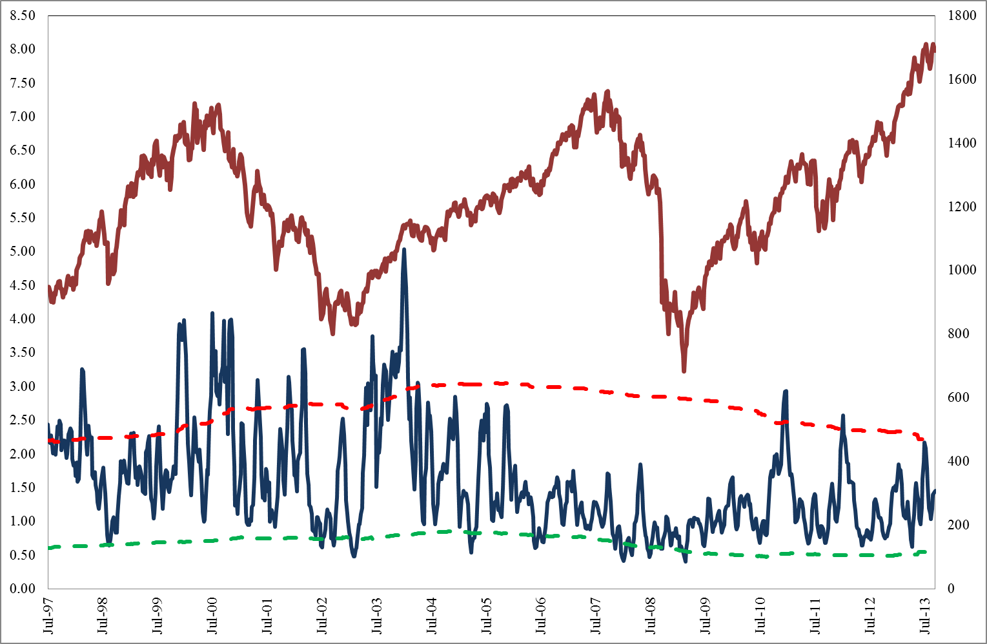
Bull/Bear Ratio from American Association of Individual Investors (AAII)
S&P 500
Ratio
4-Week Moving Average
Index
Bearish
Bullish
MTA Educational Foundation University Course – Technical Analysis of the Financial Markets © 2014

Slide 29
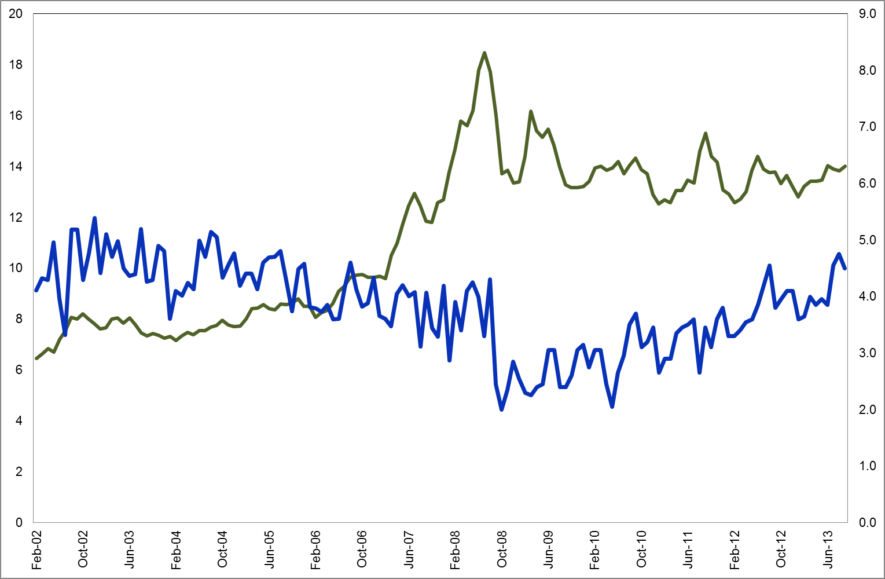
NYSE Total Short Interest vs. Short Interest Ratio
S&P 500
Short Interest Ratio
Percent
Billions of Shares
Total Short Interest
MTA Educational Foundation University Course – Technical Analysis of the Financial Markets © 2014

Slide 30
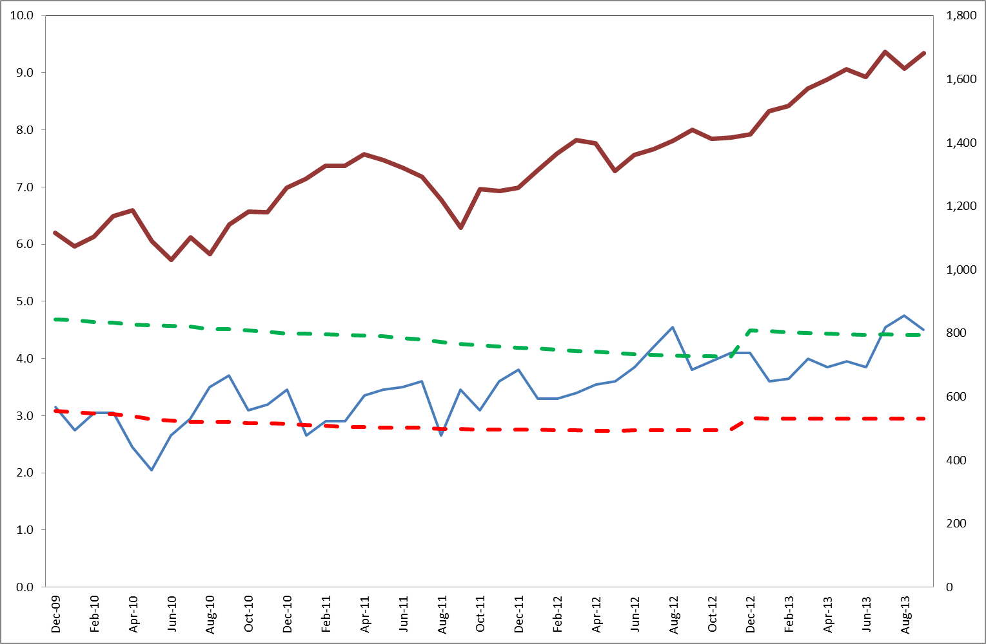
NYSE Short Interest Ratio with Bull/Bear Line
S&P 500
Short Interest Ratio
Index
Percent
Bullish
Bearish
MTA Educational Foundation University Course – Technical Analysis of the Financial Markets © 2014

