Slide 1
Topic 3: Quantum statistics
2011-09-09

Slide 2
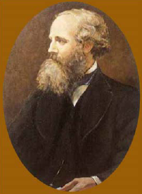
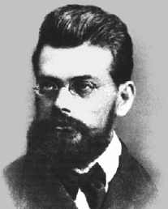
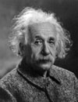
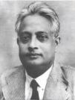
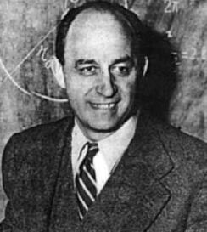
L. Boltzmann
J. Maxwell
E. Fermi
A. Einstein
Bose

Slide 3
What is statistics?

Slide 4
What is statistics?

Slide 5
What quantum statistics?
Discrete energy levels (eigen states)
Pauli exclusion principle
Indistinguishable (q or classical?)

Slide 6
Equilibrium means what?

Slide 7
How many statistics (statistical distributions)?

Slide 8
What is Bose-Einstein condensate?

