Slide 1
Semiconductor Devices -- not only to understand what were invented, but also be able create your own --
Kai Shum
2011-12-02

Slide 2
How?
Books tell you how to understand the operation principles for devices already invented
Not only understanding
But also to teach you how to invent your own devices by exploring new physical processes in semiconductors

Slide 3
Summary for invented devices
Name | Key Structure | Comment
Diode | pn | Basic unit
Bipolar Junction Transistor (BJT) | pn | 2 units
Electric-field Effect Transistor (MOSFET) | MOS | Basic unit – e-to-e
Light-emitting Diode (LED) | pn | Positively biased
Laser Diode (LD) | pn | Positively biased
Modulator | pn | Negatively biased
Electro-absorption Modulated Laser (EML) | pn | 1 unit p-biased and 2nd unit n-biased
Charge-Coupled Device (CCD) | MOS | Basic unit – o-to-e
Solar Cell | pn | Generating photo-voltage, photo-current

Slide 4
Basic device units
PN Junction
MOS (or MIS)

Slide 5
A few basic concepts
Fermi level
Contacts
Build-in electric field

Slide 6
Fermi level
Fermi level is a reference potential energy level that detects the single particle electron occupation probability in a semiconductor or dissimilar semiconductors in physical contact at equilibrium (e obey Fermi-D distribution)
Example, at the exact Fermi energy level, the probability for an electron to occupy at this energy level is 50%

Slide 7
Example 1: Intrinsic Semiconductor at 0 K

Slide 8
Example 2: Intrinsic Semiconductor at 300 K
-
-
-
-
+
+
+
+

Slide 9
Example 1: Doped Semiconductors
N-type
P-type

Slide 10
Example 1: Doped Semiconductors
N-type
P-type

Slide 11
Fermi-Energy
The Fermi energy is a concept in quantum mechanics usually referring to the energy of the highest occupied quantum state in a system of fermions at absolute zero temperature.
See a nice description on Wiki:
http://en.wikipedia.org/wiki/Fermi_energy

Slide 12
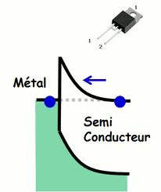
Contacts
Contacts are terminals used to accept external potentials and to a complete circuit

Slide 13
Different type of contacts
ohmic contact
Schottky contact

Slide 14
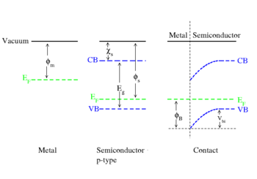
Schottky contact

Slide 15
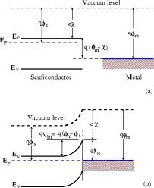
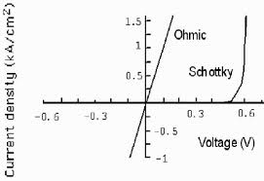
Schottky contact

Slide 16
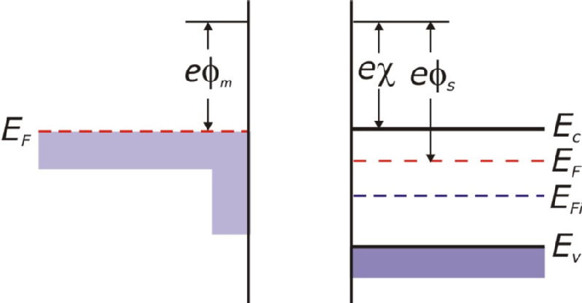
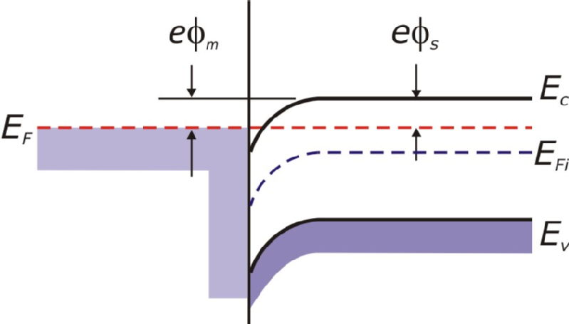
Ohmic contact

Slide 17
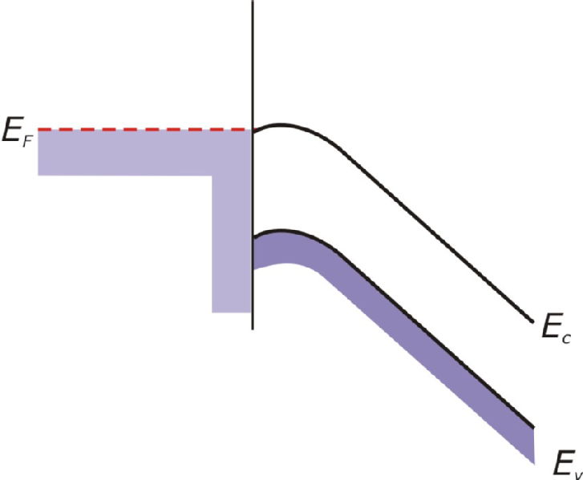
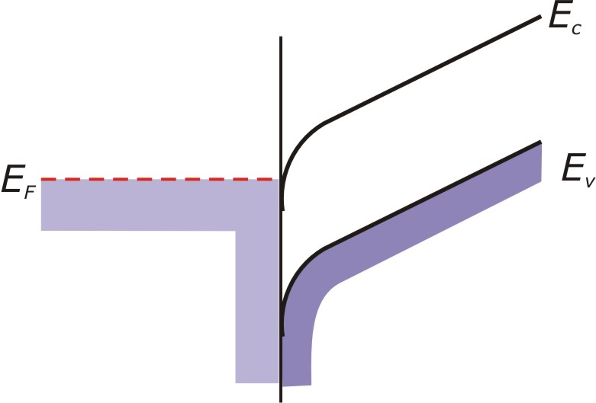
Biased contacts

Slide 18
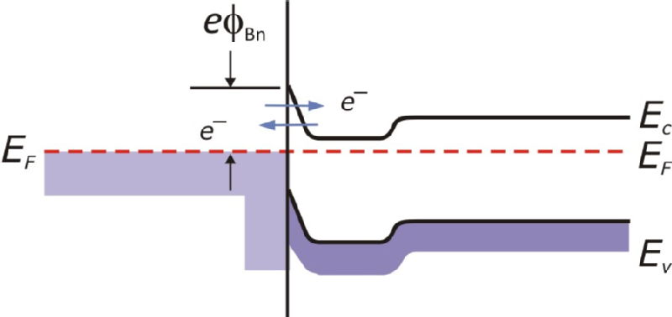
Tunneling ohm contact

Slide 19
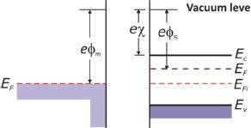
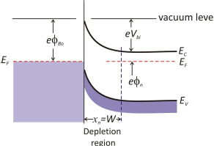
Schottky contact

Slide 20
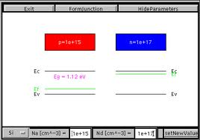
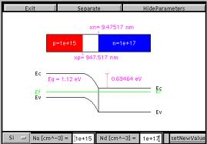
PN Junction

Slide 21
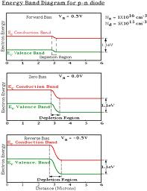
Pn junction, 0, +, and - biased

Slide 22
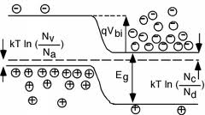
Majority carriers in pn junction

Slide 23
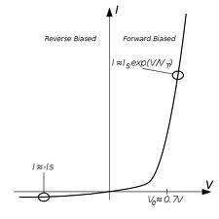
I-V curve of pn diode

Slide 24
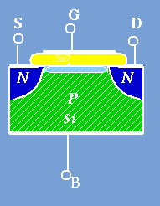
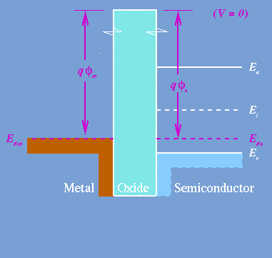
MOS (or MIS)

Slide 25
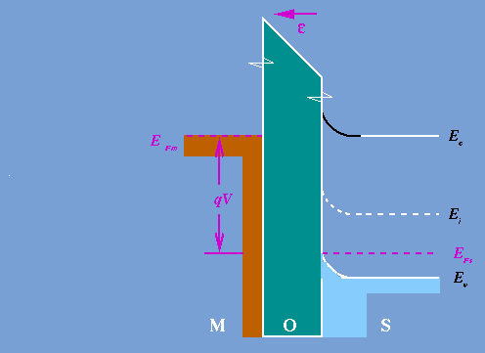
MOS, negatively biased

Slide 26
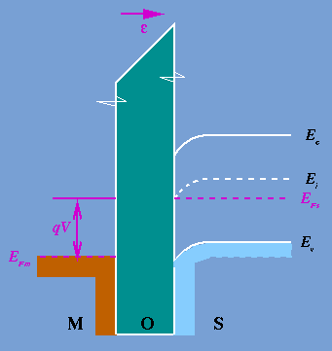
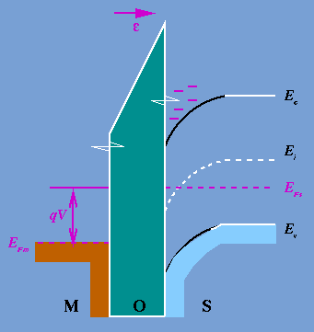
MOS positively biased

Slide 27
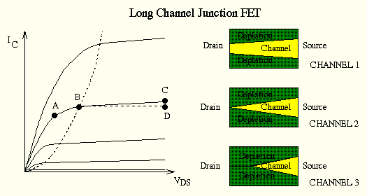
MOSFET action

Slide 28
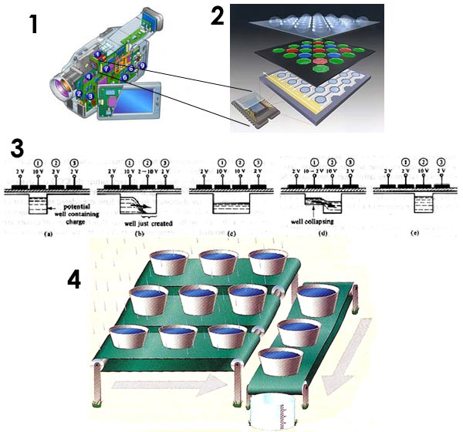

Slide 29
CCD

Slide 30
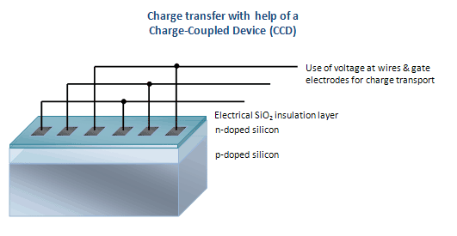

Slide 33
-

Slide 35
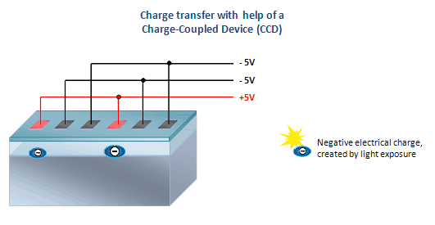

Slide 36
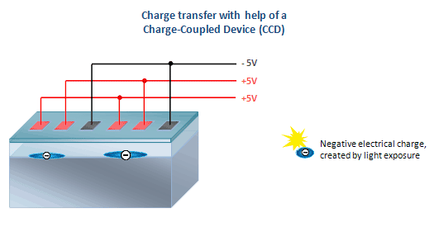

Slide 37
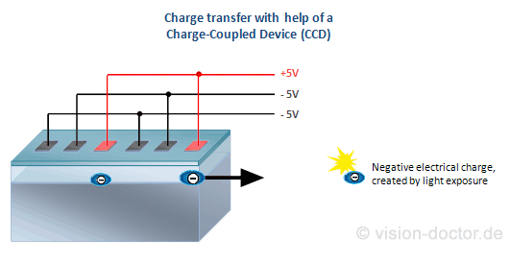

Slide 38
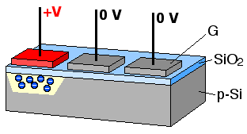

Slide 39
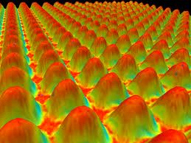
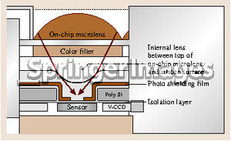

Slide 40
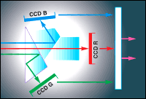
Fast color CCD

Slide 41
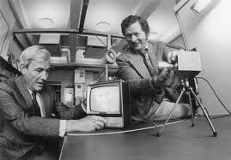
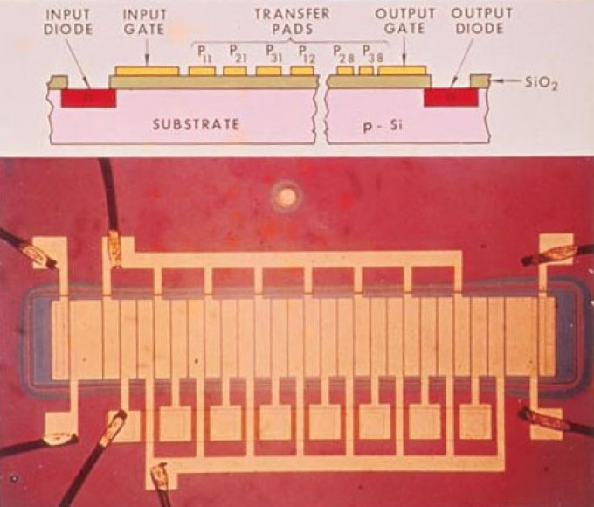
CCD Inventor

Slide 42
Solar cells

Slide 44
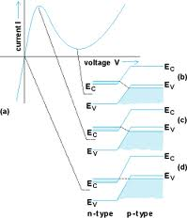
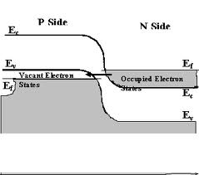
Intra-band & inter-band tunneling

Slide 45
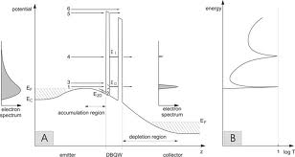
Resonant tunneling

Slide 46
To be continued on modulators, EMLs, LEDs, LDs

