Slide 1
Information Technology
Project Management
By Jack T. Marchewka
Northern Illinois University
Copyright 2009 John Wiley & Sons, Inc. all rights reserved. Reproduction or translation of this work beyond that permitted in Section 117 of the 1976 United States Copyright Act without the express permission of the copyright owner is unlawful. Request for further information should be addressed to the Permissions Department, John Wiley & Sons, Inc. The purchaser may make back-up copies for his/her own use only and not for distribution or resale. The Publisher assumes no responsibility for errors, omissions, or damages caused by the use of these programs or from the use of the information contained herein.

Slide 2
The Project Schedule and Budget
Chapter 7

Slide 3
PMBOK® Project Cost Management
Cost estimating
  Based upon the activities, their time estimates, and resource requirements, an estimate can be developed.
Cost budgeting
  Once the time and cost of each activity is estimated, an overall cost estimate for the entire project can be made. Once approved, this estimate becomes the project budget.
Cost control
  Ensuring that proper processes and procedures are in place to control changes to the project budget.

Slide 4
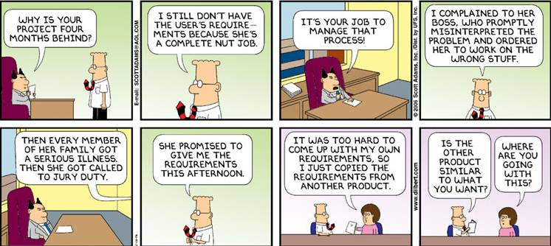
The Project Planning Framework

Slide 5
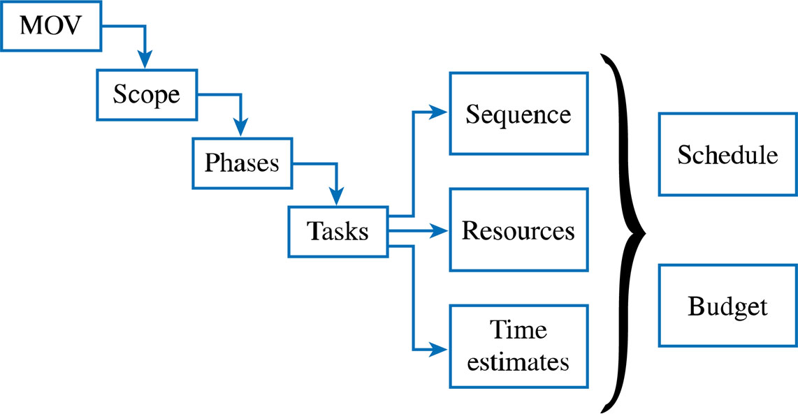
The Project Planning Framework
Project Plan
WBS

Slide 6
Budget and Schedule Development
The project’s schedule can be determined based upon the tasks and time estimates in the WBS
  The schedule will also depend on how these activities are sequenced
The project’s budget can be determined based upon the activities and time estimates from the WBS as well as the cost of the resources assigned to the WBS tasks
Iterations may still be necessary
The objective is to create a realistic project schedule and budget!

Slide 7
Developing the Project Schedule
Project Management Tools
  Gantt Charts
  Project Network Diagrams
    Activity on the Node (AON)
    Critical Path Analysis
    Program Evaluation and Review Technique (PERT)
    Precedence Diagramming Method (PDM)
    Dwight Eisenhower – “I have always found that plans are useless, but planning is indispensable”

Slide 8
Gantt Charts
Developed by Henry Gantt while working for the US Army in WWI
  Still one of the most useful and widely used project management tool
Estimates for the tasks defined in the WBS are represented using a bar across a horizontal time axis
  Diamonds are used to represent milestones
Does not show explicit relationships among the tasks
  If one task is delayed, don’t know impact on other tasks

Slide 9
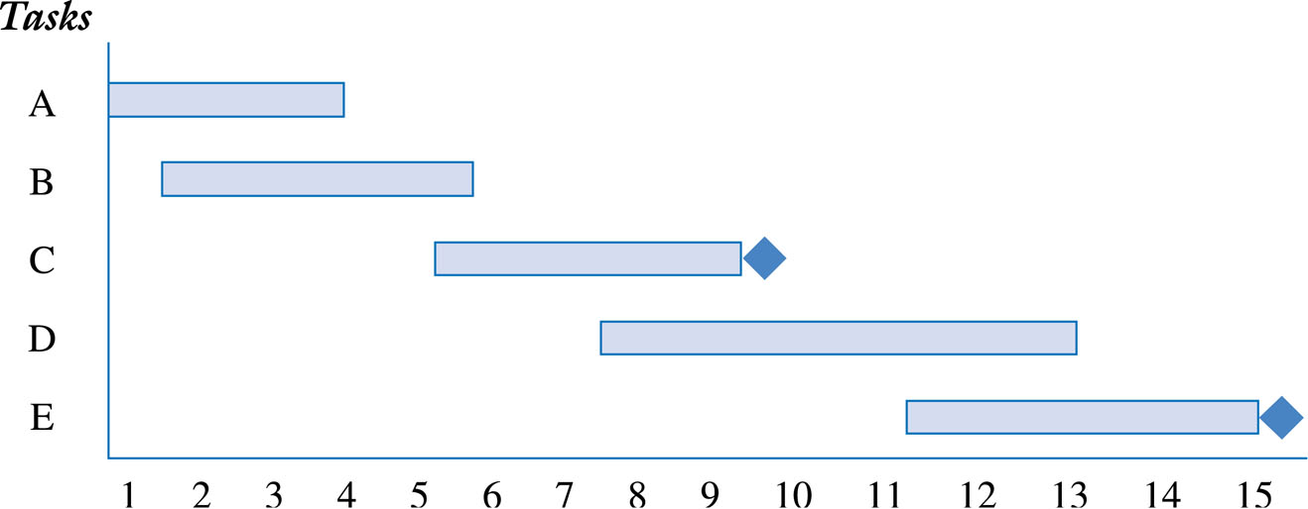
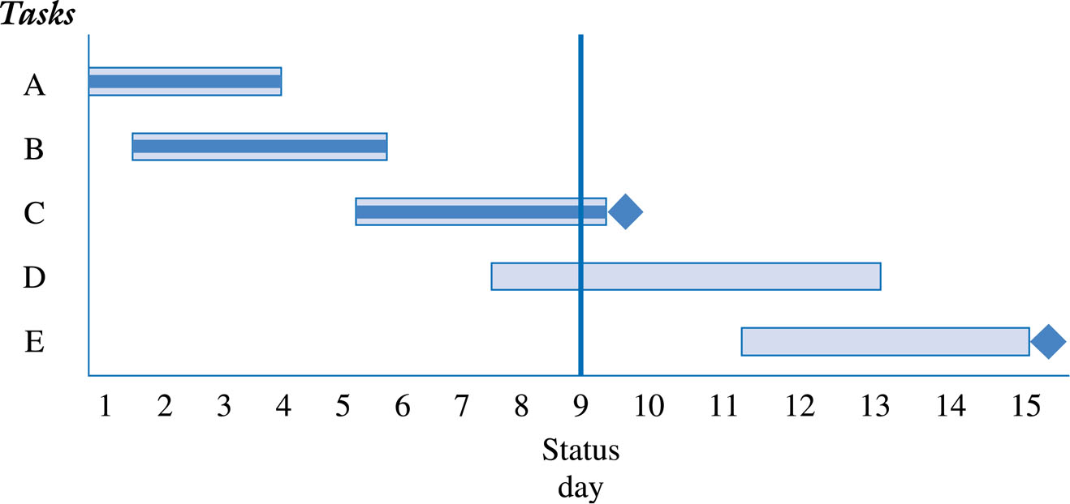
Gantt Chart for Planning and Progress

Slide 10
Project Network Diagram
Provides a visual representation of the tasks as well as the logical sequence and dependencies among the tasks
Provides information on start/finish dates and what activities may be delayed without affecting the deadline target date
  Can be used to make decisions regarding scheduling and resource assignments to shorten the time required for those critical activities that will impact the project deadline

Slide 11
How to Find the Critical Path
ACTIVITY | DESCRIPTION | IMMEDIATE PREDECESSORS
A | Build internal components | —
B | Modify roof and floor | —
C | Construct collection stack | A
D | Pour concrete and install frame | B
E | Build high-temperature burner | C
F | Install control system | C
G | Install air pollution device | D, E
H | Inspect and test | F, G

Slide 12
How to Find the Critical Path
A
Build Internal Components
C
Construct Collection Stack
F
Install Control System
E
Build Burner
H
Inspect and Test
Start
Finish
B
Modify Roof and Floor
D
Pour Concrete and Install Frame
G
Install Pollution Device

Slide 13
How to Find the Critical Path
A 2
C 2
F 3
E 4
H 2
Start
Finish
B 3
D 4
G 5

Slide 14
How to Find the Critical Path
To find the critical path, need to determine the following quantities for each activity in the network
Earliest start time (ES): the earliest time an activity can begin without violation of immediate predecessor requirements
Earliest finish time (EF): the earliest time at which an activity can end
Latest start time (LS): the latest time an activity can begin without delaying the entire project
Latest finish time (LF): the latest time an activity can end without delaying the entire project

Slide 15
How to Find the Critical Path
In the nodes, the activity time and the early and late start and finish times are represented in the following manner
ACTIVITY t
ES EF
LS LF
Earliest times are computed as
Earliest finish time = Earliest start time + Expected activity time
EF = ES + t
Earliest start = Largest of the earliest finish times of
immediate predecessors
ES = Largest EF of immediate predecessors

Slide 16
How to Find the Critical Path
At the start of the project we set the time to zero
Thus ES = 0 for both A and B
A t = 2
ES = 0 EF = 0 + 2 = 2
Start
B t = 3
ES = 0 EF = 0 + 3 = 3

Slide 17
How to Find the Critical Path
ES and EF times
A 2
0 2
C 2
2 4
F 3
4 7
E 4
4 8
H 2
13 15
Start
Finish
B 3
0 3
D 4
3 7
G 5
8 13

Slide 18
How to Find the Critical Path
Latest times are computed as
Latest start time = Latest finish time – Expected activity time
LS = LF – t
Latest finish time = Smallest of latest start times
for following activities
LF = Smallest LS of following activities
For activity H
LS = LF – t = 15 – 2 = 13 weeks

Slide 19
How to Find the Critical Path
LS and LF times
A 2
0 2
0 2
C 2
2 4
2 4
F 3
4 7
10 13
E 4
4 8
4 8
H 2
13 15
13 15
Start
Finish
B 3
0 3
1 4
D 4
3 7
4 8
G 5
8 13
8 13

Slide 20
How to Find the Critical Path
Once ES, LS, EF, and LF have been determined, it is a simple matter to find the amount of slack time that each activity has
Slack = LS – ES, or Slack = LF – EF
Activities A, C, E, G, and H have no slack time
These are called critical activities and they are said to be on the critical path
The total project completion time is 15 weeks

Slide 21
How to Find the Critical Path
Schedule and slack times
ACTIVITY | EARLIEST START, ES | EARLIEST FINISH, EF | LATEST START, LS | LATEST FINISH, LF | SLACK, LS – ES | ON CRITICAL PATH?
A | 0 | 2 | 0 | 2 | 0 | Yes
B | 0 | 3 | 1 | 4 | 1 | No
C | 2 | 4 | 2 | 4 | 0 | Yes
D | 3 | 7 | 4 | 8 | 1 | No
E | 4 | 8 | 4 | 8 | 0 | Yes
F | 4 | 7 | 10 | 13 | 6 | No
G | 8 | 13 | 8 | 13 | 0 | Yes
H | 13 | 15 | 13 | 15 | 0 | Yes

Slide 22
How to Find the Critical Path
Critical path
A 2
0 2
0 2
C 2
2 4
2 4
F 3
4 7
10 13
E 4
4 8
4 8
H 2
13 15
13 15
Start
Finish
B 3
0 3
1 4
D 4
3 7
4 8
G 5
8 13
8 13

Slide 23
Critical Path Computation
Activity | Description | Estimated Duration (Days) | Predecessor
A | Evaluate current technology platform | 2 | None
B | Define user requirements | 5 | A
C | Design Web page layouts | 4 | B
D | Set-up Server | 3 | B
E | Estimate Web traffic | 1 | B
F | Test Web pages and links | 4 | C,D
G | Move web pages to production environment | 3 | D,E
H | Write announcement of intranet for corp. newsletter | 2 | F,G
I | Train users | 5 | G
J | Write report to management | 1 | H,I

Slide 24
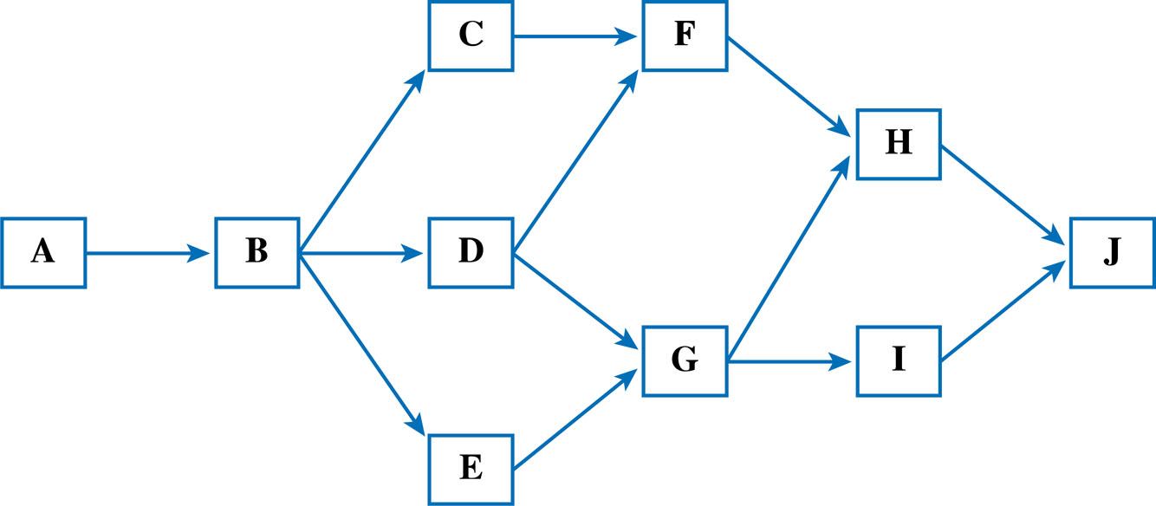
Network Diagram

Slide 25
Critical Path
C 4
H 2
7 11
F 4
15 17
8 12
11 15
16 18
12 16
J 1
A 2
B 5
D 3
18 19
0 2
2 7
7 10
18 19
0 2
2 7
7 10
G 3
I 5
10 13
13 18
E 1
10 13
13 18
7 8
9 10

Slide 26
Possible Activity Paths
Possible Paths | Path | Total
Path 1 | A+B+C+F+H+J | 18
 | 2+5+4+4+2+1
Path 2 | A+B+D+F+H+J | 17
 | 2+5+3+4+2+1
Path 3 | A+B+D+G+H+J | 16
 | 2+5+3+3+2+1
Path 4 | A+B+D+G+I+J | 19*
 | 2+5+3+3+5+1
Path 5 | A+B+E+G+I+J | 17
 | 2+5+1+3+5+1
* The Critical Path

Slide 27
Critical Path
The critical path has zero slack (or float) – any delay will impact the project completion time
    Slack - the amount of time an activity can be delayed before it delays the project
    Any change in the critical path will delay the entire project
    Task E can be delayed 2 days (from 8 to 10) without impacting the project completion time
Must be monitored and managed!
  Project manager can expedite or crash by adding resources
  Fast tracking – running activities in parallel which were originally planned as sequential
  The CP can change
  Can have multiple CPs or a CP that consists of multiple paths that meet at a common node before the last node

Slide 28
Longest Path vs Critical Path
The longest path is what it says – the longest amount of time to get to the finish
In most project the longest path and the critical path are the same, particularly as the size of the network grows

Slide 29
Longest Path vs Critical Path
If you start with a baseline schedule that has no actuals, no constraints and no deadline, and you perform some CPM scheduling on it, the path of 0 Total Float will be the Longest Path.
  If you add up the durations of all activities on that 0-float path, it will have the longest Total Duration.
If you calculate the Longest Path for a project that does have actuals, constraints, and a deadline, you will come up with a path of activities that are “important”, say “small-c critical” to the timely completion of the project.
If they are different, it’s important to monitor both paths

Slide 30
PERT
Program Evaluation and Review Technique
  Developed in 1950s to help manage the Polaris Submarine Project
Developed about the same time as the Critical Path Method
  Often combined as PERT/CPM
Employs both a project network diagram with a statistical distribution

Slide 31
Activity Times
In some situations, activity times are known with certainty
CPM assigns just one time estimate to each activity and this is used to find the critical path
In many projects there is uncertainty about activity times
PERT employs a probability distribution based on three time estimates for each activity
  A weighted average of these estimates is used for the time estimate and this is used to determine the critical path

Slide 32
Activity Times
The time estimates in PERT are
Optimistic time (a) = time an activity will take if everything goes as well as possible. There should be only a small probability (say, ¹/₁₀₀) of this occurring.
Pessimistic time (b) = time an activity would take assuming very unfavorable conditions. There should also be only a small probability that the activity will really take this long.
Most likely time (m) = most realistic time estimate to complete the activity

Slide 33
Activity Times
To find the expected activity time (t), the beta distribution weights the estimates as follows
To compute the dispersion or variance of activity completion time, we use the formula

Slide 34
Activity Analysis for PERT
Activity | Predecessor | Optimistic Estimates (Days) | Most Likely Estimates (Days) | Pessimistic Estimates (Days) | Expected Duration (a+4b+c) 6 | Variance ((b-a)/6)²
A | None | 1 | 2 | 4 | 2.2 | 0.3
B | A | 3 | 5 | 8 | 5.2 | 0.7
C | B | 2 | 4 | 5 | 3.8 | 0.3
D | B | 2 | 3 | 6 | 3.3 | 0.4
E | B | 1 | 1 | 1 | 1.0 | 0.0
F | C,D | 2 | 4 | 6 | 4.0 | 0.4
G | D,E | 2 | 3 | 4 | 3.0 | 0.1
H | F,G | 1 | 2 | 5 | 2.3 | 0.4
I | G | 4 | 5 | 9 | 5.5 | 0.7
J | H,I | .5 | 1 | 3 | 1.3 | 0.2

Slide 35
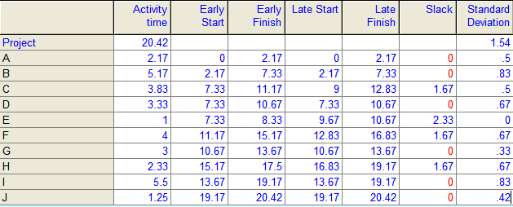
PERT Computations
* The Critical Path

Slide 36
Possible PERT Activity Paths
Possible Paths | Path | Total
Path 1 | A+B+C+F+H+J | 18.8
 | 2.2+5.2+3.8+4.0+2.3+1.3
Path 2 | A+B+D+F+H+J | 18.3
 | 2.2+5.2+3.3+4.0+2.3+1.3
Path 3 | A+B+D+G+H+J | 18.6
 | 2.2+5.2+3.3+3.0+2.3+1.3
Path 4 | A+B+D+G+I+J | 20.5*
 | 2.2+5.2+3.3+3.0+5.5+1.3
Path 5 | A+B+E+G+I+J | 18.2
 | 2.2+5.2+1.0+3.0+5.5+1.3
* The Critical Path

Slide 37
Probability of Project Completion
The critical path analysis helped determine the expected project completion time of 20.5 weeks
But variation in activities on the critical path can affect overall project completion, and this is a major concern
PERT uses the variance of critical path activities to help determine the variance of the overall project
∑
variances of activities on the critical path
Project variance =

Slide 38
Probability of Project Completion
We know the standard deviation is just the square root of the variance, so
We assume activity times are independent and total project completion time is normally distributed

Slide 39
Probability of Project Completion
The project’s expected completion date is 20.5 weeks.
  Assume that the total project completion time follows a normal probability distribution
  Chart tells us that there is a 50% chance of completing the entire project in less than 20.5 weeks and a 50% chance it will exceed 20.5 weeks
Standard Deviation = 1.55
20.5Weeks
(Expected Completion Time)

Slide 40
Probability of Project Completion
The standard normal equation can be applied as follows
From the Area Under the Standard Normal Curve table we find the probability of 0.833 associated with this Z value
  That means there is a 83.3% probability this project can be completed in 22 weeks or less
  The probability of completing in 23 weeks would be 94.6%

Slide 41
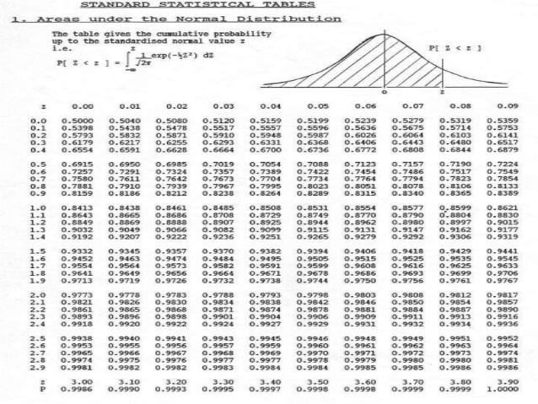

Slide 42
PERT/COST
Although PERT is an excellent method of monitoring and controlling project length, it does not consider the very important factor of project cost
PERT/Cost is a modification of PERT that allows a manager to plan, schedule, monitor, and control cost as well as time
Using PERT/Cost to plan, schedule, monitor, and control project cost helps accomplish the sixth and final step of PERT

Slide 43
Planning and Scheduling Project Costs: Budgeting Process
The overall approach in the budgeting process of a project is to determine how much is to be spent every week or month
This can be accomplished in four basic budgeting steps

Slide 44
Four Steps of the Budgeting Process
Identify all costs associated with each of the activities then add these costs together to get one estimated cost or budget for each activity
In large projects, activities can be combined into larger work packages. A work package is simply a logical collection of activities.
Convert the budgeted cost per activity into a cost per time period by assuming that the cost of completing any activity is spent at a uniform rate over time
Using the ES and LS times, find out how much money should be spent during each week or month to finish the project by the date desired

Slide 45
Budgeting for General Foundry
The Gantt chart in Figure 13.9 illustrates this project
The horizontal bars shown when each activity will be performed based on its ES-EF times
We determine how much will be spent on each activity during each week and fill these amounts into a chart in place of the bars
The following two tables show the activity costs and budgeted cost for the General Foundry project

Slide 46
Budgeting for General Foundry
Gantt chart General Foundry project
A
B
C
D
E
F
G
H
Activity
1 2 3 4 5 6 7 8 9 10 11 12 13 14 15
Week
Figure 13.9

Slide 47
Budgeting for General Foundry
Activity costs for General Foundry
ACTIVITY | EARLIEST START, ES | LATEST START, LS | EXPECTED TIME, t | TOTAL BUDGETED COST ($) | BUDGETED COST PER WEEK ($)
A | 0 | 0 | 2 | 22,000 | 11,000
B | 0 | 1 | 3 | 30,000 | 10,000
C | 2 | 2 | 2 | 26,000 | 13,000
D | 3 | 4 | 4 | 48,000 | 12,000
E | 4 | 4 | 4 | 56,000 | 14,000
F | 4 | 10 | 3 | 30,000 | 10,000
G | 8 | 8 | 5 | 80,000 | 16,000
H | 13 | 13 | 2 | 16,000 | 8,000
 |  |  | Total | 308,000
Table 13.5

Slide 48
Budgeting for General Foundry
Budgeted cost for General Foundry
 | WEEK
ACTIVITY | 1 | 2 | 3 | 4 | 5 | 6 | 7 | 8 | 9 | 10 | 11 | 12 | 13 | 14 | 15 | TOTAL
A | 11 | 11 |  |  |  |  |  |  |  |  |  |  |  |  |  | 22
B | 10 | 10 | 10 |  |  |  |  |  |  |  |  |  |  |  |  | 30
C |  |  | 13 | 13 |  |  |  |  |  |  |  |  |  |  |  | 26
D |  |  |  | 12 | 12 | 12 | 12 |  |  |  |  |  |  |  |  | 48
E |  |  |  |  | 14 | 14 | 14 | 14 |  |  |  |  |  |  |  | 56
F |  |  |  |  | 10 | 10 | 10 |  |  |  |  |  |  |  |  | 30
G |  |  |  |  |  |  |  |  | 16 | 16 | 16 | 16 | 16 |  |  | 80
H |  |  |  |  |  |  |  |  |  |  |  |  |  | 8 | 8 | 16
 |  |  |  |  |  |  |  |  |  |  |  |  |  |  |  | 308
Total per week | 21 | 21 | 23 | 25 | 36 | 36 | 36 | 14 | 16 | 16 | 16 | 16 | 16 | 8 | 8
Total to date | 21 | 42 | 65 | 90 | 126 | 162 | 198 | 212 | 228 | 244 | 260 | 276 | 292 | 300 | 308
Table 13.6

Slide 49
Budgeting for General Foundry
It is also possible to prepare a budget based on the latest starting time
This budget will delay the expenditure of funds until the last possible moment
The following table shows the latest start budget for the General Foundry project
The two tables form a budget range
Any budget can be chosen between these two values depending on when the company wants to actually spend the money
The budget ranges are plotted in Figure 13.10

Slide 50
Budgeting for General Foundry
Late start budgeted cost for General Foundry
 | WEEK
ACTIVITY | 1 | 2 | 3 | 4 | 5 | 6 | 7 | 8 | 9 | 10 | 11 | 12 | 13 | 14 | 15 | TOTAL
A | 11 | 11 |  |  |  |  |  |  |  |  |  |  |  |  |  | 22
B |  | 10 | 10 | 10 |  |  |  |  |  |  |  |  |  |  |  | 30
C |  |  | 13 | 13 |  |  |  |  |  |  |  |  |  |  |  | 26
D |  |  |  |  | 12 | 12 | 12 | 12 |  |  |  |  |  |  |  | 48
E |  |  |  |  | 14 | 14 | 14 | 14 |  |  |  |  |  |  |  | 56
F |  |  |  |  |  |  |  |  |  |  | 10 | 10 | 10 |  |  | 30
G |  |  |  |  |  |  |  |  | 16 | 16 | 16 | 16 | 16 |  |  | 80
H |  |  |  |  |  |  |  |  |  |  |  |  |  | 8 | 8 | 16
 |  |  |  |  |  |  |  |  |  |  |  |  |  |  |  | 308
Total per week | 11 | 21 | 23 | 23 | 26 | 26 | 26 | 26 | 16 | 16 | 26 | 26 | 26 | 8 | 8
Total to date | 11 | 32 | 55 | 78 | 104 | 130 | 156 | 182 | 198 | 214 | 240 | 266 | 292 | 300 | 308
Table 13.7

Slide 51
Budgeting for General Foundry
Total Budgeted Cost
A manager can choose any budget that falls between the budgets presented in the two tables
The two tables form feasible budget ranges
$300,000 –
250,000 –
200,000 –
150,000 –
100,000 –
50,000 –
0 –
Budget Using Earliest Start Times, ES
Budget Using Latest Start Times, LS
Figure 13.10
| | | | | | | | | | | | | | |
1 2 3 4 5 6 7 8 9 10 11 12 13 14 15
Weeks

Slide 52
Monitoring and Controlling Project Costs
Costs are monitored and controlled to ensure the project is progressing on schedule and that cost overruns are kept to a minimum
The status of the entire project should be checked periodically
The project is now in it’s 6th week of 15 weeks
  Activities A,B, and C have completed at costs of $20,000, $36,000 and $26,000 respectively
  Activity D is only 10% complete at a cost of $6,000
  Activity E is 20% complete at a cost of $20,000
  Activity F is 20% complete with a cost of $4,000
What is the value of the work completed?
Are there any cost overruns?

Slide 53
Monitoring and Controlling Project Costs
Monitoring and controlling budgeted cost
ACTIVITY | TOTAL BUDGETED COST ($) | PERCENT OF COMPLETION | VALUE OF WORK COMPLETED ($) |  |  | ACTUAL COST ($) |  |  | ACTIVITY DIFFERENCE ($)
A | 22,000 | 100 |  | 22,000 |  |  | 20,000 |  |  | –2,000
B | 30,000 | 100 |  | 30,000 |  |  | 36,000 |  |  | 6,000
C | 26,000 | 100 |  | 26,000 |  |  | 26,000 |  |  | 0
D | 48,000 | 10 |  | 4,800 |  |  | 6,000 |  |  | 1,200
E | 56,000 | 20 |  | 11,200 |  |  | 20,000 |  |  | 8,800
F | 30,000 | 20 |  | 6,000 |  |  | 4,000 |  |  | –2,000
G | 80,000 | 0 |  | 0 |  |  | 0 |  |  | 0
H | 16,000 | 0 |  | 0 |  |  | 0 |  |  | 0
 |  | Total |  | 100,000 |  |  | 112,000 |  |  | 12,000
Table 13.8
Overrun

Slide 54
Monitoring and Controlling Project Costs
The value of work completed, or the cost to date for any activity, can be computed as follows
Value of work completed
(Percentage of work complete)
x (Total activity budget)
=
The activity difference is also of interest
Activity difference = Actual cost
– Value of work completed
A negative activity difference is a cost underrun and a positive activity difference is a cost overrun

Slide 55
Monitoring and Controlling Project Costs
Value completed is $100,000 while actual cost is $112,000; cost overrun of $12,000
Using the earliest start times budget, by the end of the 6th week we should have completed
  75% of D (vs 10%), 50% of E (vs 20%) and 66.7% of F (vs 20%) and spent $162,000 so the project is behind schedule
Using the latest start times budget, by the end of the 6th week we should have completed
  50% of D (vs 10%), 50% of E (vs 20%) and 0% of F (vs 20%) and spent $130,000 so the project is also behind schedule

Slide 56
Project Crashing
Projects will sometimes have deadlines that are impossible to meet using normal procedures
By using exceptional methods it may be possible to finish the project in less time than normally required
However, this usually increases the cost of the project
Reducing a project’s completion time is called crashing

Slide 57
Project Crashing
Crashing a project starts with using the normal time to create the critical path
The normal cost is the cost for completing the activity using normal procedures
If the project will not meet the required deadline, extraordinary measures must be taken
The crash time is the shortest possible activity time and will require additional resources
The crash cost is the price of completing the activity in the earlier-than-normal time

Slide 58
Four Steps to Project Crashing
Find the normal critical path and identify the critical activities
Compute the crash cost per week (or other time period) for all activities in the network using the formula
Crash cost – Normal cost
Normal time – Crash time
Crash cost/Time period =

Slide 59
Four Steps to Project Crashing
Select the activity on the critical path with the smallest crash cost per week and crash this activity to the maximum extent possible or to the point at which your desired deadline has been reached
Check to be sure that the critical path you were crashing is still critical. If the critical path is still the longest path through the network, return to step 3. If not, find the new critical path and return to step 2.

Slide 60
General Foundry Example
General Foundry has been given 14 weeks instead of 16 weeks to install the new equipment
The critical path for the project is 15 weeks
What options do they have?
The normal and crash times and costs are shown in Table 13.9
Crash costs are assumed to be linear and Figure 13.11 shows the crash cost for activity B
Crashing activity A will shorten the completion time to 14 but it creates a second critical path B,D,G,H because when you recalculate the LF and LS times for B and D they now match the EF and ES
Any further crashing must be done to both critical paths

Slide 61
General Foundry Example
Normal and crash data for General Foundry
ACTIVITY | TIME (WEEKS) |  | COST ($) |  | CRASH COST PER WEEK ($) | CRITICAL PATH?
 | NORMAL | CRASH | NORMAL | CRASH
A | 2 | 1 | 22,000 | 23,000 | 1,000 | Yes
B | 3 | 1 | 30,000 | 34,000 | 2,000 | No
C | 2 | 1 | 26,000 | 27,000 | 1,000 | Yes
D | 4 | 3 | 48,000 | 49,000 | 1,000 | No
E | 4 | 2 | 56,000 | 58,000 | 1,000 | Yes
F | 3 | 2 | 30,000 | 30,500 | 500 | No
G | 5 | 2 | 80,000 | 86,000 | 2,000 | Yes
H | 2 | 1 | 16,000 | 19,000 | 3,000 | Yes
Table 13.9

Slide 62
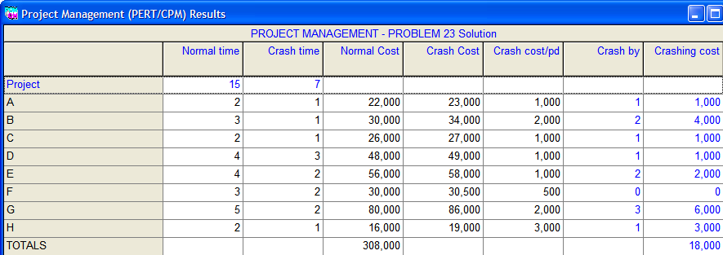
General Foundry - QM

Slide 63
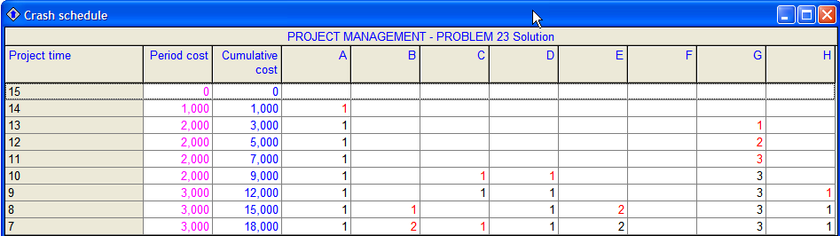
General Foundry - QM

Slide 64
Revised Path After Crashing
After crashing the project by 1 week, this is the new network
  Two critIcal paths
    A-C-E-G-H
    B-D-G-H
NODE | Time | ES | EF | LS | LF
A | 1 | 0 | 1 | 0 | 1
B | 3 | 0 | 3 | 0 | 3
C | 2 | 1 | 3 | 1 | 3
D | 4 | 3 | 7 | 3 | 7
E | 4 | 3 | 7 | 3 | 7
F | 3 | 3 | 6 | 9 | 12
G | 5 | 7 | 12 | 7 | 12
H | 2 | 12 | 14 | 12 | 14

Slide 65
Precedence Diagramming Method - PDM
Based on 4 fundamental relationships
  Finish-To-Start (FS)
    B can not start until A is completed (e.g., testing can not begin until coding is complete)
  Start-To-Start (SS)
    Two tasks can or must start at the same time; they don’t have to finish at the same time (parallel tasks)
  Finish-To-Finish (FF)
    Two tasks can start at different times and have different durations but must finish together
  Start-To-Finish (SF)
    Task A can not END until task B starts (e.g., nurse on night shift can not leave until day nurse arrives)

Slide 66
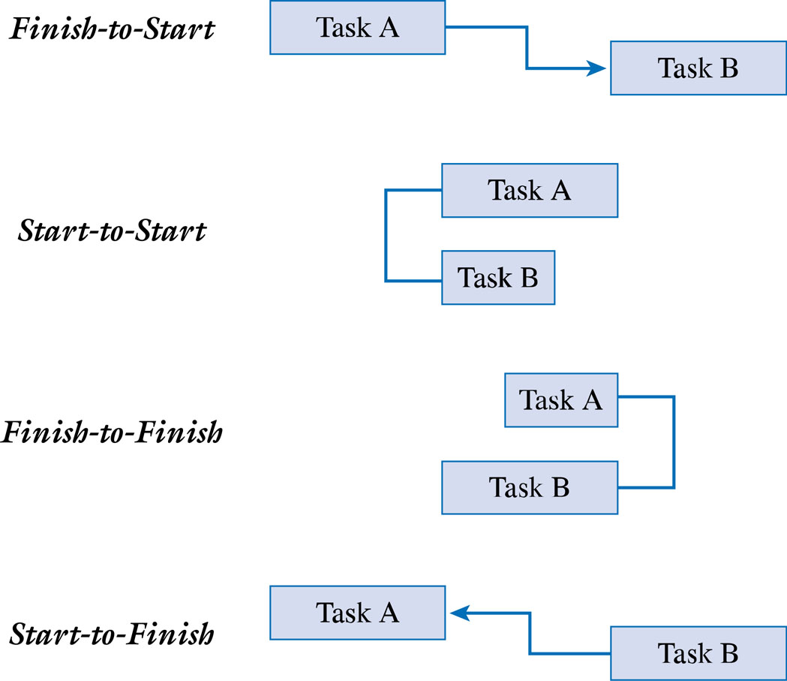
PDM Relationships
Task A can not finish until task B starts. Ex., nurse working midnight – 8AM shift can not leave until nurse from next shift arrives

Slide 67
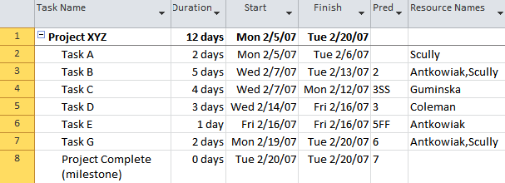
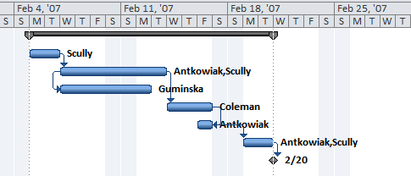
Project Budget Example
A & B - Start to Finish
B & C - Start to Start
D & E – Finish to Finish

Slide 68
Lead and Lag times
Lead is starting the next task before the first task is complete
    Example: Begin installing the operating systems when half of the PCs are set up
Lag (or negative lead) is the adding of a buffer of time before the next task begins
    Example: Once the walls have been painted, wait one day before laying the carpet so that the walls have had a chance to dry

Slide 69
Critical Chain Project Management (CCPM)
Introduced in 1997 in a book called Critical Chain by Eliyahu Goldratt (1947-2011)
Based on his previous work called the Theory of Constraints
  TOC is an overall management philosophy – takes into account that processes are exposed to risk because of the weakest person or part of the process can unfavorably affect the outcome of the process (bottleneck, unskillful resource)
CCPM is based on the idea that people often inflate or add cushioning to their estimates to create a form of “safety” to compensate for uncertainty or risk because …
  Your work is dependent upon the work of someone else, and you believe that starting your work will be delayed
  Your pessimism from previous experience where things did not go as planned
  Your belief that the project sponsor or customer will cut your project schedule or budget so you inflate your estimates to guard against this cut
  Youtube video - http://www.youtube.com/watch?v=BRMDCRPGYBE

Slide 70
Critical Chain Project Management
A constraint limits any system’s output.
The Goal – Goldratt
Originally proposed as a process for removing in bottlenecks from production processes
It also offers guidelines for project management in managing slack time and more efficiently employing project resources
Goldrattt raised the point in “The Goal” that the majority of poor effects within business operations stem from a very small number of causes
  Many of the problems we deal with are the result of a few core problems

Slide 71
Critical Chain Project Management
Any system must have a constraint; otherwise its output would increase without bound or got to zero
The key lies in identifying the most central constraint within the system

Slide 72
TOC Methodology
Identify the principal constraint
Exploit the constraint – view all activities in terms of this constraint
  Have only one advanced application programmer, the sequence of all project work to be done by the programmer has to be first scheduled across the organization’s entire portfolio of active projects
Subordinate the system
  Now schedule the rest of the project activities
Elevate the constrain
  Eliminate the constraint (acquire additional resources e.g., hire additional programmer)
Repeat the process since there’s always a system constraint – continuous improvement

Slide 73
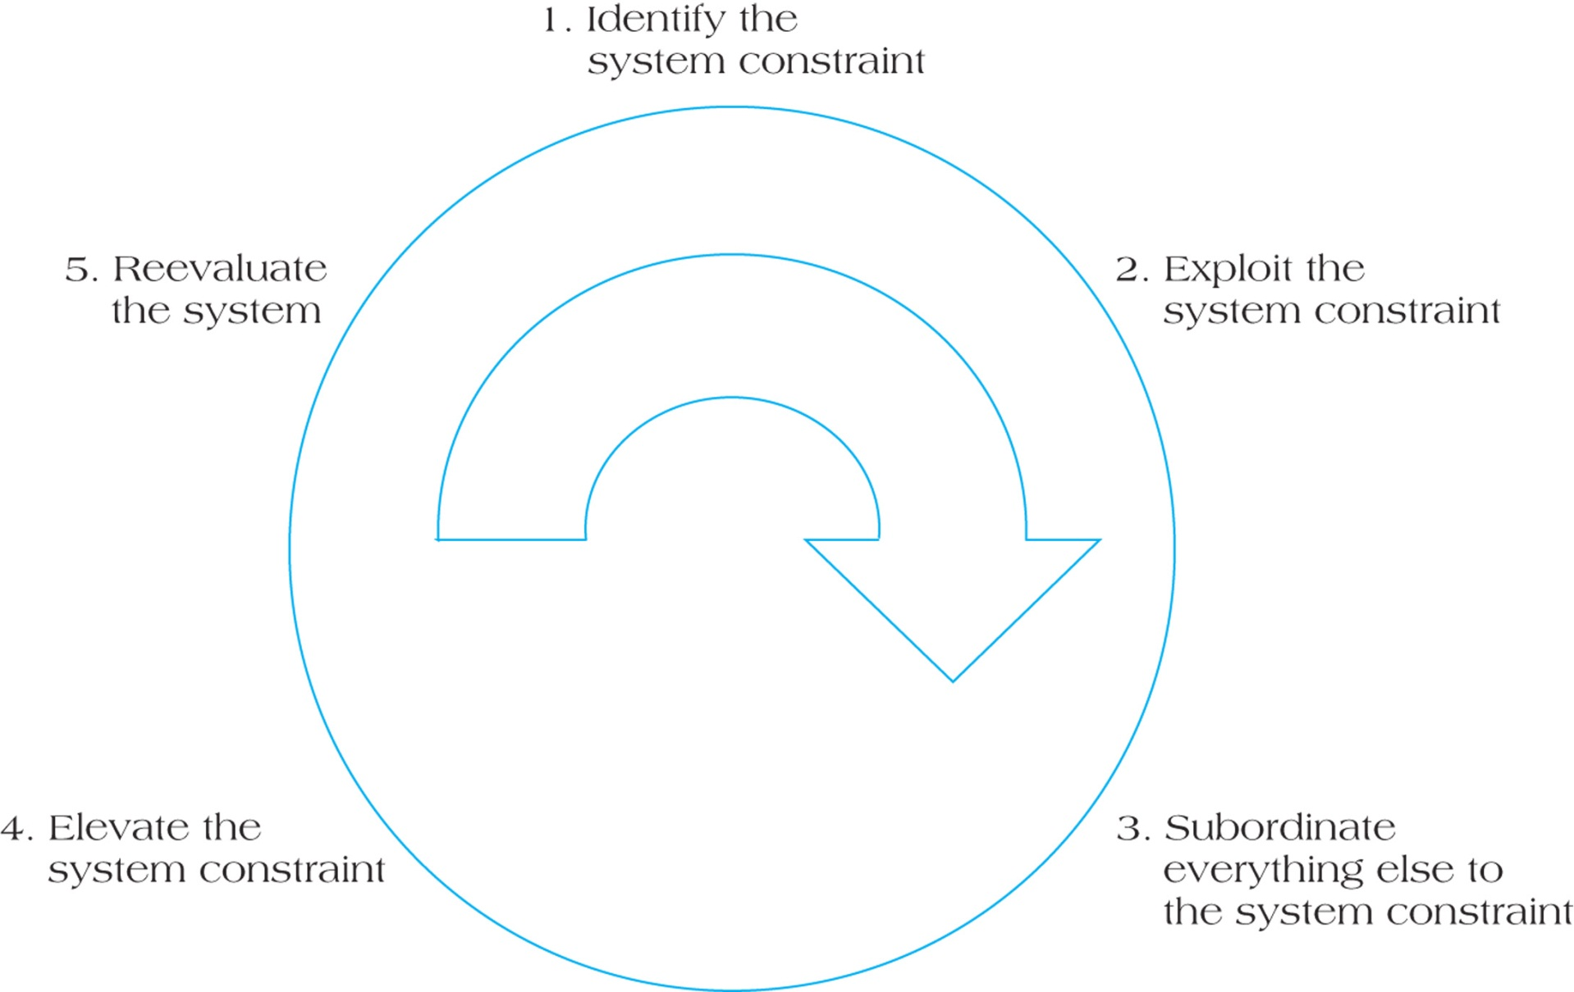
Five Key Steps in Theory of Constraint Methodology
Copyright © 2012 Pearson Education, Inc. Publishing as Prentice Hall

Slide 74
If people build safety into their estimates, then …
Why are projects still late?
  Student’s Syndrome or procrastinating until the last minute before starting to work on a task
  Parkinson’s Law or the idea that work expands to fill the time available
    People will rarely report finishing something early because there is little incentive to do so or because they may fear that management will cut their estimates next time
  Multitasking of resources or “resource contention”
    A person is often assigned to more than one project or required to attend meetings, training, etc. As a result, they can no longer devote their time to tasks that are on the critical path
  Path Merging

Slide 75
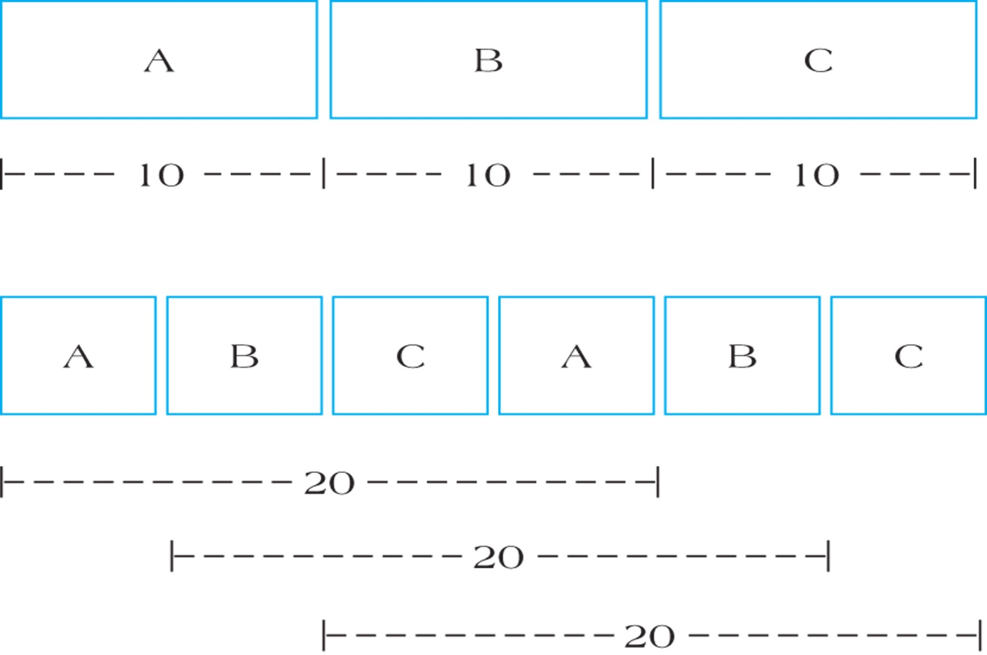
Effects of Multitasking on Activity Durations
FIGURE 11.7
Copyright © 2012 Pearson Education, Inc. Publishing as Prentice Hall

Slide 76
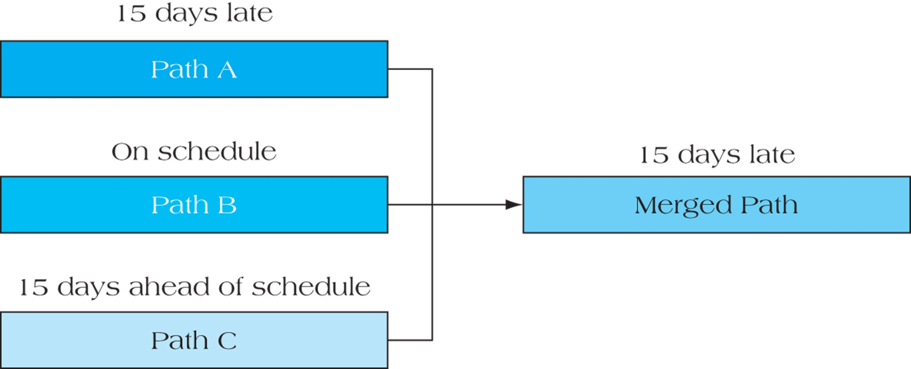
Effect of Merging Multiple Activity Paths
FIGURE 11.8
Copyright © 2012 Pearson Education, Inc. Publishing as Prentice Hall

Slide 77
CCPM Assumptions
Begins by asking each person or team working on a task to provide an estimate that would have a 50% chance of being completed as planned
  About half of the project tasks will be completed on time, about half won’t
Instead of adding safety to each task, put that safety in the form of buffers where it is needed most
  Feeding buffers
    Reduce the likelihood of bottlenecks by ensuring that critical tasks will start on time when a non-critical task acts as a feeder to another task on the critical path

Slide 78
CCPM Assumptions
  Resource buffers
    Reduce resource contention
    With task C on the critical path, it has the potential to become a bottleneck if the resource assigned to it must multitask on other projects
    CCPM takes a project portfolio view and suggests that other projects begin so that the resource needed for task C can be dedicated solely for that task
    CCPM proposes that a resource buffer be created so that the resource assigned to task C can be expected to complete the task with a 50% probability in 5 days
  End of Project buffers
    Are equal to one-half of the time saved from putting safety into each task

Slide 79
CCPM Changes
Due dates & milestones eliminated
Realistic estimates – 50% level not 90%
“No blame” culture
Subcontractor deliveries & work scheduled ES
Non critical activities scheduled LS
Factor the effects of resource contention
Critical chain usually not the critical path
Solve resource conflicts with minimal disruption

Slide 80
The Critical Chain Project Schedule

Slide 81
Critical Chain Project Management
And the critical path are similar
  The difference is the CCPM takes into account resource contention
Takes a more project portfolio view
  Other projects should be scheduled so that a resource can be dedicated to a particular task
Requires that everyone understand that each project task has a 50% chance of being completed as scheduled, so about half of the tasks will be late.
  This is the reason for having the project buffer.
  Instead of tracking each task individually, we become more concerned with the project buffer –i.e., the project will be late only if it uses more than the allotted project buffer.
Instead of penalties for being late, bonuses or other incentives for completing tasks early may be needed
TOC Illustrated

Slide 82
CCPM Critiques
No milestones used
Not significantly different from PERT
Unproven at the portfolio level
Anecdotal support only
Incomplete solution
Overestimation of activity duration padding
Cultural changes unattainable

Slide 83
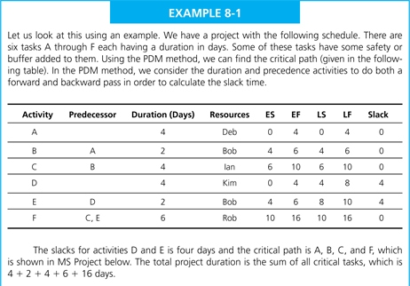
Critical Chain Project Management

Slide 84
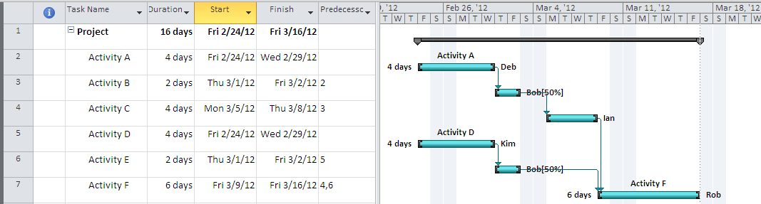
Critical Chain Project Management

Slide 85
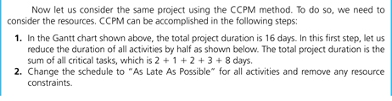
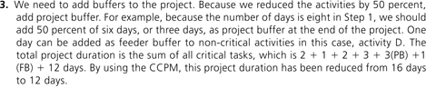
Critical Chain Project Management

Slide 86
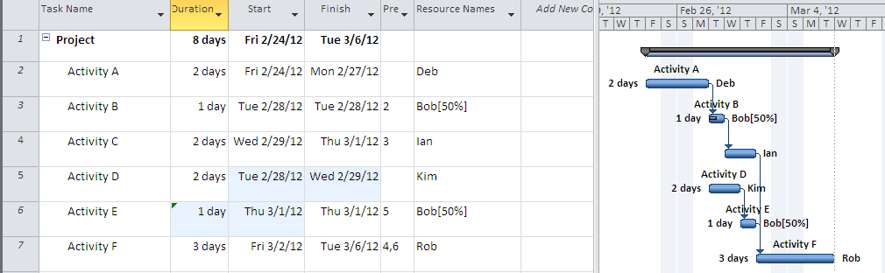
Critical Chain Project Management
Reduce time by 50%
8 days instead of 16

Slide 87
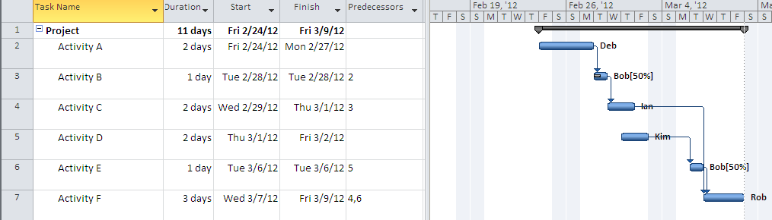
Critical Chain Project Management
As total time is 8 days add 50% to the project
  3 days as project buffer
  1 day to task D which is not on the critical path
  Total time is sum of critical tasks A+B+C+F+Project Buffer+Feeder Buffer = 2+1+2+3+3+1 = 12 days
  Notice Bob is no longer multitasking

Slide 88
Critical Chain Project Management

