Slide 1
Optical- Coherence Tomography
Candice Wills

Slide 2
Who Are the Founders of the Technology?
OCT was developed by the Research Laboratory of Electronics (RLE) Laser Medicine and Medical Imaging Group, along with Professor James G. Fujimoto and other close collaborators. These groups together with Massachusetts Institute of Technology’s Lincoln Laboratory and the New England Eye Center came up with “a clinical prototype OCT” in 1991. (NAS)

Slide 3
What is Optical- Coherence Tomography?
Optical- Coherence Tomography (OCT) is a technology that enables medical personnel to visually interpret what is inside of a tissue specimen without having to dissect it. It can be compared to the x-ray of an examined body part.
OCT uses a process called interferometery which involves interfering with light waves to determine “wavelength, spectral fine structure, indices of infraction, and very small linear displacements;” each of which play a role in arriving at the intended image as a result of the lights reflection upon them. (Merriam-Webster) This is what contributes to the recreated image that is produced by the technology.

Slide 4
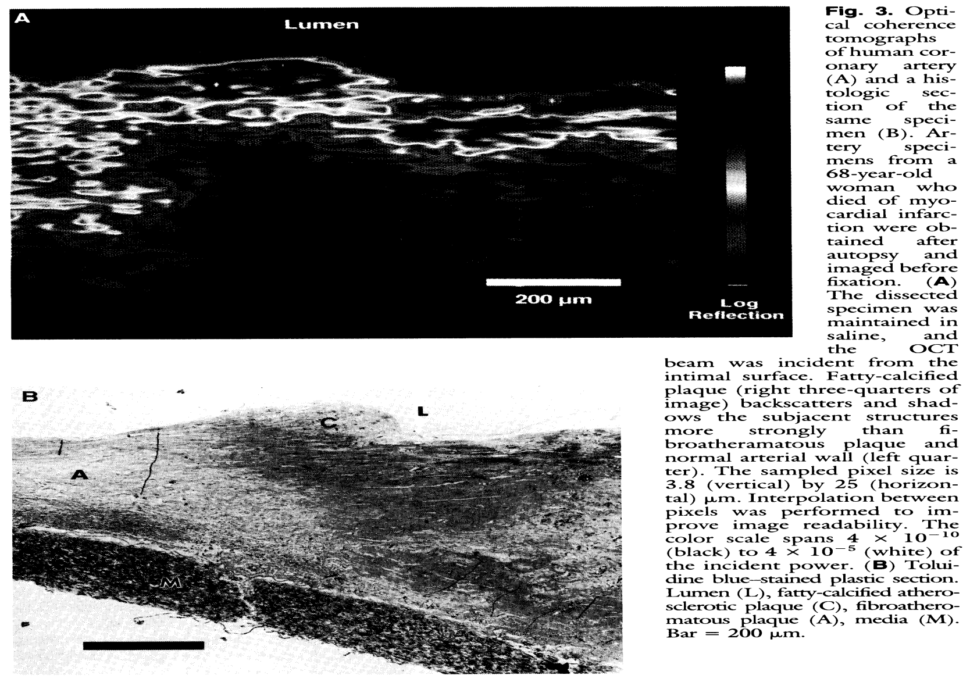
Here we see the image produced using Optical Coherence Tomography (A) compared to the same artery that was dissected and viewed under the microscope (B). It is safe to say that the images have apparent similarities reinforcing the notion that OCT is an alternative to histology.
The image shows an artery of the heart of a sixty- eight year old woman who died from a myocardial infarction, in other words a heart attack. There was plaque build up on the artery and it can clearly be seen by the image produced by the OCT.

Slide 5
How does OCT Work?
OCT includes a process called interferometery which involves interfering with light waves to determine “wavelength, spectral fine structure, indices of infraction, and very small linear displacements;” each of which play a role in arriving at the intended image as a result of the lights reflection upon them. (Merriam-Webster)
Light diffuses through the skin and bounces off the tissue structures it encounters.
The light then reflects onto a reference mirror. It then transmits that information to a computer enabling the computer to recreate the image using light and dark colors.

Slide 6
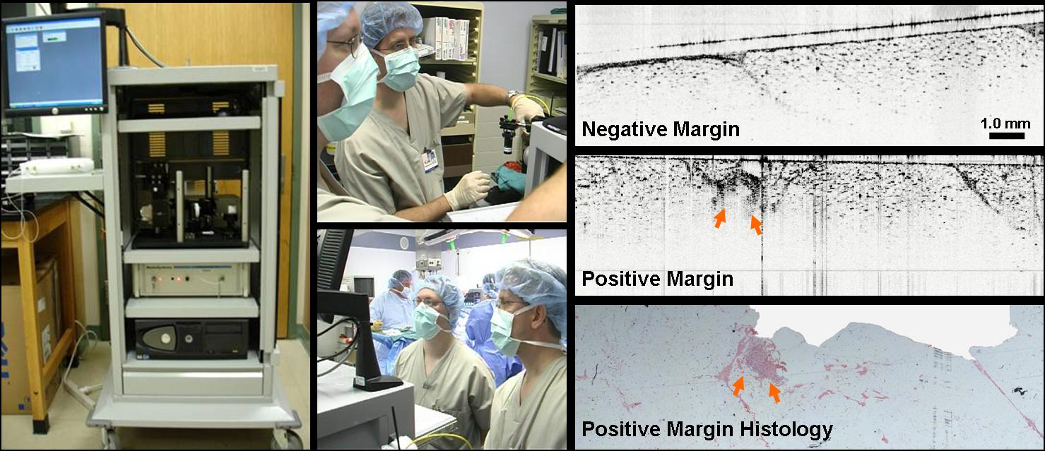
Uses for OCT
OCT is most commonly used in medicine to examine the eye and tissue structures. It viewed as an alternative to histology because the specimen does not have to be dissected, or in the case of the eye be removed for examination.
In the image above, surgeons are using optical coherence tomography to examine a patient’s breast tissue which has been extracted as a result of cancer cells that accumulated in the tissue. On the right, the top image retrieved through the use of OCT shows no sign of cancer cells. From the OCT image in the middle cancer cells can be seen and are depicted by the red arrows. The image at the bottom shows a pathology slide which coincides with the OCT image exhibiting the presence of cancer in the tissue again using the red arrows.

Slide 7
OCT’s Market Performance
In 1996 the first commercial OCT product entered the ophthalmic market.
There is a decent amount of competitionin the industry, and in order to protect their technology from being imitated one manufacturer of the technology, Carl Zeiss Meditec, continuously creates new and efficient products.
The company also won a Frost & Sullivan award for their extraordinary work in the industry and their commitment to producing the leading market product.
When it comes to the performance S-curve OCT has not yet reached maturity, and I don’t foresee it leveling off any time soon. This is because Optical Coherence Tomography is presently still in the improvement phase on the S-curve. Companies continue to come up with new ways to improve the technology, whether it be in imaging quality or maybe at some point a greater tissue penetration depth.
It has come a long way from its origination in 1991 to now and still continues to evolve. There has been the shift in imaging quality, and even the leap from two to three- dimensional pictures and video.

Slide 8
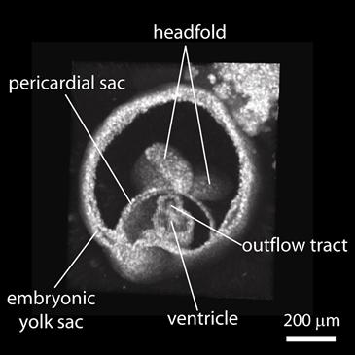
How Far Has OCT Come?
3D Image and Video of the Embryonic Heartbeat using OCT
Credit: Kirill Larin- Technology Review
The image below was captured from an OCT three- dimensional video of a mouse embryo. From the video and this picture one can observe the “pericardial sac [which] is the structure surrounding the heart; the ventricle [which] is one of the heart's chambers; the outflow tract [which] is the structure from which blood will flow into the arteries and then on to the rest of the body.” (Bourzac) Because the heart of a mouse is much like that of humans, medical personnel will be able to study its development as a result of the advancement in OCT technology. From that, they will be able to discover the origin of many ailments and potentially even arrive at cures. It will be beneficial both for study and for treatment.
Link to OCT video:
http://link.brightcove.com/services/player/bcpid263777539?bctid=45765043001

