Slide 1
Emerging User Interface Technologies
By: Soheeb Amin
Notes:
Hello. My presentation today is about the emerging technologies in the world of user interfaces.

Slide 2
What are User Interfaces?
A user interface is the connector between man and the technology he is using.
They consist of an input, which is our command to the interface, and an output, which is the result of our command.
The type of interface is determined by the method of input.
Notes:
User interface: For example, a keyboard which is used by our fingers to type is a user interface.
Type of interface: meaning the way we communicate is the input. So again, a keyboard is an input device, and the output is whatever comes on the screen as a result of the using of the keyboard.

Slide 3
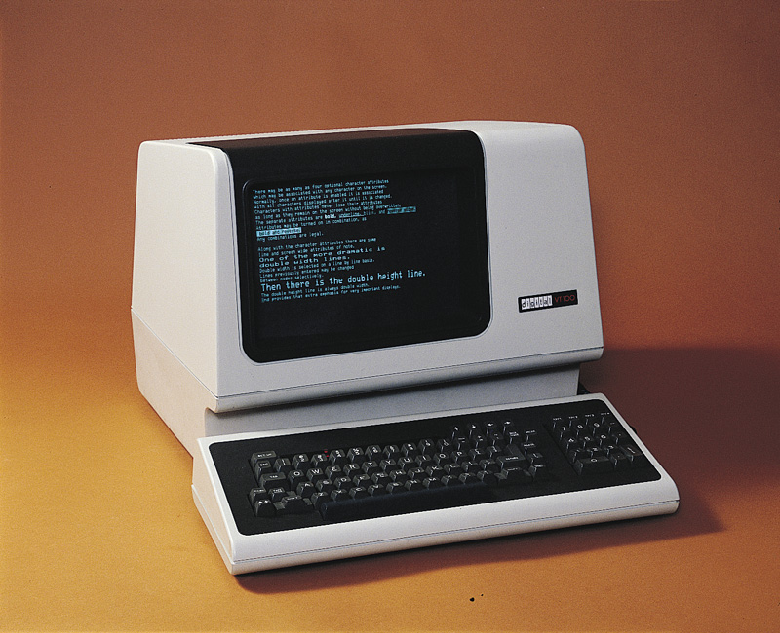
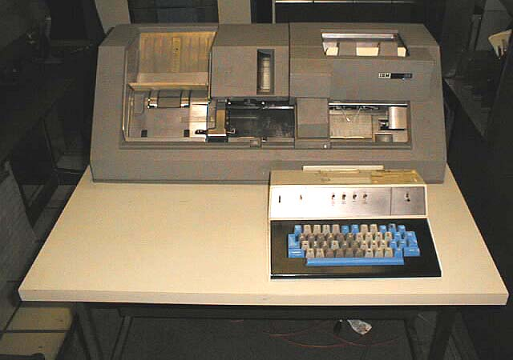
What did interfacing begin with?
Batch computing
Command-line
Notes:
These are the output results of interfacing:
Batch computing was the first machine interface, and was used by punch card typing
Command line interface was the usage of text on a software screen.

Slide 4
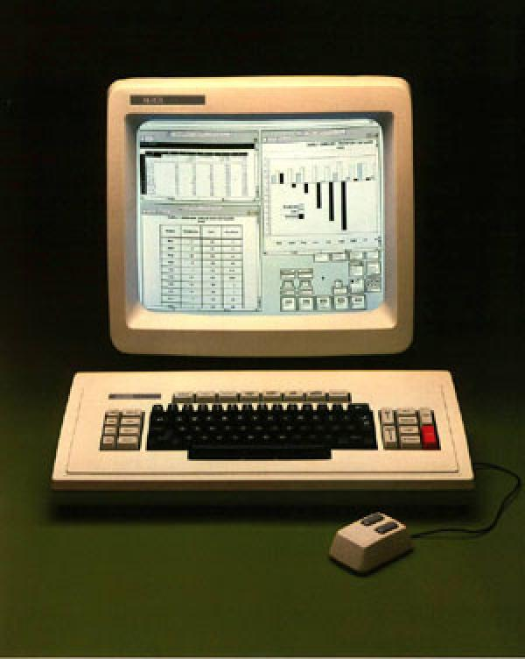
Graphic User Interface
The dawn of the modern day computer
Used graphics and images over plain text
Notes:
It is the interface of everything involving graphics. This interface began with the usage of radar systems and continued to develop until we have the technologies we have today.

Slide 5
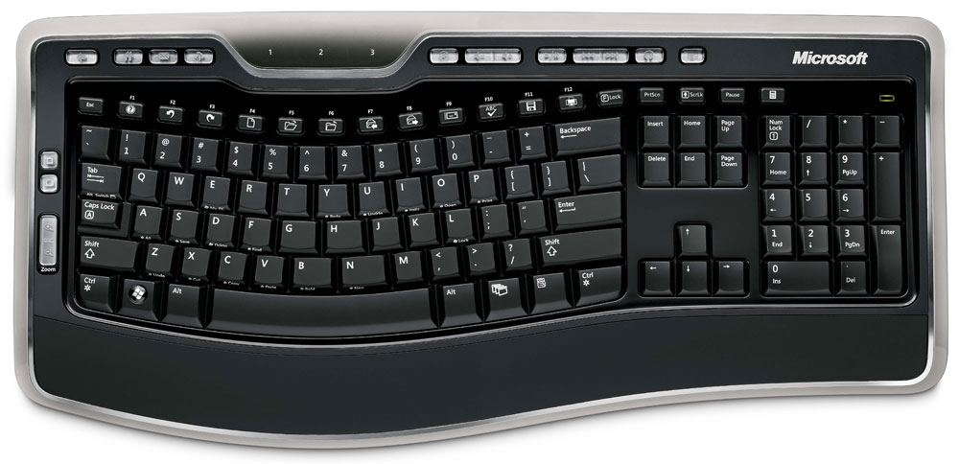
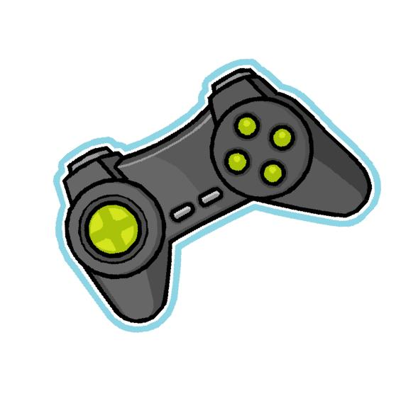
How do we input the output?
The most basic way is the pressing of buttons, like phones, keyboards, game controllers, etc.
Notes:
Now that we have reached the phase where everything is GUI as the output, what are the ways of inputting?

Slide 6

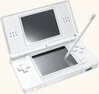
How do we input the output?
Other more modern methods are the usage of touch-screens.
Another, less common method is sound recognition.
Notes:
Touch screens, though not very popular in the past, have become part of the basic design of most hand-held electronics.
Sound recognition is still avoided due to the lack of proper recognition by most computers.
The Nintendo DS even has games in which one must blow in the mic to, for eample, blow out a candle in a game. That is a new interface. It is a new way of interacting with the game.

Slide 7
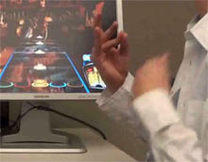
Emerging methods of interfacing
One rising way of interfacing with technology is through muscle controlled interfaces.
Notes:
The way it works is a band of electrodes attaches to a one’s forearm and read electrical activity from different arm muscles. These signals are then correlated to specific hand gestures, such as touching a finger and thumb together, or gripping an object tighter than normal, and can then interact with, say for example a computer, in doing a command using that motion
The idea is using this technology could allow us to control objects that have the right sensors on them to be controlled from a distance.

Slide 8
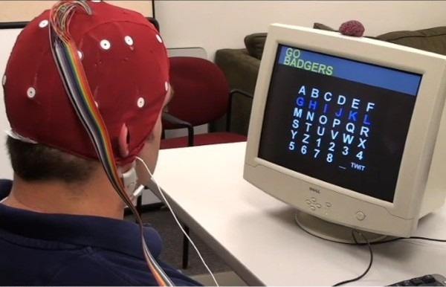
The future of interfacing
Mind Controlled interfacing has actually already been achieved.
Notes:
This technology could enable amputees to move bionic limbs, or even allow those who are paralyzed to experience movement again. In fact, there already exists cases in which this technology has enabled people who suffer from paralysis to community just with their minds.
The University of Pittsburg was successfully able to connect a robotic arm to a monkey’s brain by implanting a chip in the monkey’s head. Within days, the monkey was able to move the arm for tasks as if it was his own.

Slide 9
Pros of New Interfaces
Convenient new ways to interact with technology.
For the disabled, allows them to interface with technology and even their own bodies.
Great way to keep technology entertaining
Notes:
With the breakthrough of so many new interfaces with so many different objects within the last decade, it is not too far-fetched of an idea to say that we are redefining how the human being interacts with the world he has made home since his existence.
If there is someone who has no senses at all, with the advancement of brain interfaces, his thoughts could still be conveyed to the world, and maybe we could convey messages back.

Slide 10
Cons of New Interfaces
Limited ideas.
Risks in experiments.
Still underdeveloped.
Notes:
How many different ways can we even do a task? Our hands are what we use and the interfaces we have developed.
Its not very safe to implant a chip in a person’s brain.
Though we have been progressing in the field, there is still much work to be done.

Slide 11
THE END
Thanks for veiwing

