Slide 1
Home Automation

Slide 2
Imagination comes to LIFE
Everything At home is computerized
Circuits are all connected to computers
Computer is set to individuals needs(different programs)

Slide 3
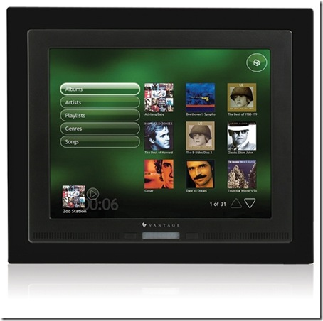
Home
Wires are set along through out house.
Computers are set and control different parts of the house.
House is wired through for complete customization. (Scene MR. Mrs. Smith 29 :18)

Slide 4

Morning
Alarm could be set for any specific time and blinds and music can be set for a personal touch
Bath is set a specific time
House set to specific temp
While in shower your are told the News of your choice
Breakfast is made and placed at a table as soon as you get to the eating area.(casper)

Slide 5
Clothes
Clothes can be selected pertaining to weather and style needs
No more miss matching
Steam ironed daily

Slide 6
Midday
Kids? (food is prepared for them)
Program could be set for kids(I.E. TV after HW)
Home cleaned by the use of dirt trackers

Slide 7
Miscellaneous
Laundry area that automatically cleans clothes
Speakers running through house (talk to someone in another room)
TVs in mirror screen
Pet care

Slide 8
Night
Dinner is prepared from a menu of choice(Computer could be taught different recipes)

Slide 9

Security
Peace of mind
24/7 monitoring
(Kohler,

Slide 10

Tweaks
Solar panels can be placed on roof top
Lights can set to turn off when not in use.
Phone calls can be made through video sharing.
Rooms can be changed to make need of other things.
Notes:
http://www.youtube.com/watch?v=g-PKEid1Y6E&feature=related

Slide 11
Pros
Ease of life
Safety
Spend time on more important things
Home up keep will be less expensive and simpler.

Slide 12
Cons
Expensive
Specific designed homes will take longer to be constructed.
Job loss.

