Slide 1
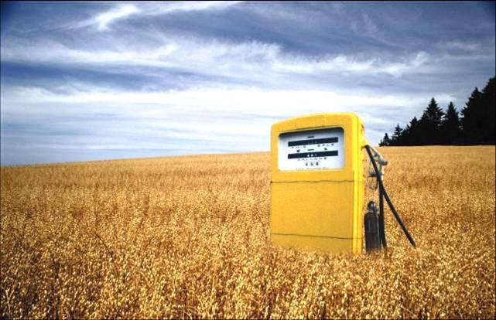
BIOFUELS
KEY TO A BETTER FUTURE?

Slide 2
WHAT ARE BIOFUELS?
Biofuels are produced from living organisms or from metabolic by-products (organic or food waste products). In order to be considered a biofuel the fuel must contain over 80 percent renewable materials. It is originally derived from the photosynthesis process and can therefore often be referred to as a solar energy source.

Slide 3
two most common types of biofuels
BIODIESEL
BIOETHANOL
is made from vegetable oils, animal fats or recycled greases. Biodiesel can be used as a fuel for vehicles in its pure form, but it is usually used as a diesel additive to reduce levels of particulates, carbon monoxide, and hydrocarbons from diesel-powered vehicles. Biodiesel is produced from oils or fats using transesterification and is the most common biofuel in Europe.
is an alcohol made by fermenting the sugar components of plant materials and it is made mostly from sugar and starch crops. Ethanol is usually used as a gasoline additive to increase octane and improve vehicle emissions. Bioethanol is widely used in Brazil and in the USA.

Slide 4
The biodiesel cycle

Slide 5
The bioethanol cycle

Slide 6
Crops used to produce biofuels
Sugar crops:
Including sugar cane, sugar beets, and sweet sorghum

Slide 7
Crops used to produce biofuels
STARCH CROPS :
Including corn, wheat, barley, cassava, and milo

Slide 8
Crops used to produce biofuels
OILSEED CROPS:
Including rapeseed , canola, soybean , sunflower, and mustard

Slide 9
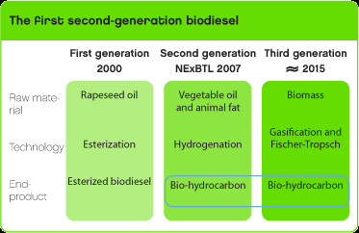

Slide 10
The Pros of biofuel
For one, since such fuels are derived from agricultural crops, they are inherently renewable--and our own farmers typically produce them domestically, reducing our dependence on unstable foreign sources of oil. Additionally, ethanol and biodiesel emit less particulate pollution than traditional petroleum-based gasoline and diesel fuels. They also do not contribute to global warming, since they only emit back to the environment the carbon dioxide (CO2) that their source plants absorbed out of the atmosphere in the first place.

Slide 11
the cons of biofuel
Biofuels are easily utilize but not readily accessible.
Biofuels are renewable but crops are still not enough.
Biofuels uses more energy than they can produce
As an alternative to this “traditional” diesel or gasoline fuel, it is expected to yield significant energy security and environmental advantage to its consumers.

Slide 12
Biodiesel producing nations

Slide 13
bioethanol producing nations

Slide 14
biofuel companies looking outside the box
Arizona Biodiesel, makes B99 biodisel from waste restaurant grease. Its CEO,Dan Rees, believes the biofuels industry was founded to be local and use local waste materials. He believes biodiesel should use local resources to benefit the local economy and benefit the local environment.
Amereco Biofuels Corp. was developed to meet the standards for soy diesel. Its plant is geared for 15 million gallons a year. All its products are made from recycled ingredients.

Slide 15
biofuel companies looking outside the box con.
Algae Biosciences, part of the Northern Arizona Center for Emerging Technologies, produces algae in contaminant-free salt water aquifers near Holbrook, AZ, where there's a pristine salt water aquifer from a long-dried up sea!. The company is producing a wide range of products, of which algae-based biodiesel is a byproduct.

Slide 16
Where the debate of biofuels stands today
for
against

Slide 17
Where the debate of biofuels stands today
for
against
Notes:
Although much progress has been made into the production and use of biofuels the world is still debating the long term effects and usage.

Slide 18
The end
THANK YOU

