Slide 1
Database Systems: Design, Implementation, and Management Tenth Edition
Chapter 5
Advanced Data Modeling

Slide 2
Entity Integrity: Selecting Primary Keys
Primary key is the most important characteristic of an entity
Single attribute or some combination of attributes
Primary keys and foreign keys work together to implement relationships
Properly selecting primary key has direct bearing on efficiency and effectiveness

Slide 3
Natural Keys and Primary Keys
Natural key is a real-world identifier used to uniquely identify real-world objects
Familiar to end users and forms part of their day-to-day business vocabulary
Generally, data modeler uses natural identifier as primary key of entity being modeled
May instead use composite primary key or surrogate key
Surrogate key - a PK created to simplify the identification of entity instances
Has no meaning, exists only to distinguish one entity from another (e.g., Autonumber)

Slide 4
Primary Key Guidelines
Attribute that uniquely identifies entity instances in an entity set
Could also be combination of attributes
Main function is to uniquely identify an entity instance or row within a table
Guarantee entity integrity, not to “describe” the entity
Primary keys and foreign keys implement relationships among entities
Behind the scenes, hidden from user

Slide 5
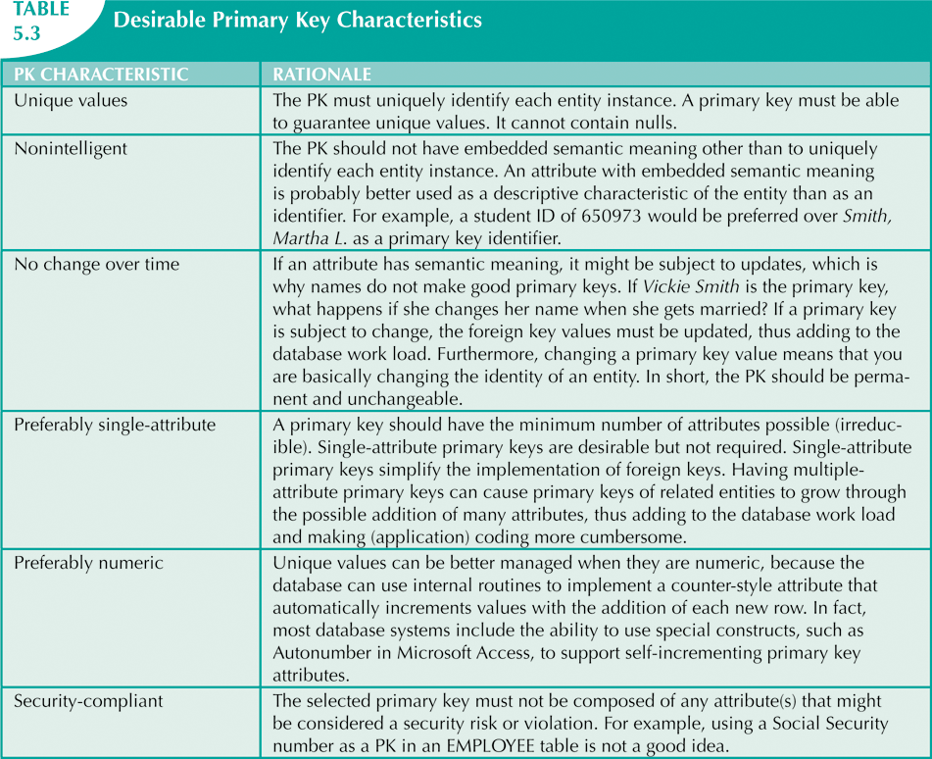

Slide 6
When to Use Composite Primary Keys
Composite primary keys useful in two cases:
As identifiers of composite entities
In which each primary key combination is allowed once in M:N relationship
As identifiers of weak entities
In which weak entity has a strong identifying relationship with the parent entity
Automatically provides benefit of ensuring that there cannot be duplicate values

Slide 7
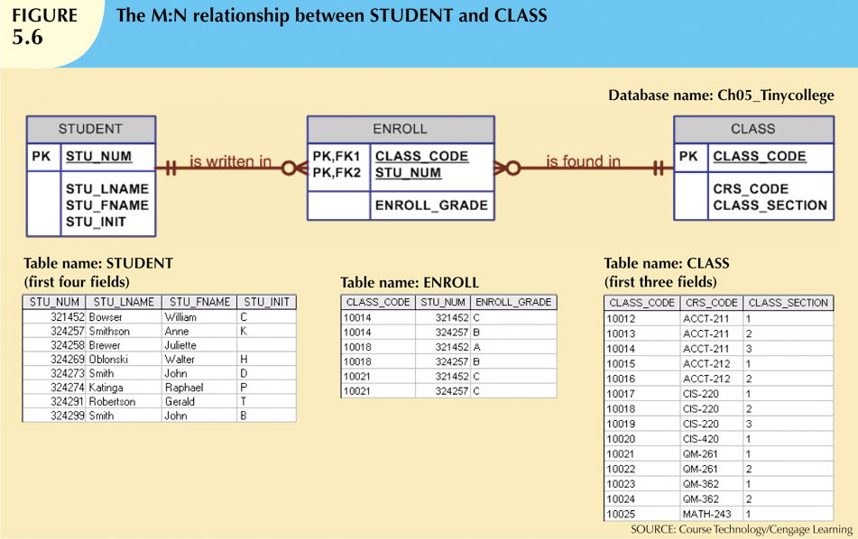
Composite PK of ENROLL ensures a student can not register for the same class twice

Slide 8
When to Use Composite Primary Keys
When used as identifiers of weak entities normally used to represent:
Real-world object that is existent-dependent on another real-world object
Real-world object that is represented in data model as two separate entities in strong identifying relationship
Dependent entity exists only when it is related to parent entity
EMPLOYEE and DEPENDENT – latter uses a composite PK containing employee id
LINE exists only as part of INVOICE

Slide 9
When To Use Surrogate Primary Keys
Especially helpful when there is:
No natural key
Selected candidate key has embedded semantic contents
Selected candidate key is too long or cumbersome

Slide 10
When To Use Surrogate Primary Keys
If you use surrogate key:
Ensure that candidate key of entity in question performs properly
Use “unique index” and “not null” constraints

Slide 11
When To Use Surrogate Primary Keys
A catering hall has a number of rooms it rents for small parties
What should be the PK? DATE,TIME_START,ROOM
What if, in addition to the room, additional equipment were to be used from the RESOUCE table
Composite key for linking table would be DATE,TIME_START,ROOM, RSC_ID
Quite lengthy
If that became FK in another entity, it would be quite complex to maintain
Instead use numeric, single attribute surrogate key

Slide 12
Design Cases: Learning Flexible Database Design
Data modeling and design requires skills acquired through experience
Experience acquired through practice
Four special design cases that highlight:
Importance of flexible design
Proper identification of primary keys
Placement of foreign keys

Slide 13
Design Case 1: Implementing 1:1 Relationships
Foreign keys work with primary keys to properly implement relationships in relational model
Put primary key of the “one” side on the “many” side as foreign key
Primary key: parent entity
Foreign key: dependent entity

Slide 14
Design Case 1: Implementing 1:1 Relationships
In 1:1 relationship, there are two options:
Place a foreign key in both entities (not recommended)
Place a foreign key in one of the entities
Primary key of one of the two entities appears as foreign key of other

Slide 15
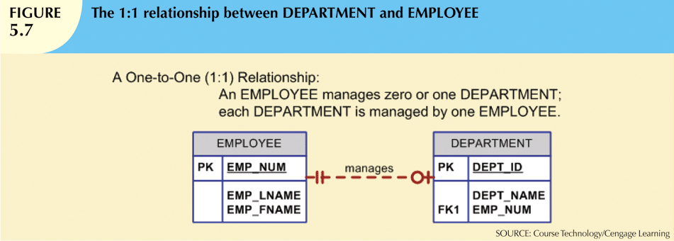

Slide 16
Design Case 2: Maintaining History of Time-Variant Data
Normally, existing attribute values are replaced with new value without regard to previous value
Time-variant data:
Values change over time
Must keep a history of data changes
Keeping history of time-variant data equivalent to having a multivalued attribute in your entity
Must create new entity in 1:M relationships with original entity
New entity contains new value, date of change

Slide 17
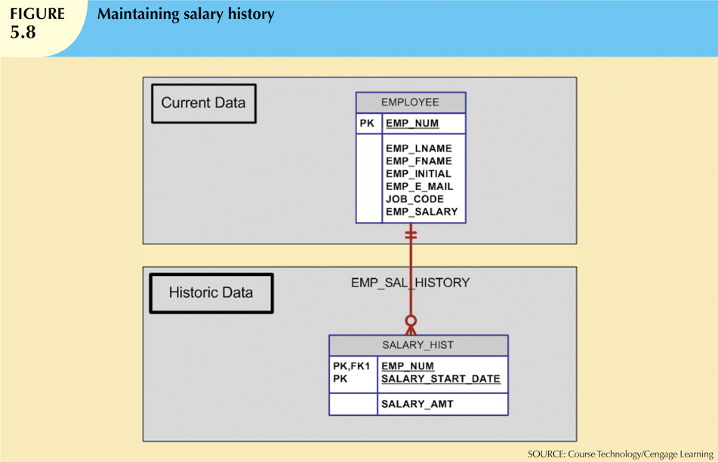

Slide 19
Design Case 3: Fan Traps
Design trap occurs when relationship is improperly or incompletely identified
Represented in a way not consistent with the real world
Most common design trap is known as fan trap
Fan trap occurs when one entity is in two 1:M relationships to other entities
Produces an association among other entities not expressed in the model

Slide 20
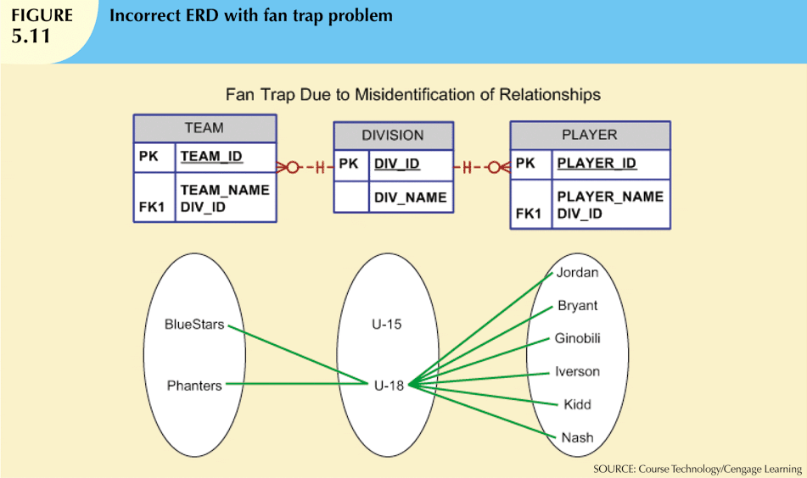

Slide 21
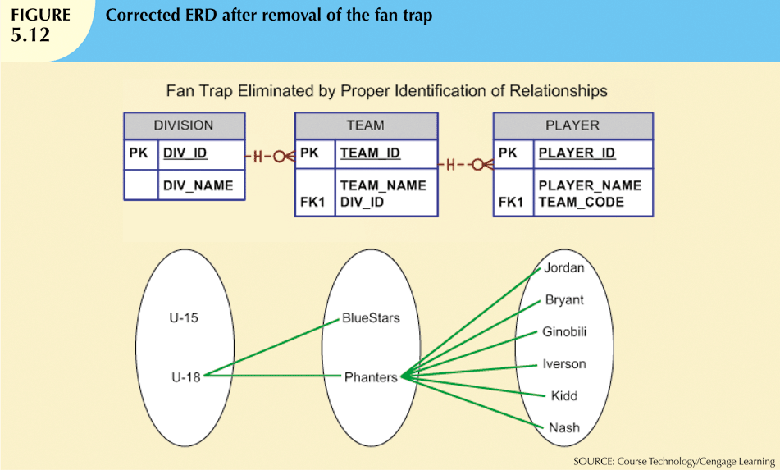

Slide 22
Design Case 4: Redundant Relationships
Redundancy is seldom a good thing in database environment
Occurs when there are multiple relationship paths between related entities
Main concern is that redundant relationships remain consistent across model
Some designs use redundant relationships to simplify the design
In the following example, the relationship between DIVISION and PLAYER is not needed as all information can be obtained through TEAM

Slide 25
Portion of Tiny College ERD

Slide 26
Tiny College - New Requirement
Tiny College wants to keep track of the history of all administrative appointments (date of appointment and date of termination).
The Tiny College chancellor may want to know how many deans worked in the College of Business between January 1, 1960 and January 1, 2010 or who the dean of the College of Education was in 1990. Given that information, create the complete ERD containing all primary keys, foreign keys, and main attributes.

Slide 27
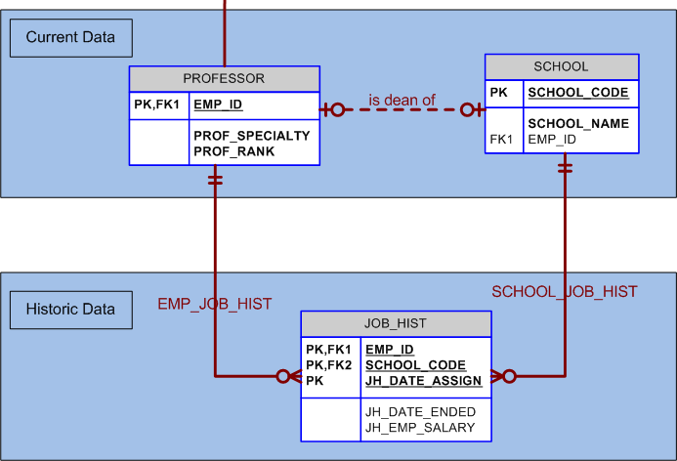
Tiny College ERD

