Slide 1
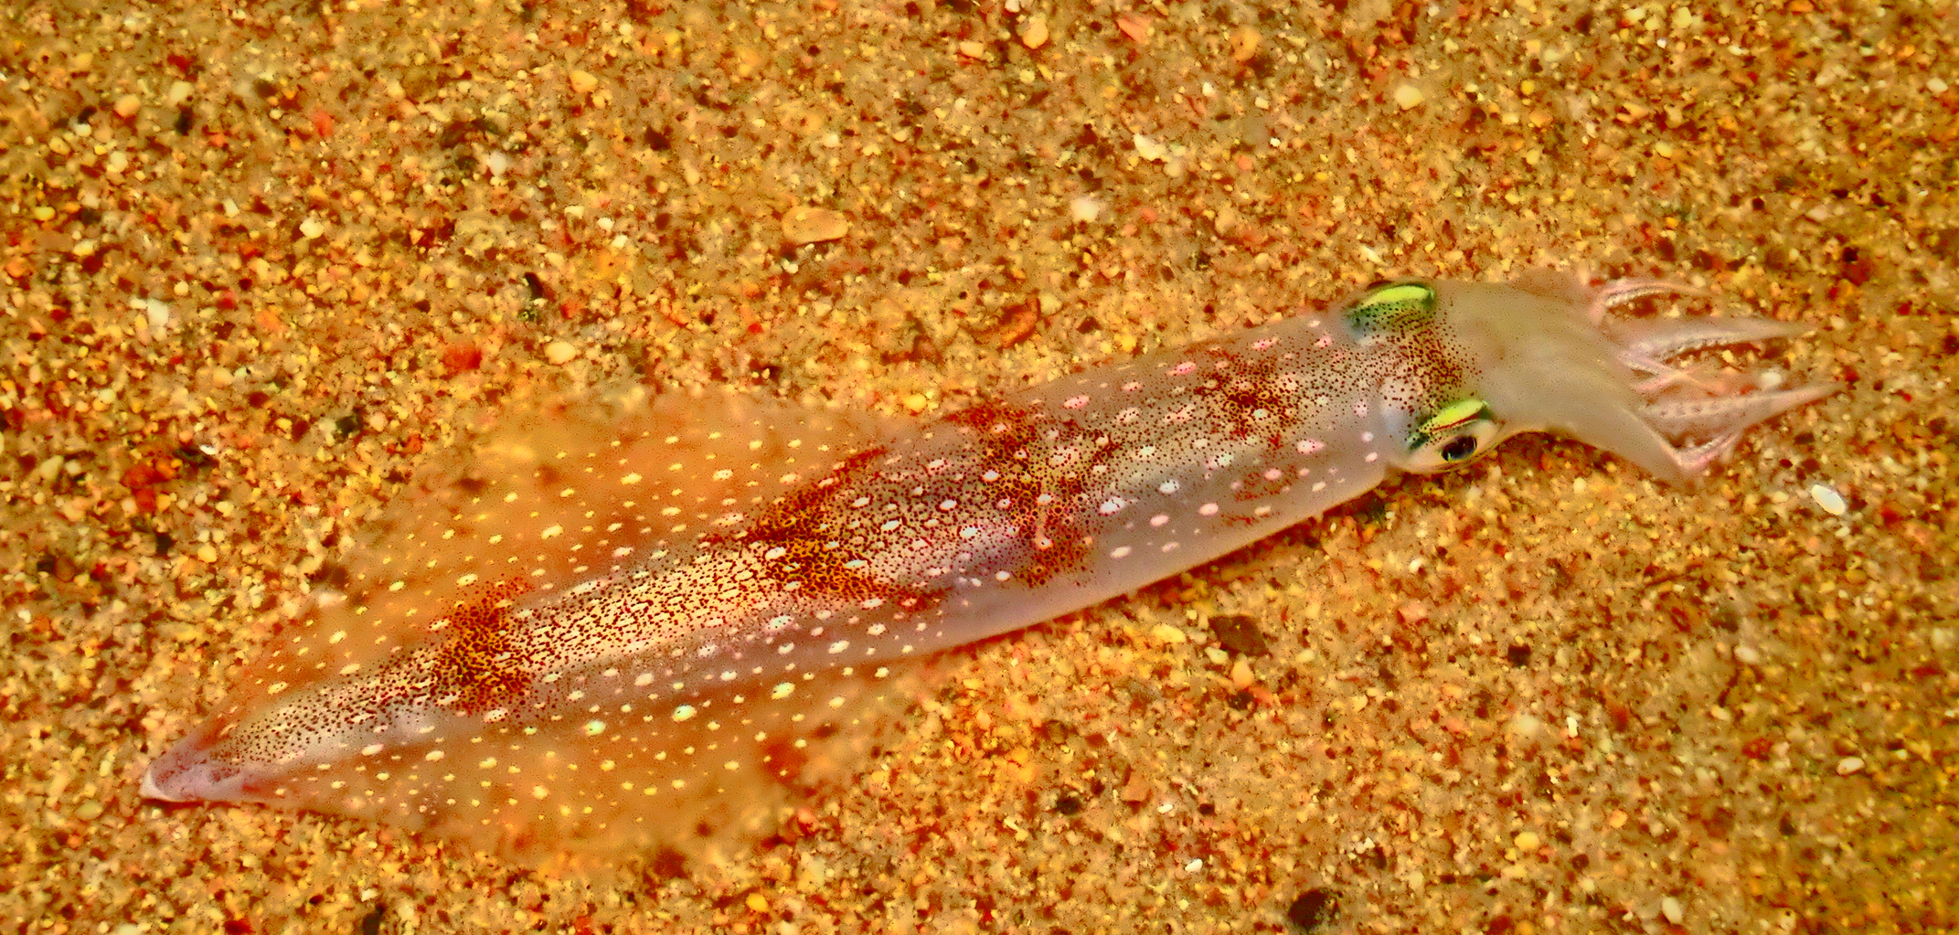
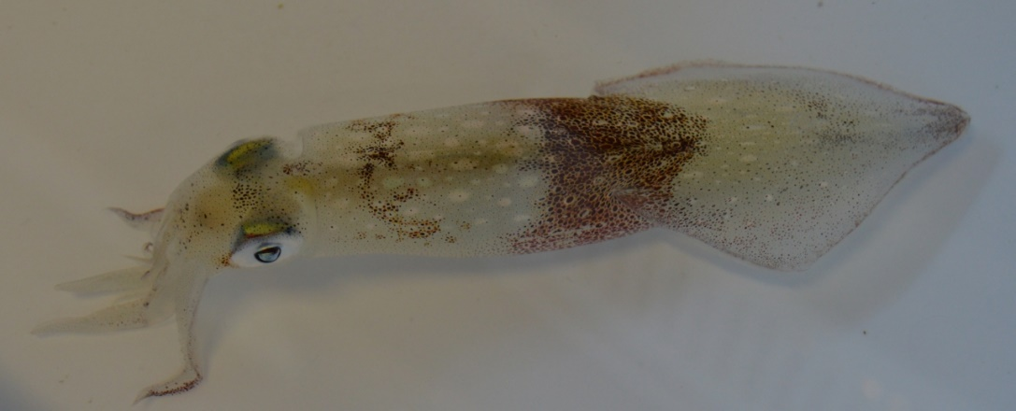
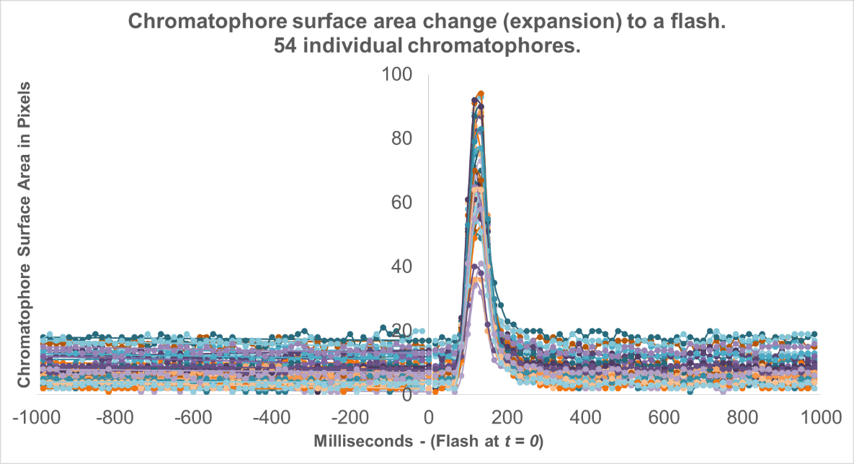
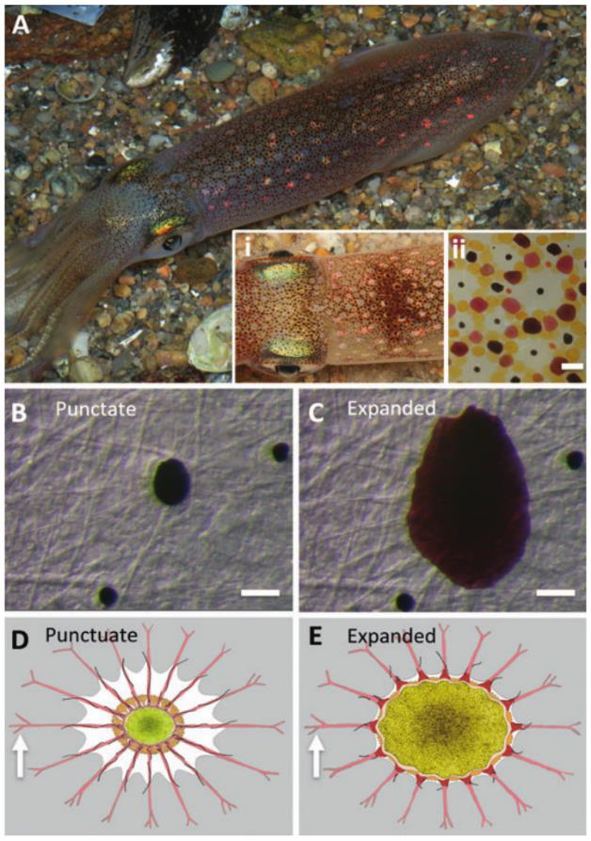
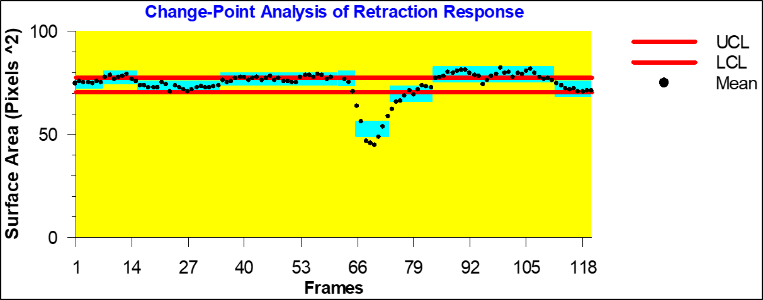
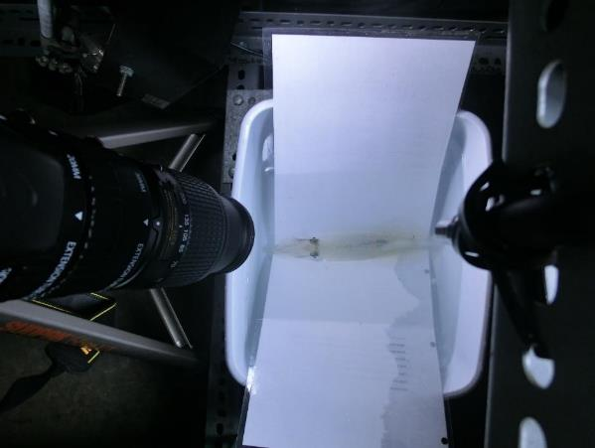
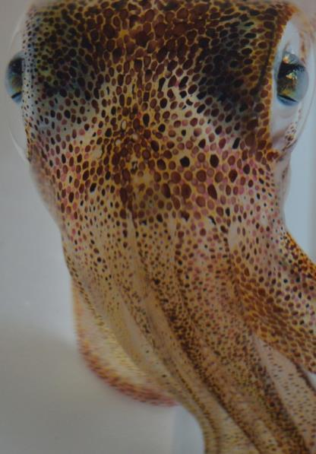
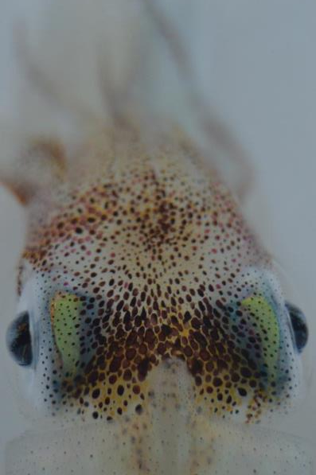
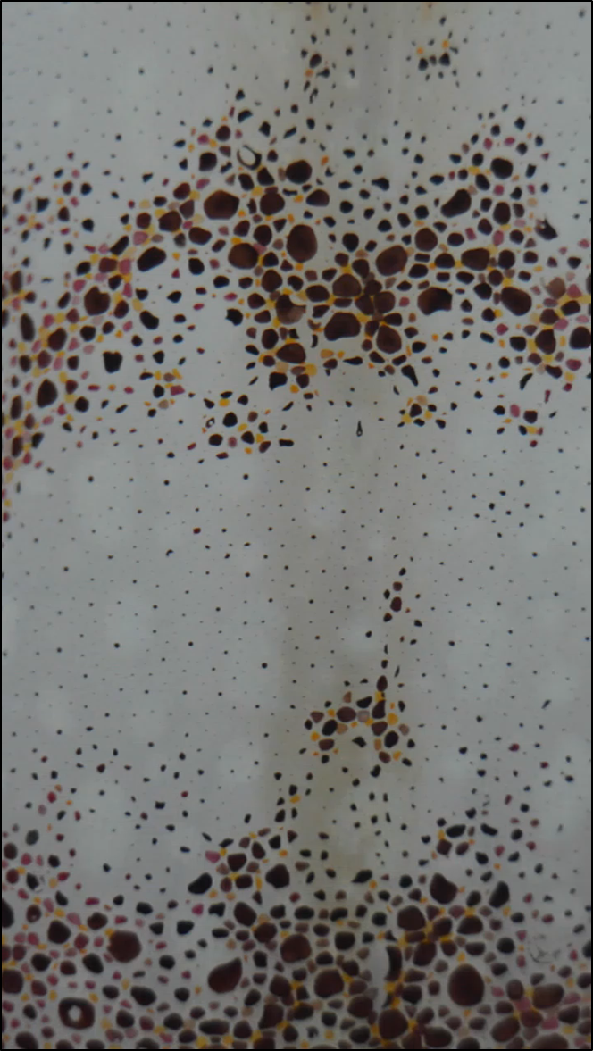
Timing rapid body patterning in cephalopods: using intact, living squid to measure the speed of chromatophore coordination in response to a visual stimulus
*STAVROS HADJISOLOMOU¹, KAMIL KLOSKOWSKI², ALLA CHAVARGA², RITA EL-HADDAD³, ISRAEL ABRAMOV²
¹Social and Behavioral Sciences, American University of Kuwait; ²Psychology, Brooklyn College of the City University of New York; ³Fawzia Sultan Healthcare Network, Kuwait
INTRODUCTION
METHODS (cont.)
RESULTS
DISCUSSION
The coleoid cephalopods are masters of rapid, adaptive body patterning for high-fidelity camouflage or communication. This is achieved through a coordination between intradermal pigmented organs (chromatophores), and broad band reflectors (iridophores).
While the anatomical arrangement of the neuro-muscular components of chromatophores and the sensory contributions of the visual system has been studied extensively, a description of the information processing of the chromatophore control system is still unknown.
Our main objective in this study was to establish the mathematical parameters (latency, speed and duration) of chromatophore control at the single organ level by video-recording a close-up perspective of the skin and using a light flash stimulus to elicit body pattern changes.
Data Scoring and Analysis:
SpotMetrics: Image Analysis Plugin to automate detection, tracking and measurement of chromatophores over time.
Change Point Analysis: Detects significant surface area changes of individual chromatophores.
Only tracked chromatophores having significant expansion or retraction (~4600 chromatophores overall).
Our results here indicate differences between the scale of chromatophore surface area changes during expansion or retraction.
An explanation for this phenomenon: chromatophore expansion and retraction depend on two different mechanisms; during expansion, the surrounding radial muscles pull and expand the pigment while during retraction, the same muscles relax causing the pigment to shrink in size due to elasticity effects from tethering.
These findings highlight the importance in understanding the mechanisms of chromatophore retraction since it is an important part of the chromatophore system.
Additional differences were found when analyzing chromatophores from the different body areas of 1) Head and Arms, 2) Mantle and 3) Fin. Out of the three regions, the mantle, head, and arms showed the biggest surface area expansions with 168% and 159% corresponding changes. The fin had 116% increases on average. It is not clear why there would be differences of close to 50% between the fin and the rest of the areas. However, it is worth considering the role of these three different body areas when it comes to camouflage. The arms, head, and mantle make up the biggest part of the body’s surface area.
Speed:
Between body parts, the chromatophores on head and arms are the fastest, followed by the fin at second place and mantle at the end.
Considering the minute differences between the body parts in the magnitude of response, it is surprising that the chromatophores on head and arms are ~33 ms earlier than those on the mantle.
The time difference may not be explained due to response magnitude since these two body parts are almost identical.
This temporal difference may be explained by the differences in the circuitry of chromatophores on head and arms (anterior chromatophore lobe) compared to those of the mantle (posterior chromatophore lobe).
Such parameters will help contribute to our understanding of how sensor and motor systems coordinate to generate appropriate coloration in cephalopods.
SENSORY INPUT
(VISUAL - EXTRAOCULAR)
INFORMATION PROCESSING
(CNS)
(Bell et al., 2013)
MOTOR OUTPUT
(EFFECTORS)
METHODS
Sample Size:
Six Squid (Doryteuthis pealeii, Lesueur, 1821)
Variables:
Startle stimulus: light flashes, inter-stimulus interval of 10 seconds
Startle Response: chromatophore surface area changes
Chromatophore expansion and retraction on different body regions. Light Flash presentation at 0.
Surface area normalized by pre-flash average; 1 = pre-flash average surface area.
Temporal Dynamics of Responses:
Latency (point of 5% initial change in surface area)
Duration: to Max Response
Duration: 5% change a) before, and, b) after peak.
Results presented here indicate both chromatophore expansion and retraction as direct results of the flash of light. While our results match those of previous studies showing chromatophore expansion, our studies are the first demonstration of a chromatophore retraction as a response to a flash stimulus, in any cephalopod species studied so far.

