Slide 1
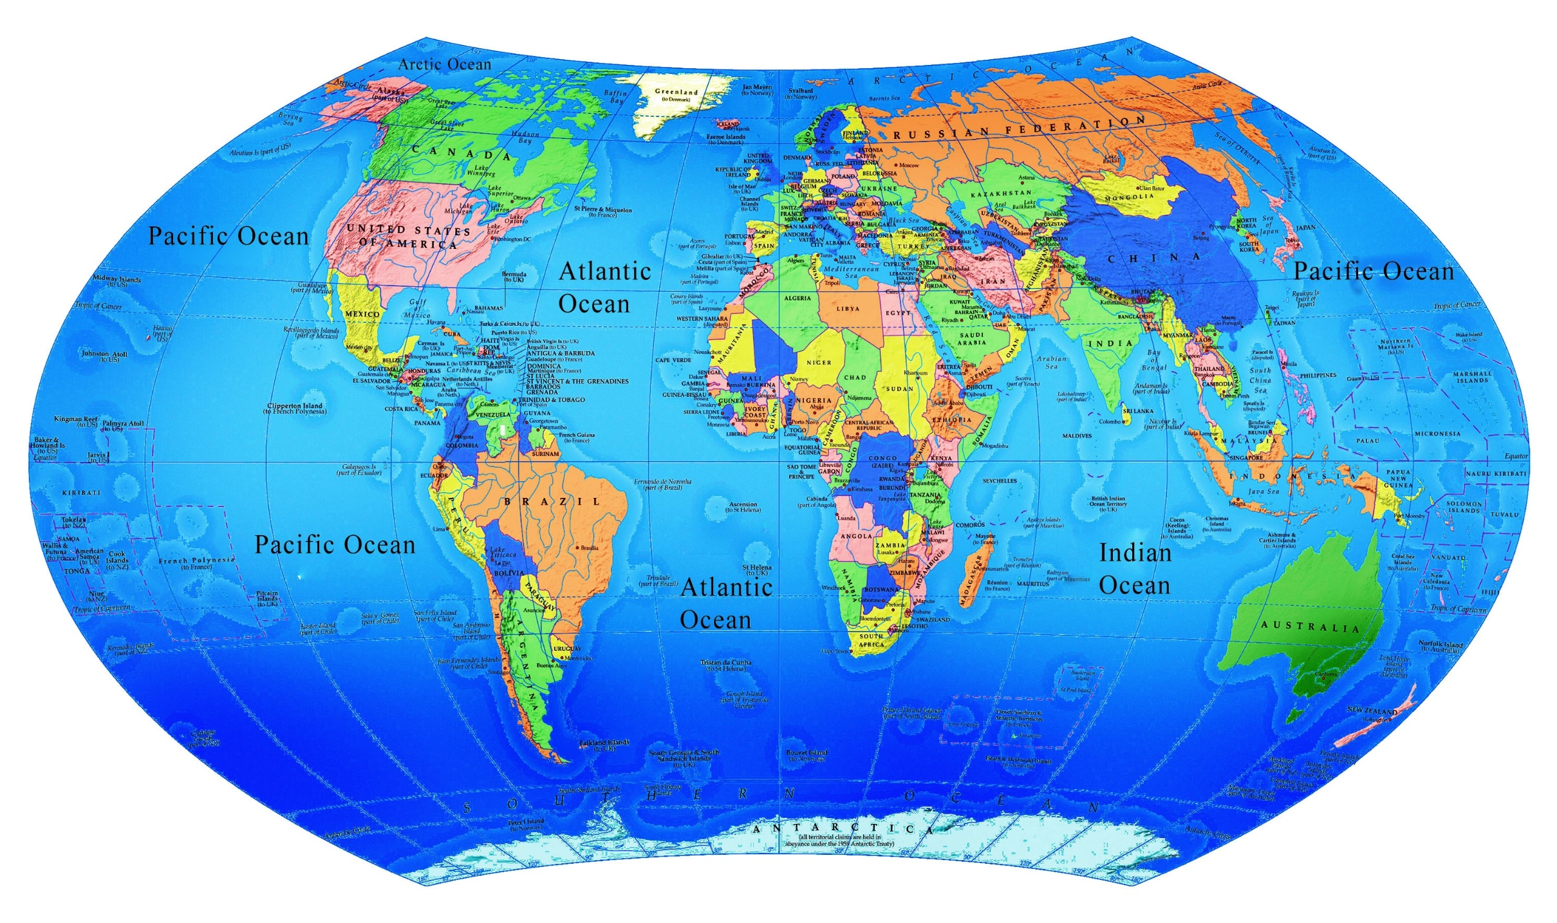
Notes:
There is only one ocean, although it is divided into the Atlantic, Pacific, Indian, and Arctic Oceans in this map

Slide 2
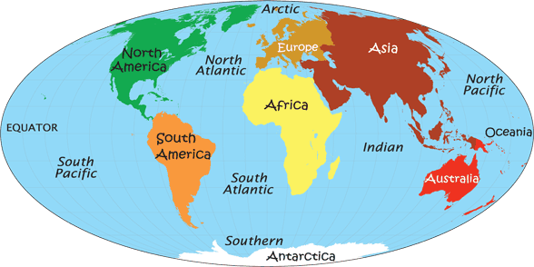
Notes:
However some people add a “Southern Ocean” and split the Atlantic and Pacific into a Northern and Southern part. So the 4 “oceans” have now become 7. This is nice because we like to talk about the “Seven Seas”. A sea is really something different than an ocean. It is usually a part of an ocean that is surround quite a bit by land. There is one Sea called the Sargasso Sea which has NO land around it, but is part of the Atlantic Ocean. The different “oceans” (or parts of the one ocean) have some things going on in them which make them somewhat unlike other parts of the oceans. You might think of them as “countries” which are on the same land mass. The seven are like “countries” on the same water mass!

Slide 3
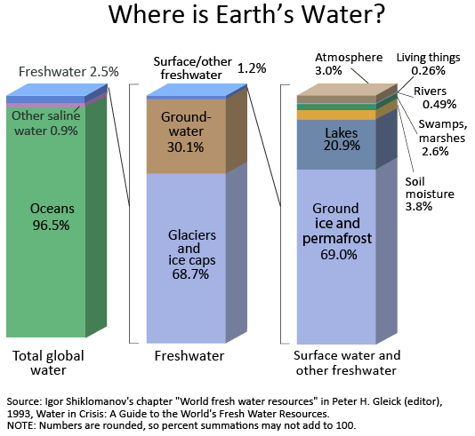
Notes:
This diagram shows the distribution of the waters on the earth. Some is salt water and some is fresh water. No water is 100% fresh in natural environments. While we talk about “salt water”. The term “salt” is used loosely here. It means not only the calcium chloride (salt) but many other minerals that are found in the “salt” water.

Slide 4
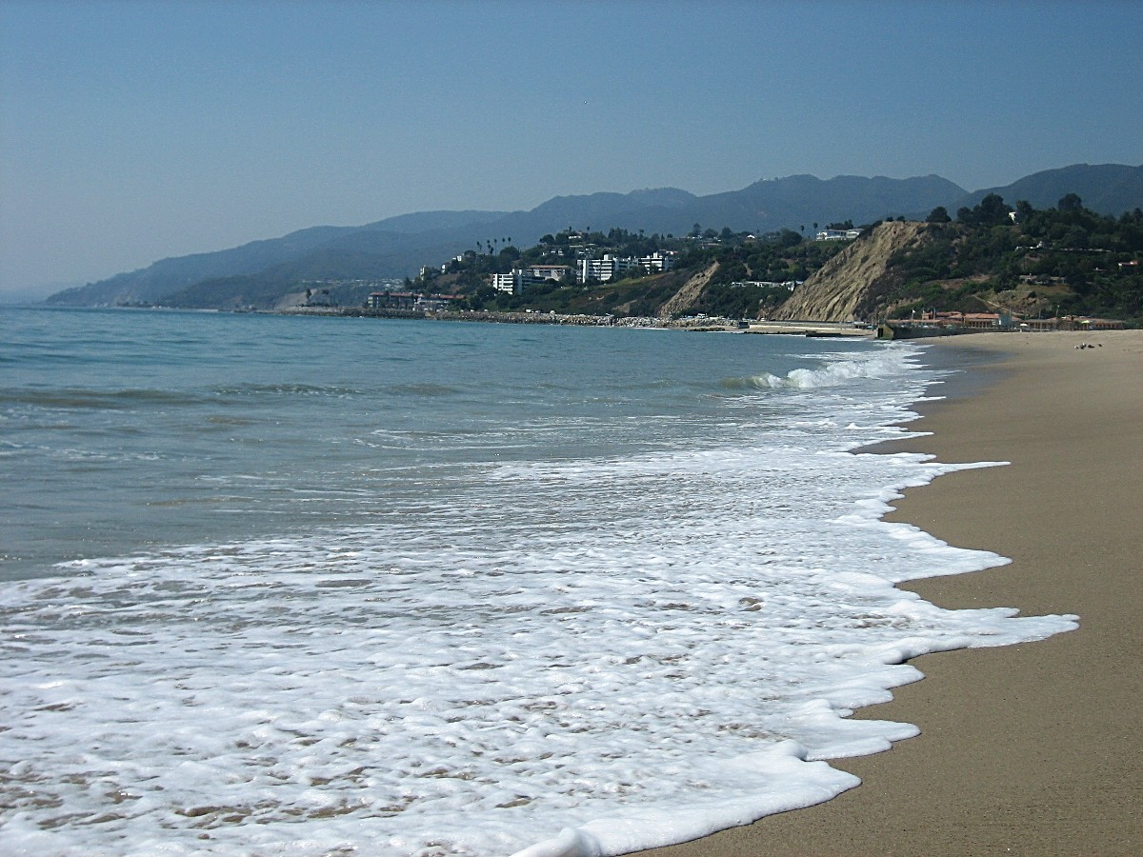
Notes:
This is a nice sunny, empty, clean beach which is what people often think of when they think of a beach

Slide 5
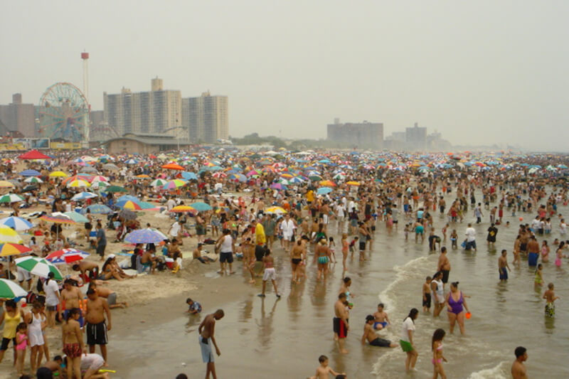
Notes:
This is the reality. A zillion people on a hot day jamming the beach and………

Slide 6
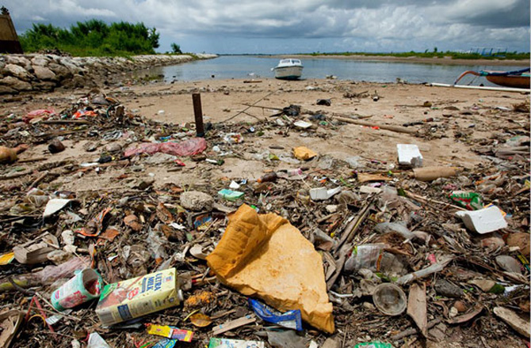
Notes:
Leaving this kind of mess behind. Much of this washes up on the shore and was not left on the beach by people. They just threw it in the water in many cases and it finished up here.

Slide 7
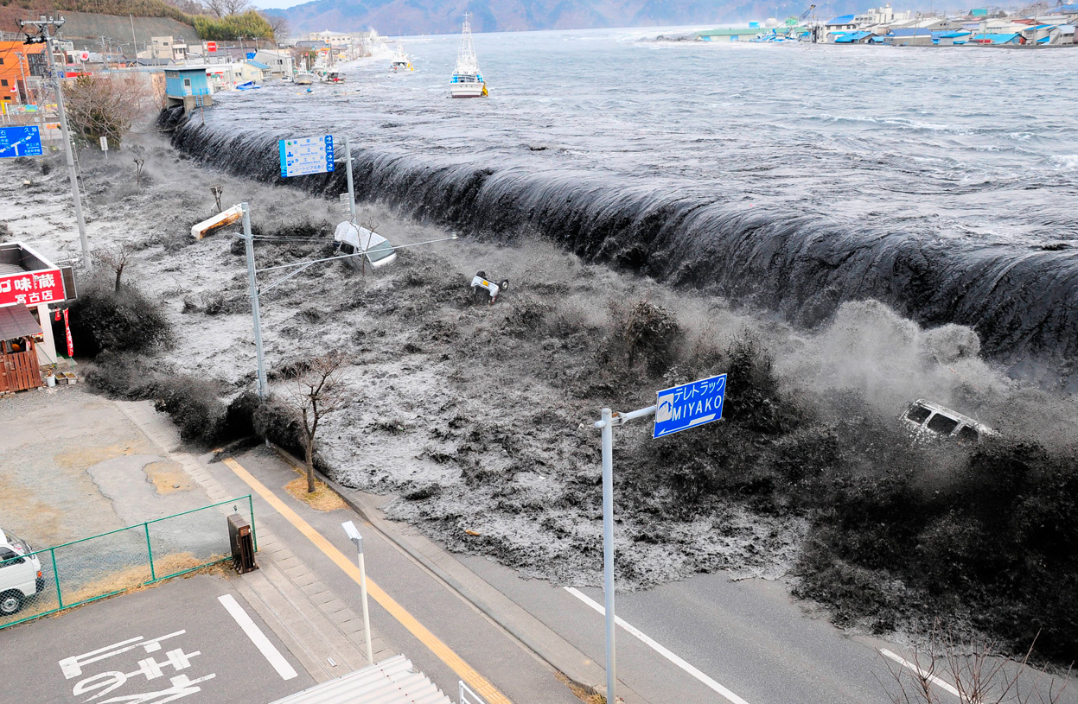
Notes:
The shore of course is prone to disasters like this “tsunami” (Japanese for a “harbor wave”). This is the water pouring over a wall from the harbor. It is from the Fukushima earthquake and tsunami that hit Japan on March 11, 2011

Slide 8
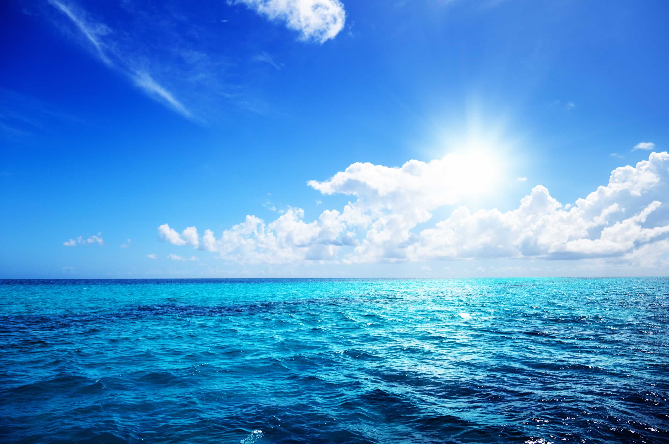
Notes:
We might like to think of the ocean as peaceful and restful….

Slide 9
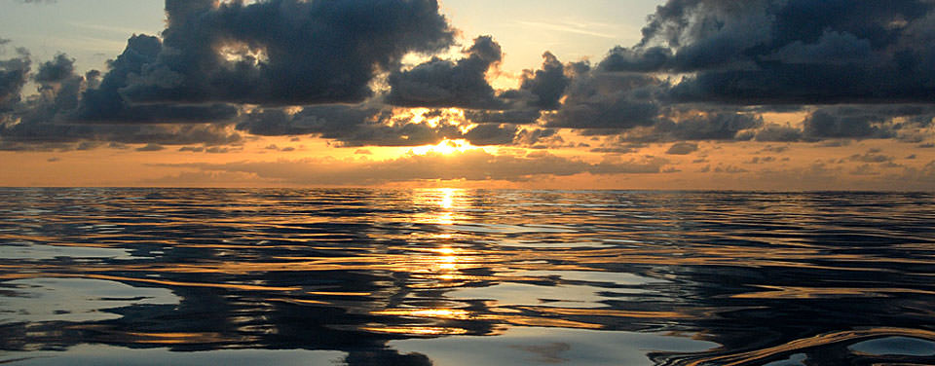
Notes:
Especially at sunset or sun rise.

Slide 10
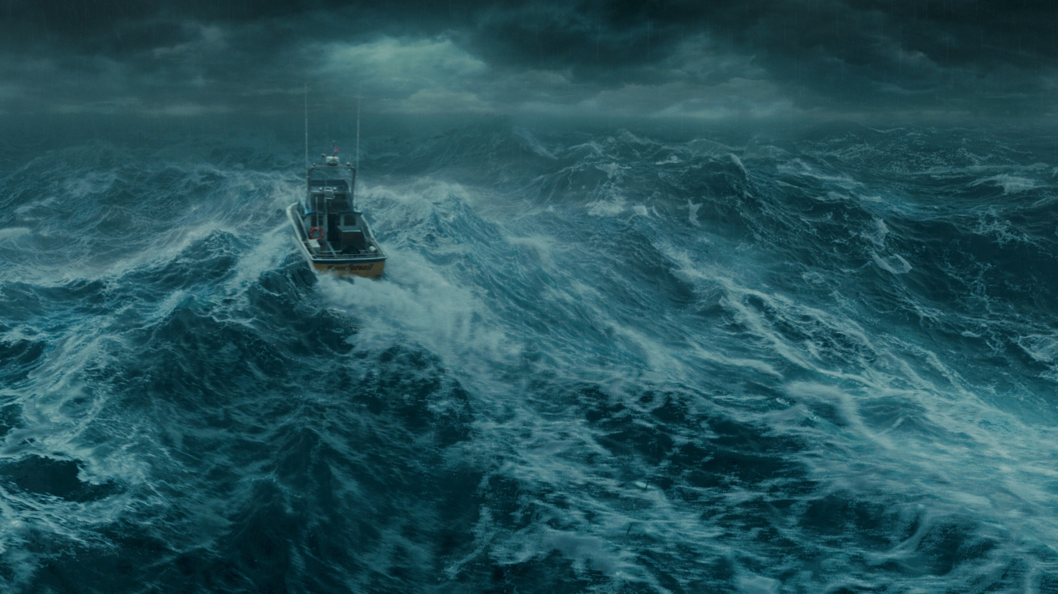
Notes:
But the truth is that the ocean can be extremely dangerous with huge waves, strong currents and severe storms.

Slide 11
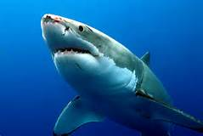
Notes:
Aside from the surface, there are many animals and plants in the water, some of which can be extremely dangerous to people. This shark can deliver a vicious bite, but shark attacks are relatively rare. You have a better chance being killed taking a selfie than by a shark!

Slide 12
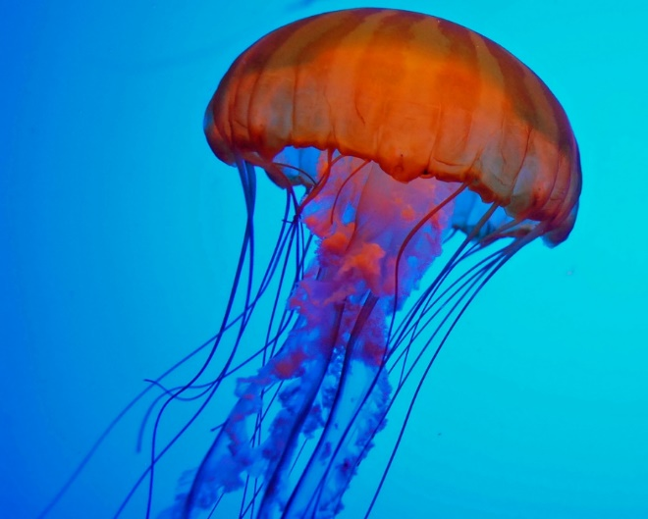
Notes:
Even small creatures like jellyfish can cause painful and sometimes lethal stings with stinging cells that are released on contact. These have one or more poisons and some jelly fish may have stings that can be fatal.

Slide 13
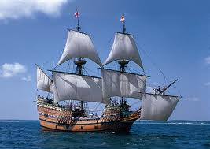
Notes:
The ocean is a highway if you have something to sail with. This is a replica of the Mayflower, the ship on which the pilgrims and others voyaged to the “New World”. This replica (called cleverly, the Mayflower II) is currently based in Plymouth, Mass. In the area where the travelers spent their first years here.

Slide 14
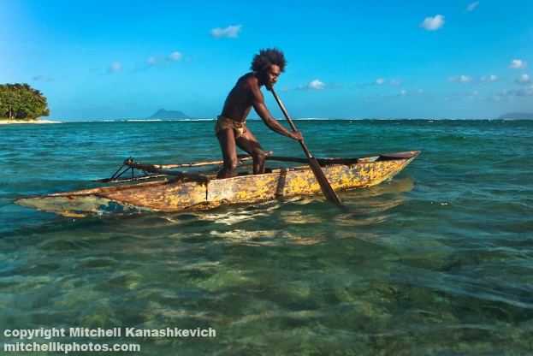
Notes:
Boats come in many kinds. This is an outrigger.

Slide 15
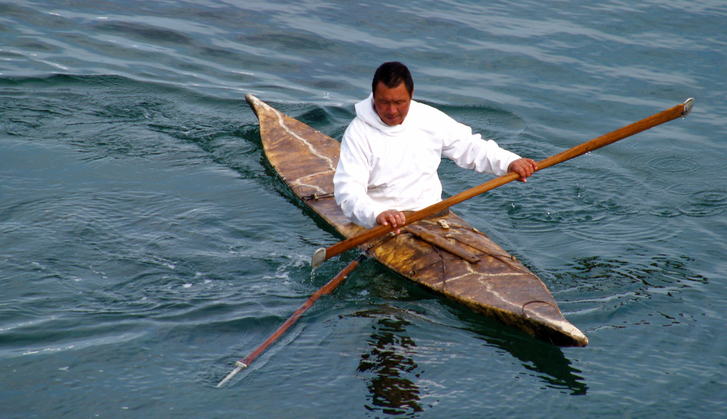
Notes:
This is a kayak, a boat made by Inuit peoples. Inuits can throw harpoons while being in the boat in this position - something that is very difficult to do.

Slide 16
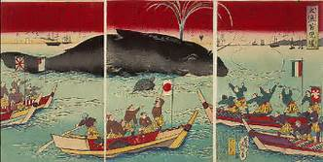
Notes:
Japanese boats shown in this painting are involved in a whale hunt. Japanese, like many people around the world hunted whales.

Slide 17
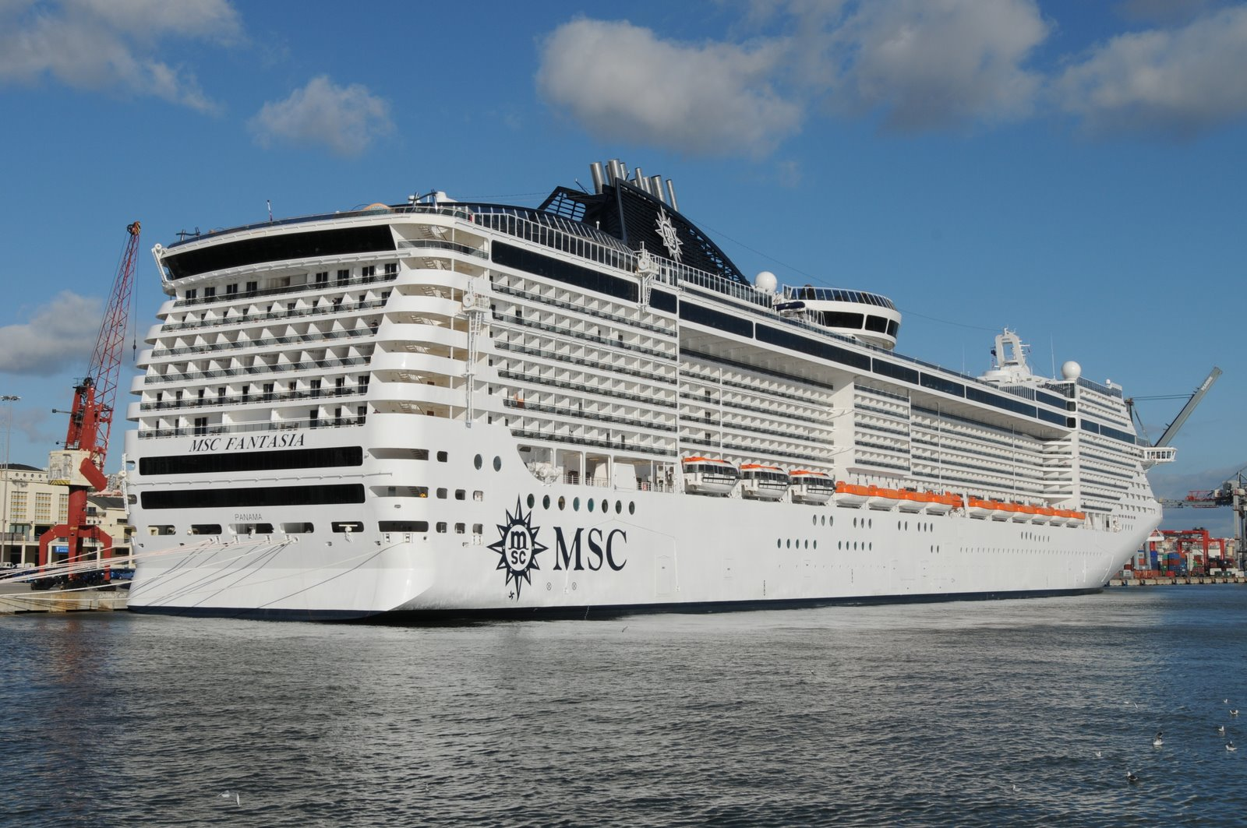
Notes:
Cruise ships hold more than 1,000 travelers are huge. Rafts differ from boats in that a raft floats because the material than makes it up floats. Boats float because of the way the are constructed. Boats can be made of steel, which normally would sink. When an object displaces water, and amount of water displaced weighs more than the object, the object will float. (More on this later)

Slide 18
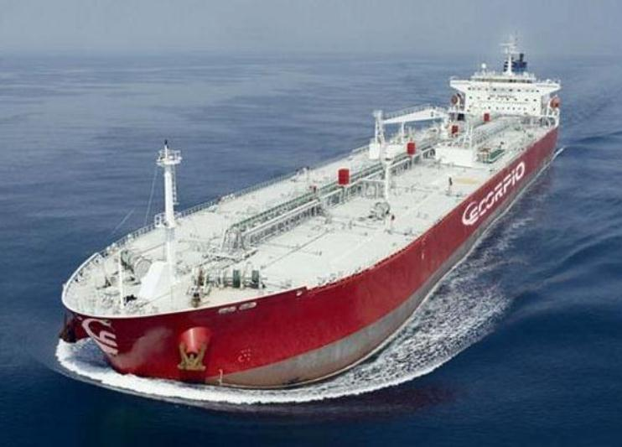
Notes:
Cargo ships and freighters have grown to huge sizes and can carry immense amounts of cargo – which can be, but isn’t always, oil. These ships occasionally become damaged and oil (or cargo) may wind up in the ocean. The Exxon Valdez on March 24, 1989 struck a reef and spilled nearly 11 million gallons of oil into the ocean (the exact amount is difficult to figure – more on that later too) . Runoff from the land puts much more oil into the sea than the Exxon Valdez did.

Slide 19
Notes:
Pirates are heavily romanticized in the West, but in most parts of the world are seen as a bunch of sea thugs. There activities are illegal and they can be very dangerous. They still exists although the current crop seem less romanticized than the “Pirates of the Caribbean” days. Pirates go way back in time. Julius Caesar was harassed by them.

Slide 20
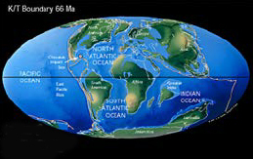
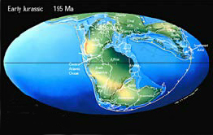
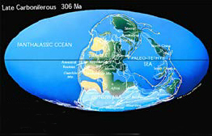
Holocene
Pleistocene
Pliocene
Miocene
Oligocene
Eocene
Paleocene
CENOZOIC
K-T Boundary➔
Cretaceous
Jurassic
Triassic
MESOZOIC
⬅ Late Jurassic
Permian
Carboniferous
Devonian
Silurian
Ordovician
Cambrian
PALEOZOIC
Late Carboniferous ➔
Notes:
It is important to note that the world is always in a state of flux. Continents move around, mountains form and are worn away. Some of the movement causes land to appear and in some cases that may split a species in half. This could easily impact the evolution of those animals because one half would be adapting to one environment while the other would be adapting to a different one

Slide 21
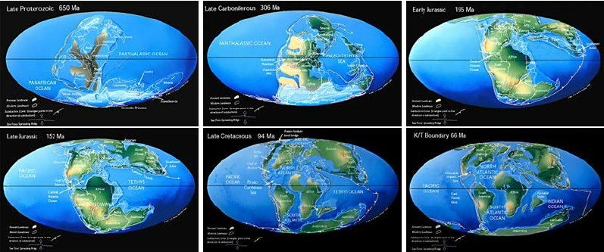
Notes:
This sows the ways in which the world continents have moved around and the ways the oceans have changed as well.

Slide 22
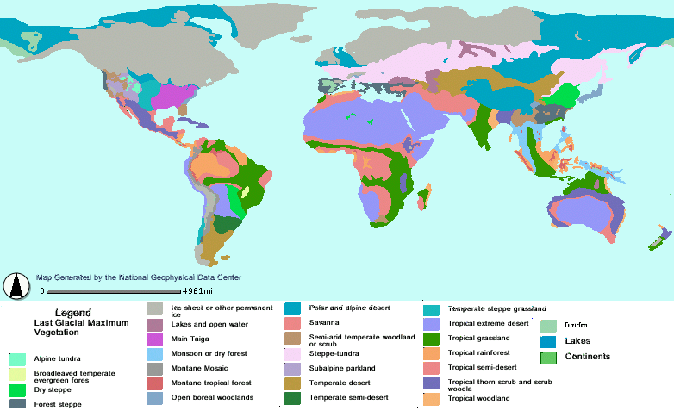
Notes:
The world has gone through ice ages while people have been in existence and so the heating up and cooling off of the earth is nothing new. Current concerns are about the speed at which it is happening. This map shows how the climates were at the time of the maximum descent last glaciation. Glaciers came as far as Eastern Parkway on the East Coast. Since then (about 14,000 years ago) the earth has been warming and the glaciers have been receding. As the glaciers recede, the water from the glaciers goes into the oceans and the ocean levels rise. When the ocean levels are low and the glacier is down, then parts of the ocean floor become exposed. This means the distances between land masses may be considerably smaller, making migrations easier. So there was a land bridge connecting Alaska to Asia at one time. Now the Bering Strait appears there since the glaciers have gone back north and the sea levels have risen inundating the land bridge.

Slide 23
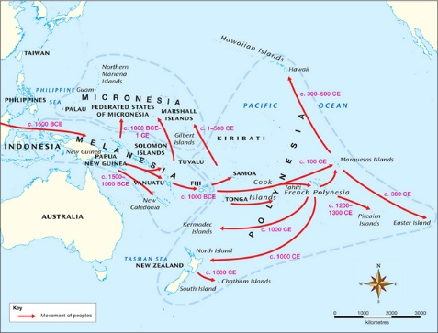
Notes:
Even when the oceans were at their lowest, it would not have been possible to walk to the Pacific Islands. There must have been some navigation by water. Australia may have been populated some 50,000 years ago and that would certainly have necessitated some sort of crossing of the waters. The part by water would have been shorter then, but still some kind of boat or raft would have been necessary.

Slide 24
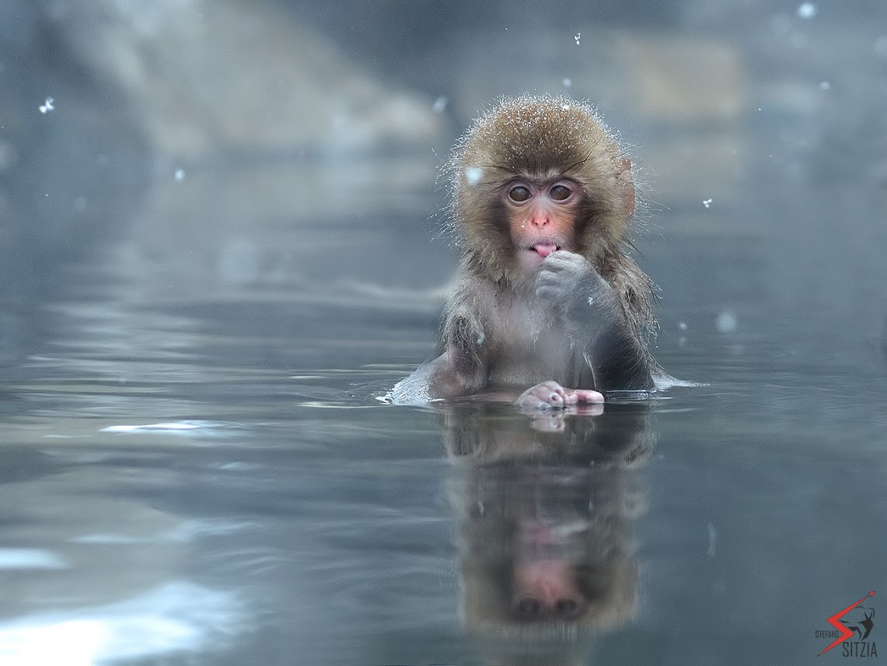
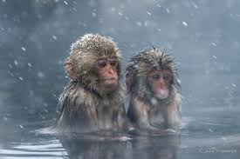
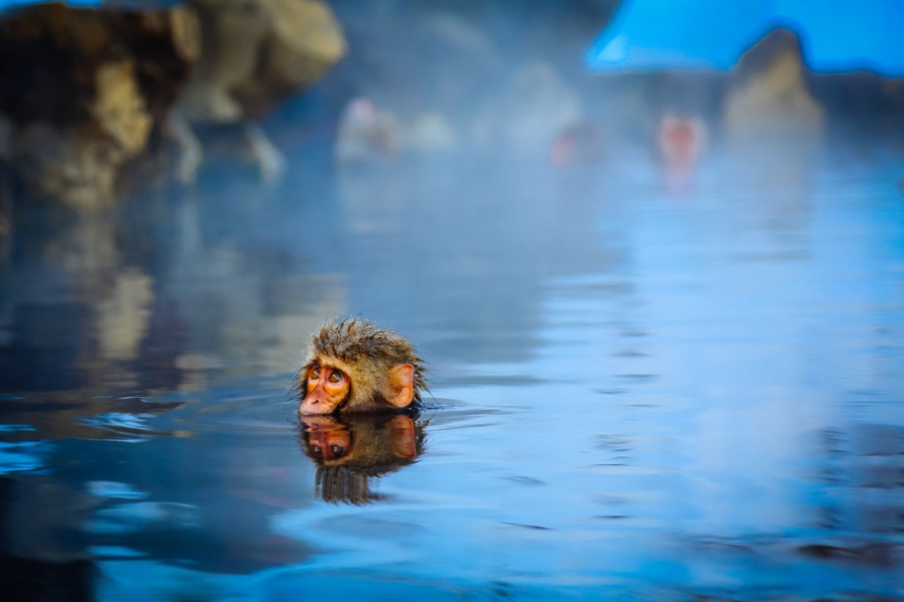
Japanese macaques, the only primate
other than humans to live in a snowy
climate, sometimes take a “dip” in a
nice onsen or “hot spring” apparently
To get warm.
It is clear from these pictures
That the monkeys are capable
of swimming.
These monkeys are technically called
Macaca fuscata fuscata. Another
Subspecies can also be found in Japan which
Is somewhat smaller and goes by the name
Macaca fuscata yakui.
Notes:
People are not the only creatures who like warm water!

Slide 25
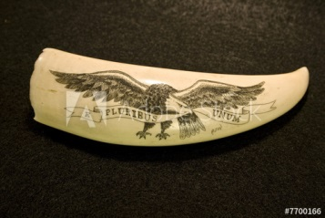
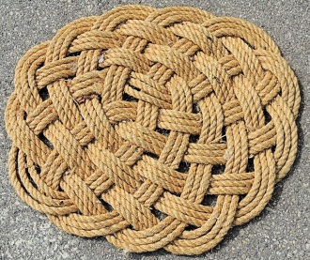
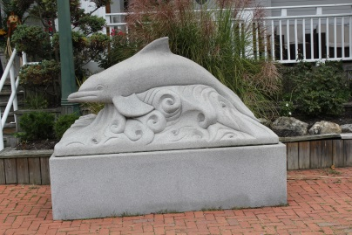
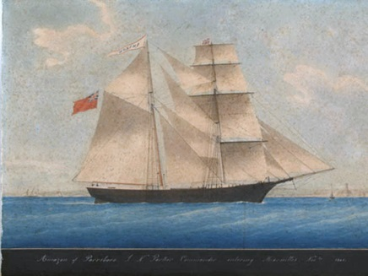
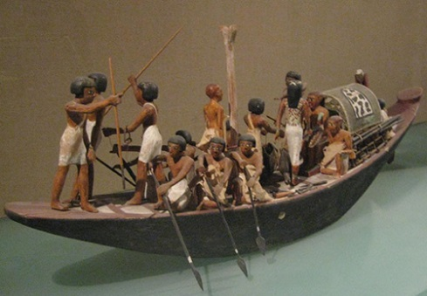
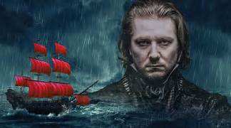
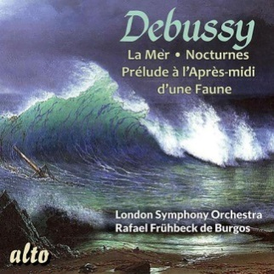
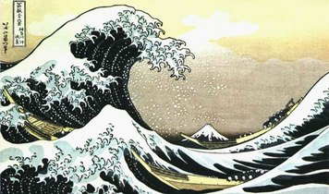
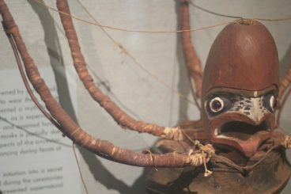
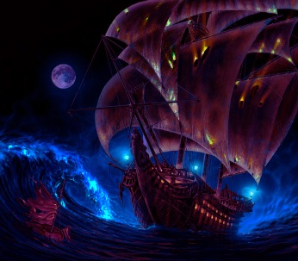
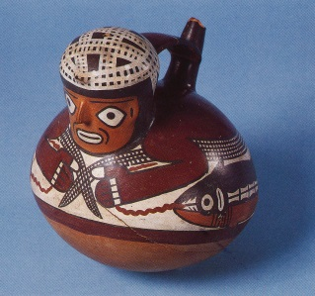
ANY CULTURE THAT EXISTS NEAR THE SEA RECOGNIZES IT IN ARTISTIC FORM
ART: PAINTING
ART: SCULPTURE
ART: MUSIC
ART: PERFORMANCE
ART: CRAFT
ART: FILM
Notes:
The oceans have inspired all the arts in some wat or another. The top row shows painting, scrimshaw (carving on ivory) and some knot work. Sculpture and painting have their examples. The Flying Dutchman, a story about a phantom ship has been made into an opera by Wagner and Debussy has written music bout the sea as well. In the last row there are some examples of art work.

Slide 26
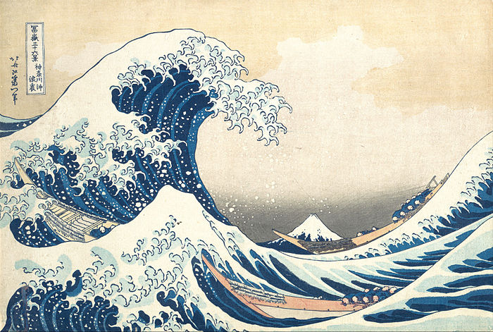
Notes:
The Great Wave (The Great Wave off Kanagawa) by Katsushika Hokusai is thought by some to be a tsunami, but others feel it is a “rogue wave” an unexpectedly high wave compared to those around at the moment.

Slide 27
Sea Fever
By John Masefield
I must go down to the seas again, to the lonely sea and the sky,
And all I ask is a tall ship and a star to steer her by;
And the wheel’s kick and the wind’s song and the white sail’s shaking,
And a grey mist on the sea’s face, and a grey dawn breaking.
I must go down to the seas again, for the call of the running tide
Is a wild call and a clear call that may not be denied;
And all I ask is a windy day with the white clouds flying,
And the flung spray and the blown spume, and the sea-gulls crying.
I must go down to the seas again, to the vagrant gypsy life,
To the gull’s way and the whale’s way where the wind’s like a whetted knife;
And all I ask is a merry yarn from a laughing fellow-rover,
And quiet sleep and a sweet dream when the long trick’s over.
Notes:
John Masefield’s famous poem “Sea Fever” paints a romantic word picture of a yearning to be at sea.

Slide 28
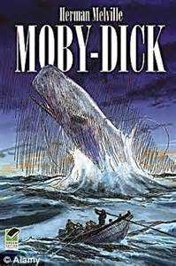
Notes:
Melville’s classic tale of whaling, Moby Dick, is a complex symbolic story, rife with religious symbolism. It film incarnations have been largely “adventure stories” which the book is not. In 2019 we will be celebrating the 200th anniversary of Melville’s birth (along with that of Walt Whitman).

Slide 29
Notes:
The Flying Dutchman appears in several art forms from story telling to opera. The operatic version has him sailing the seas forever – or until he finds a woman who will be true to him until death. A sample of the music appears on the web page about art.

Slide 30
Notes:
Debussy was also moved by the ocean and wrote his orchestral piece La Mer. Other composers have followed suit and written pieces about the ocean Brittan’s “Sea Intervals” from Billy Budd are another example.

Slide 31
THE SEA IN PAINTINGS
JAPAN
Notes:
So the socean has been depicted in many art forms

Slide 32
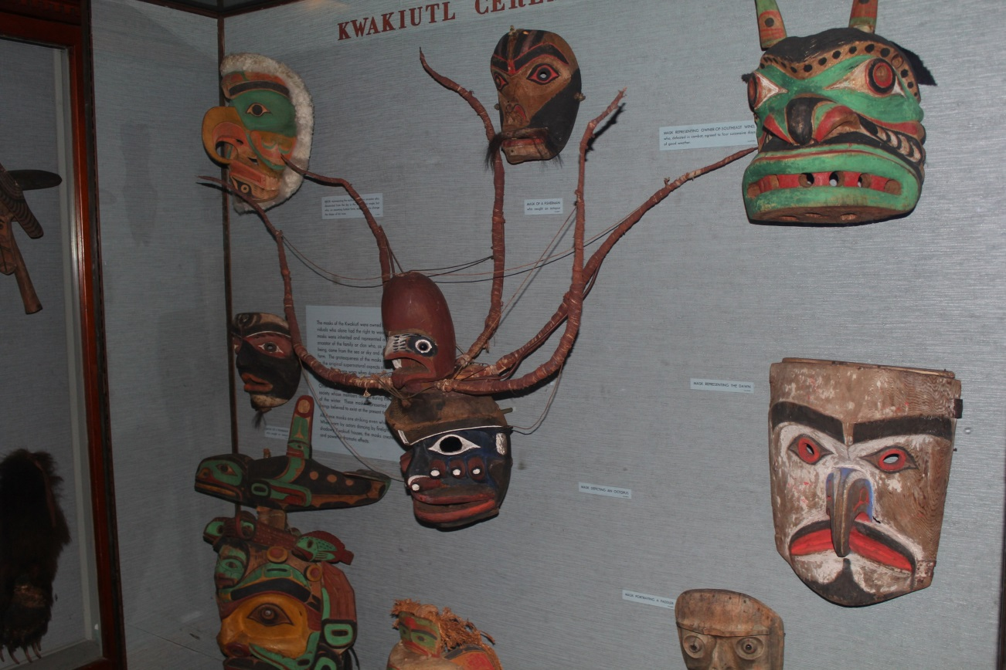
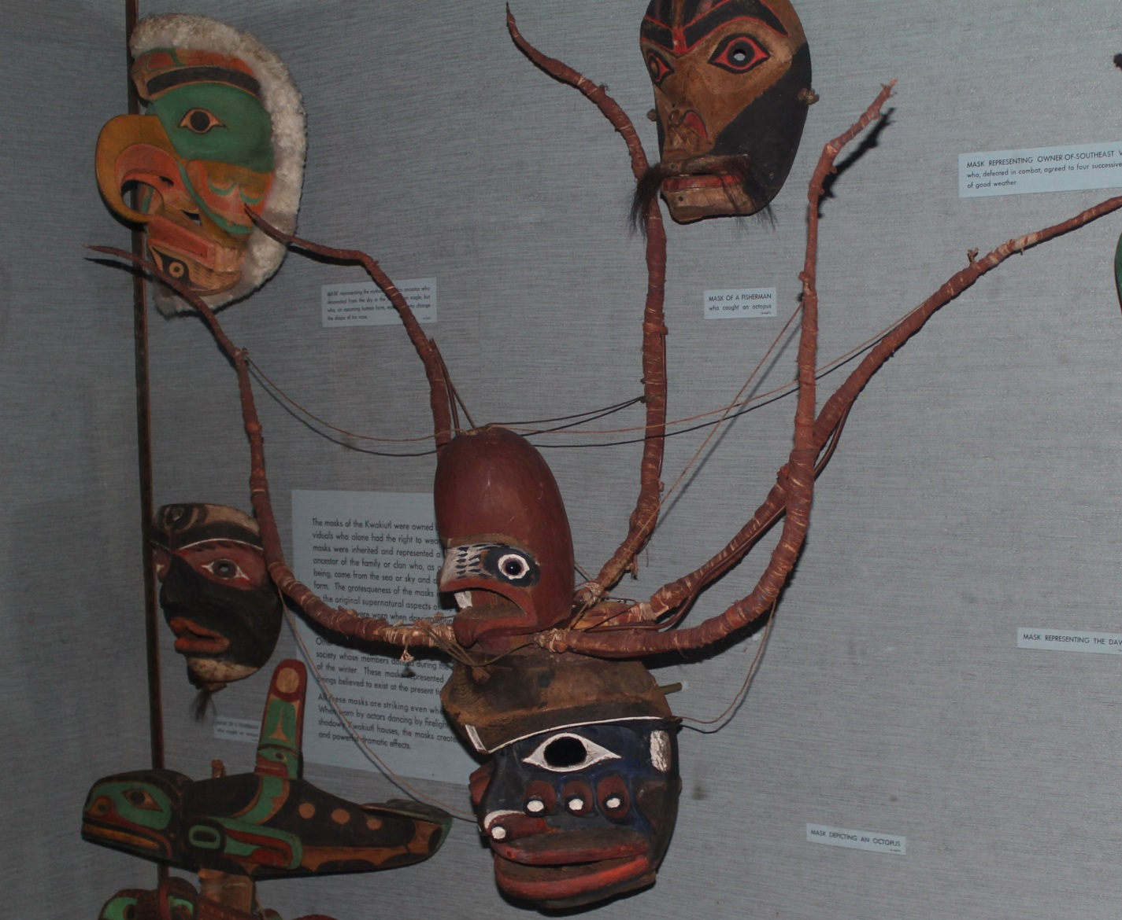
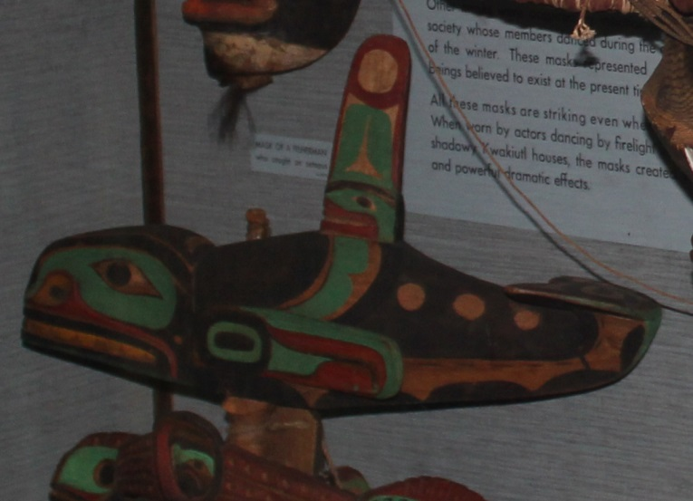
NORTH AMERICAN INDIAN DEPICTIONS
Depictions from the North West Coast
Notes:
Here an octopus surmounts a Kwakiutl (Kwakwa̱ka̱'wakw) mask, while to the right of the mask is a carved killer whale.

Slide 33
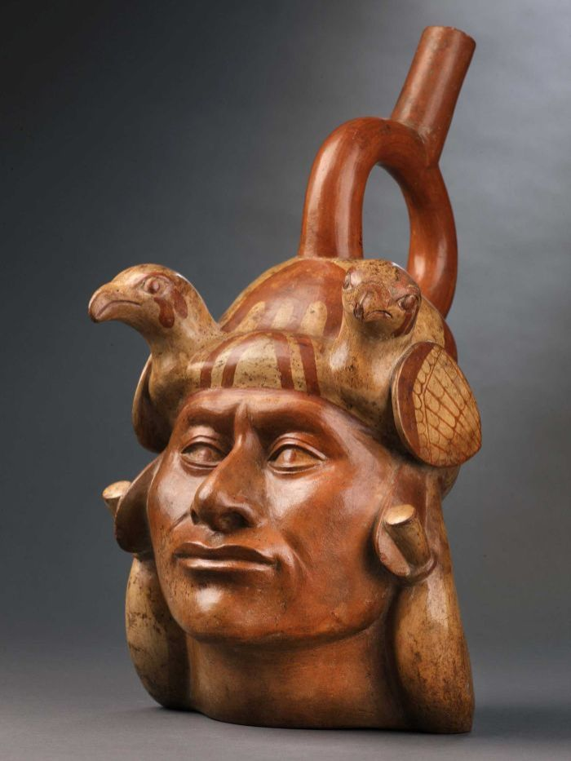
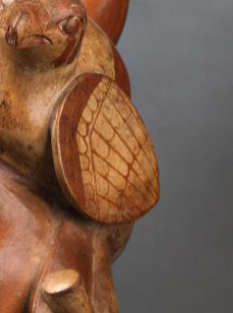
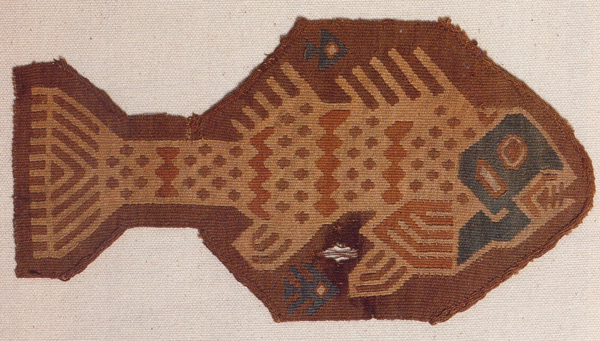
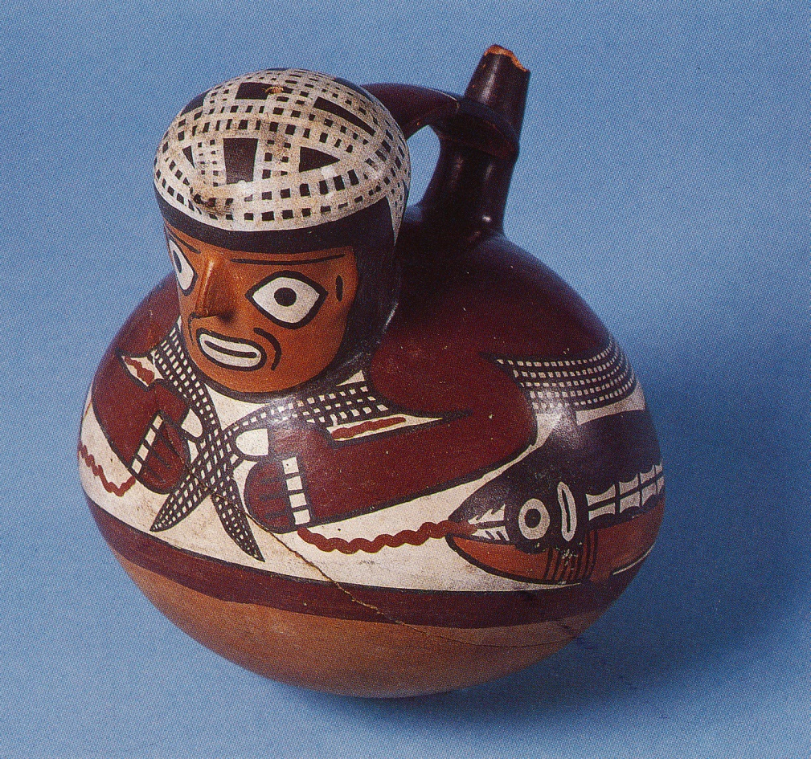
DEPICTIONS FROM SOUTH AMERICAN INDIANS
Notes:
These designs on pottery and textile come from South America. Note the shell covering the ear. The textile fish in the upper right and the fisherman with a fish on the end of the line can be found in the Peoples of South America Hall at the American Museum of Natural History

Slide 34
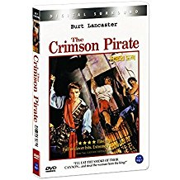
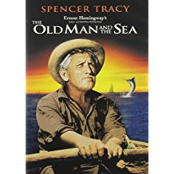
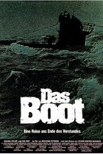
MOTION PICTURES
Notes:
Narrative films about the ocean are numerous. These dal with humans on the sea, ships sinking, real and imaginary monsters and real disasters.

Slide 35
AND SOME DOCUMENTARIES
Notes:
These are non fiction films, which is to say they are “editorials”. Almost all films reflect something about the ideas and attitudes of the film maker. Videos from security cameras may be the one excpetion. Tose are basically unwatchable.

